Slide 1
Geology of Britain & Ireland

Slide 2
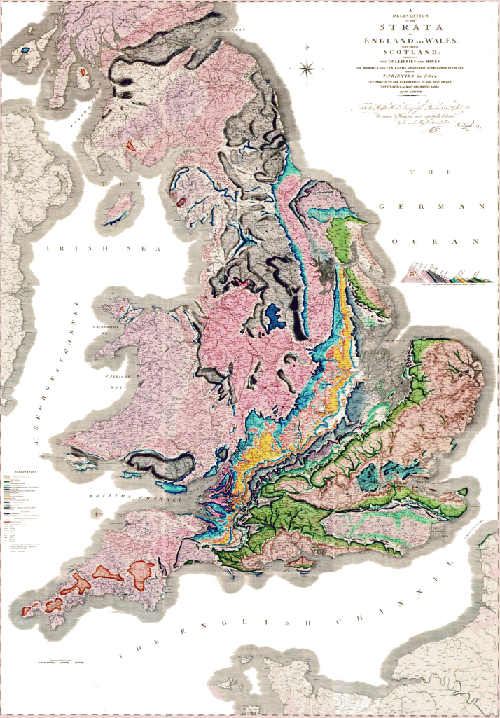
Birthplace of geology and geologic maps
Map and section by William Smith (1815)

Slide 3
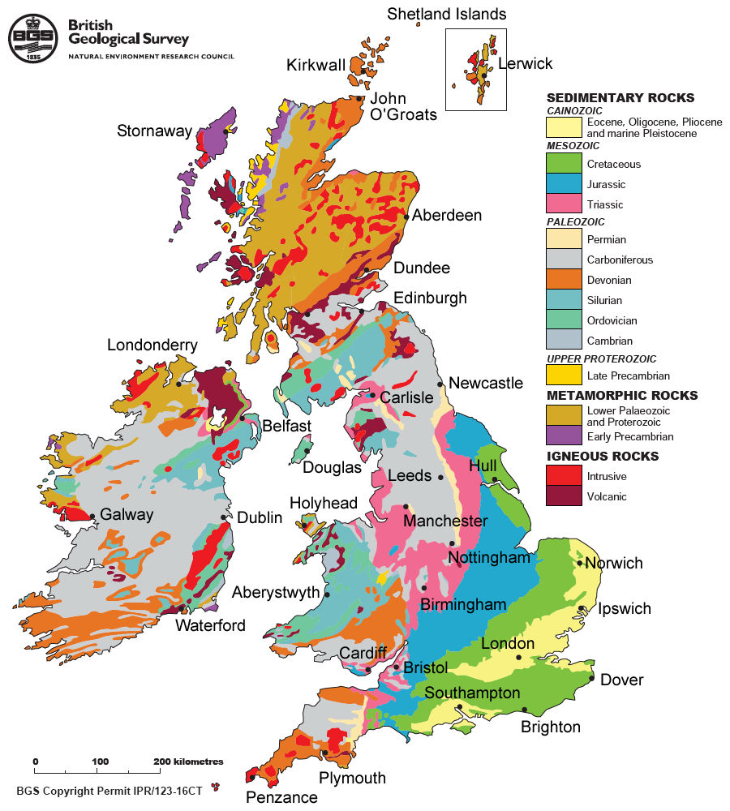
What do you see?? Think regions…

Slide 4
three parts:
- Metamorphic & old North
- Paleozoic center
- Meso-Cenozoic South East
- Also volcanic rocks, including intrusives

Slide 5
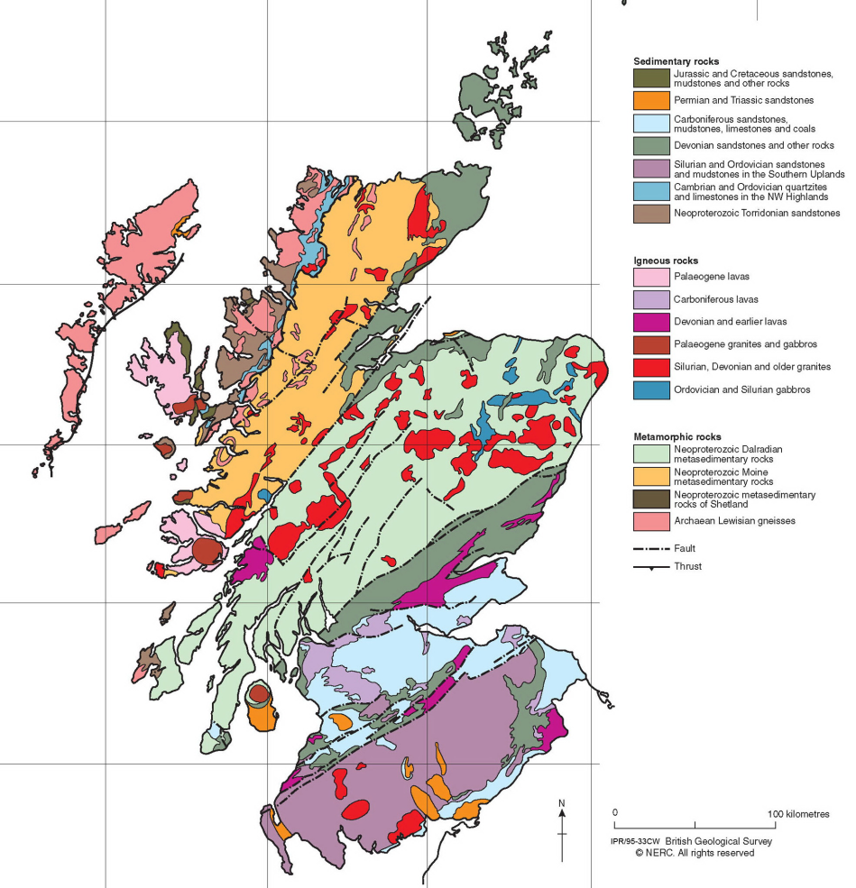
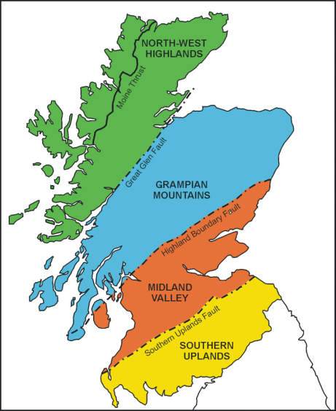
The North
Lots of igneous & metamorphic rocks =>
Remnants of old mountain range:
Caledonian mountains

Slide 6
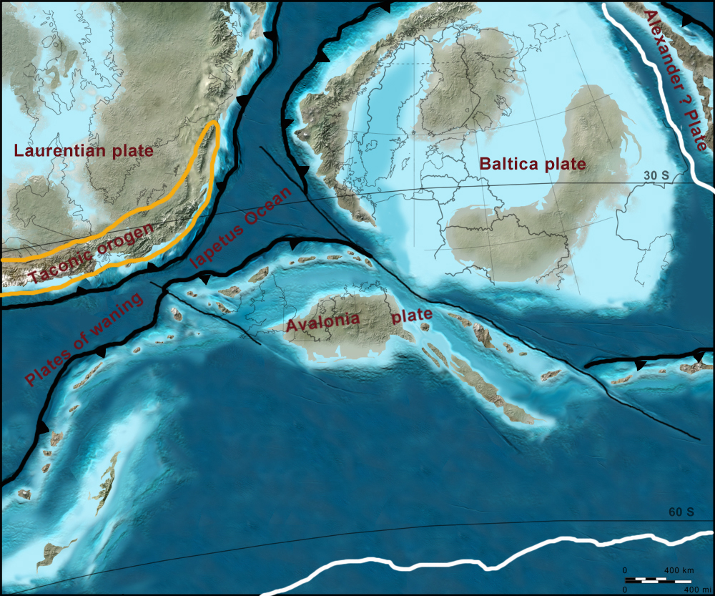
Ordovician 450 Ma

Slide 7
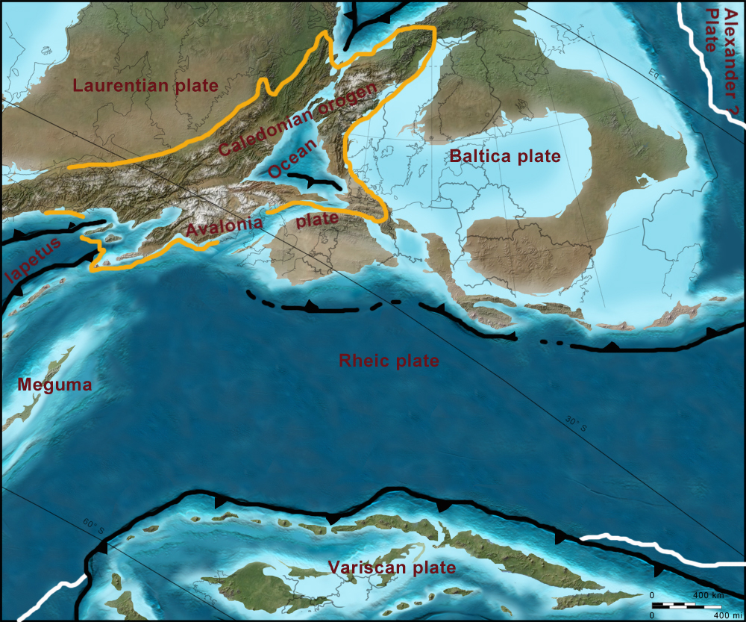
Silurian 425 Ma

Slide 8
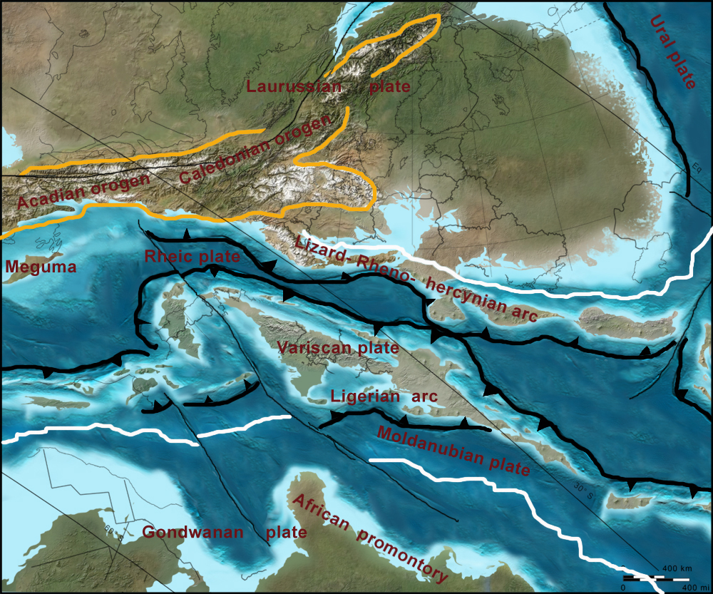
Devonian 400 Ma

Slide 9
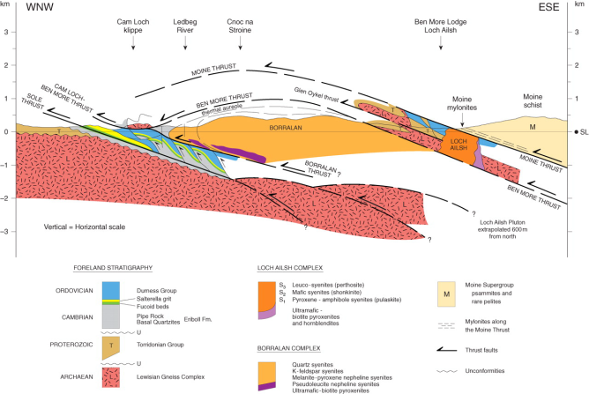
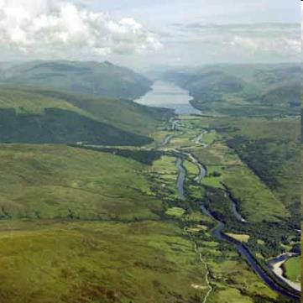
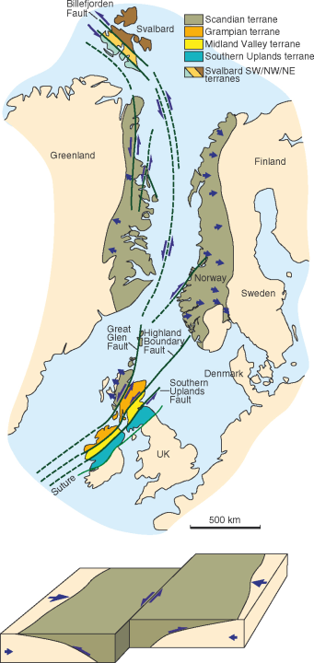
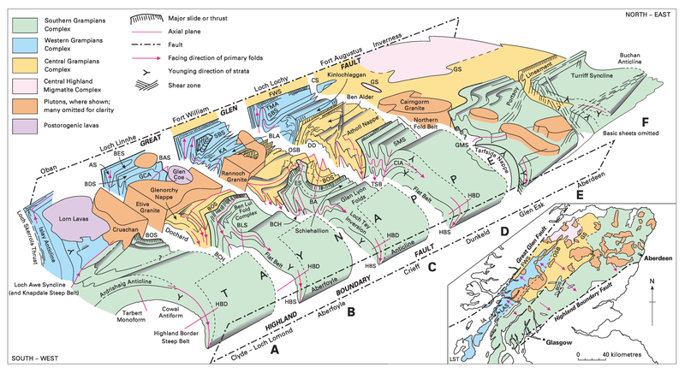
Marine sediments, volcanic arc, older parts of continents, all mashed together in Caledonian mountains
Thrust faulting (Moine), but also strike slip (Great Glen Fault, Highland Boundary)

Slide 10
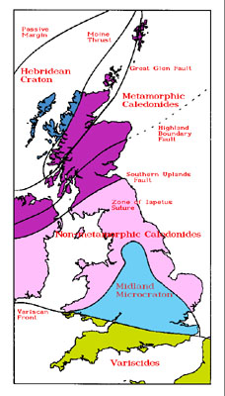
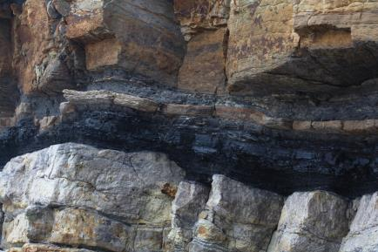
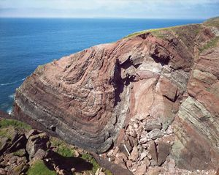
Meanwhile further south…
South of UK (Avalonia) was also involved in Caledonian collision, but was much less deformed and not metamorphosed
Cambrian: sediments
Ordovician: some volcanics, shales
Silurian: sediments, Caledonian orogeny
Devonian: more orogeny, volcanics in Scotland, old red sandstone from erosion of Caledonian mountains, marine rocks in Devon
www.awesomestories.com
coal old red sandstone
http://earthwise.bgs.ac.uk

Slide 11
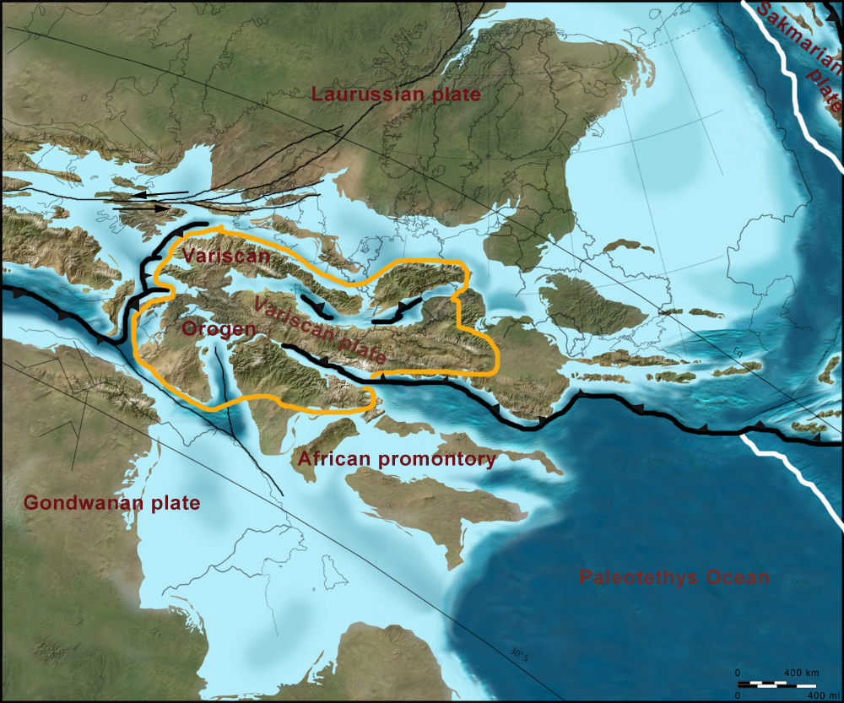
Carboniferous: UK on equator, shallow sea: limestones, later delta: swamps => coal. Late Carb: Variscan Orogeny in south of UK and Ireland: Pangea

Slide 12
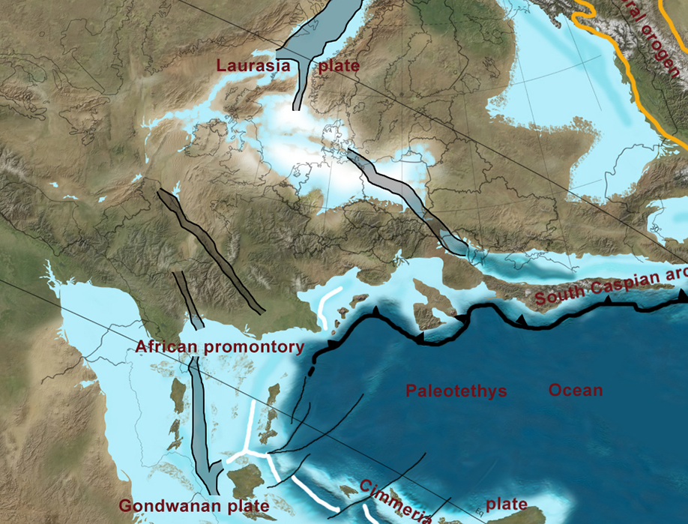
Permian: desert conditions, erosion => sandstones, then shallow sea => salt deposits (Zechstein) in North Sea area

Slide 13
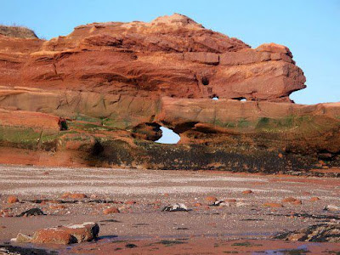
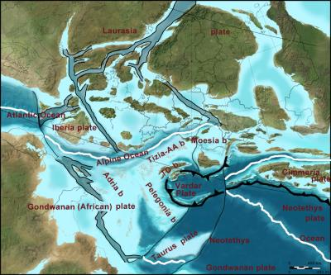
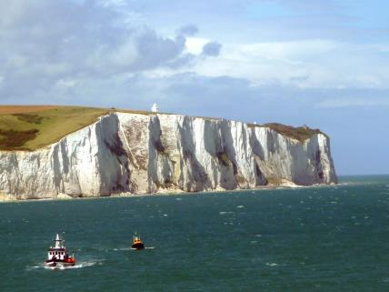
Mesozoic
Triassic:
Variscan erodes: new red sandstone (aka..?)
Jurassic:
Pangea break up, UK flooded, marine sediments
Deposition of source rocks (Posidonia, Kimmeridge)
Cretaceous:
Atlantic starts to open up.
Global high sea level: mainly limestone deposits
Alpine orogeny starts
http://www.langolodellageologia.com
news.agu.org

Slide 14
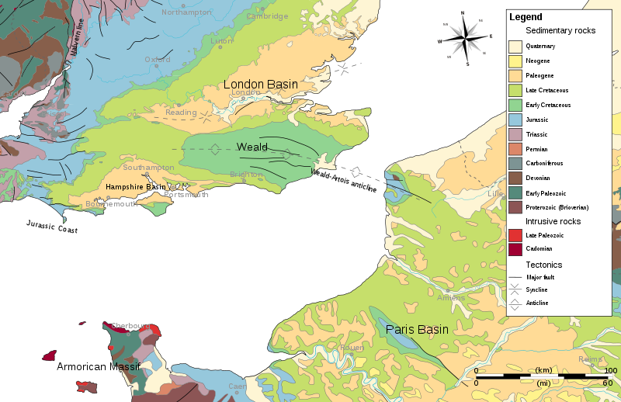
Alpine Orogeny
Alpine Orogeny forms series of folds and reactivation of old faults
wikipedia.org

Slide 15
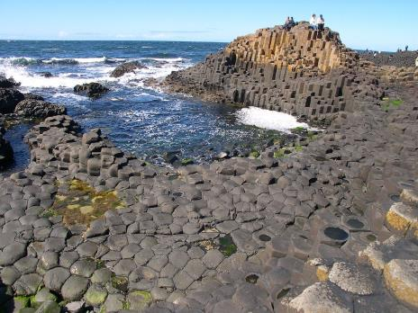
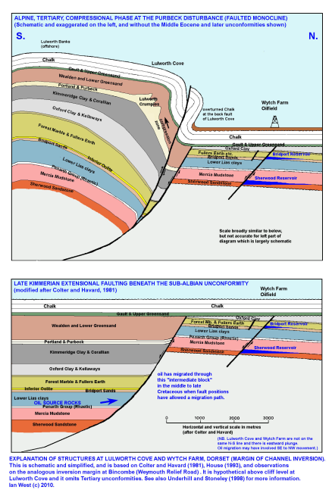
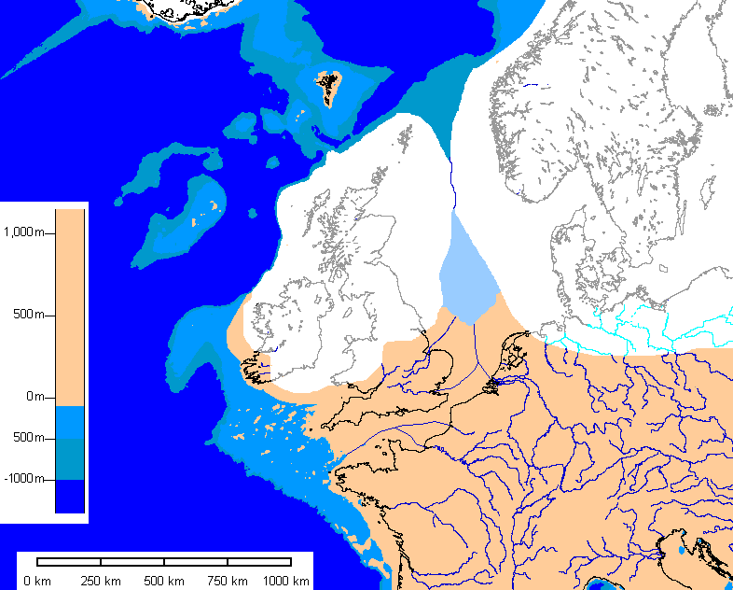
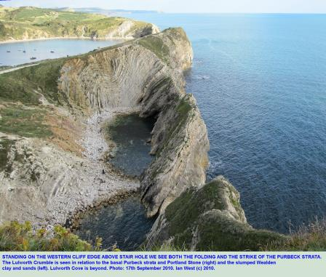
Cenozoic
Paleogene:
Atlantic opens, last volcanic activity in Scotland & N-Ireland
Most of Britain uplifted, inversion, North Sea forms
Neogene: continued uplift, erosion
Pleistocene:
Ice ages, up to 1 km of ice on Britain, as far south as London
wikipedia.org
Scotland still rebounds, London sinks ~ 1mm/y
http://www.southampton.ac.uk
www.uwgb.edu

Slide 16
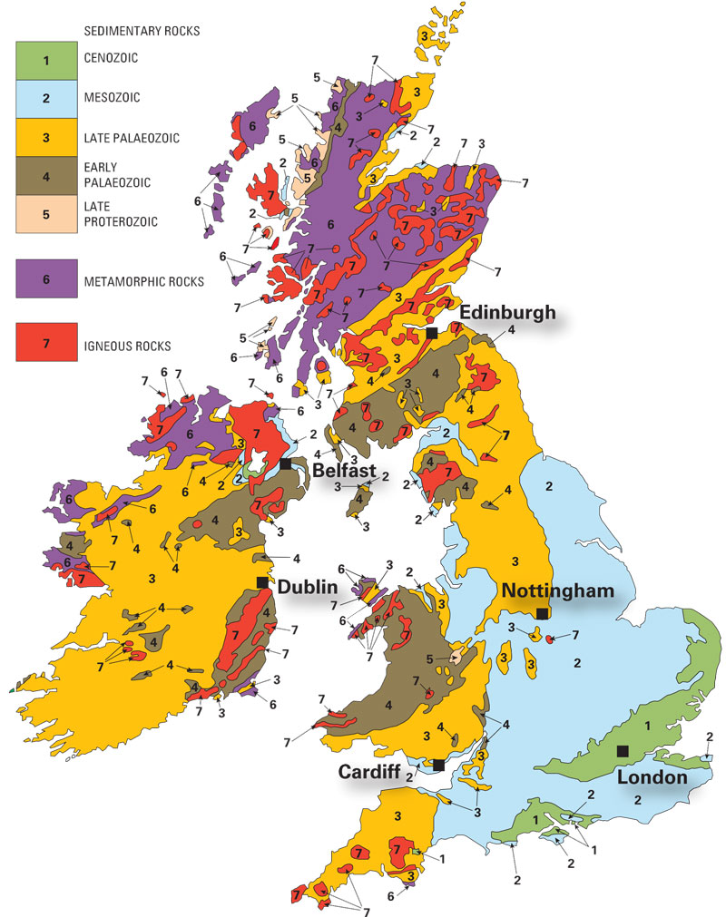
The geology of Great Britain & Ireland
www.bgs.ac.uk

Slide 17
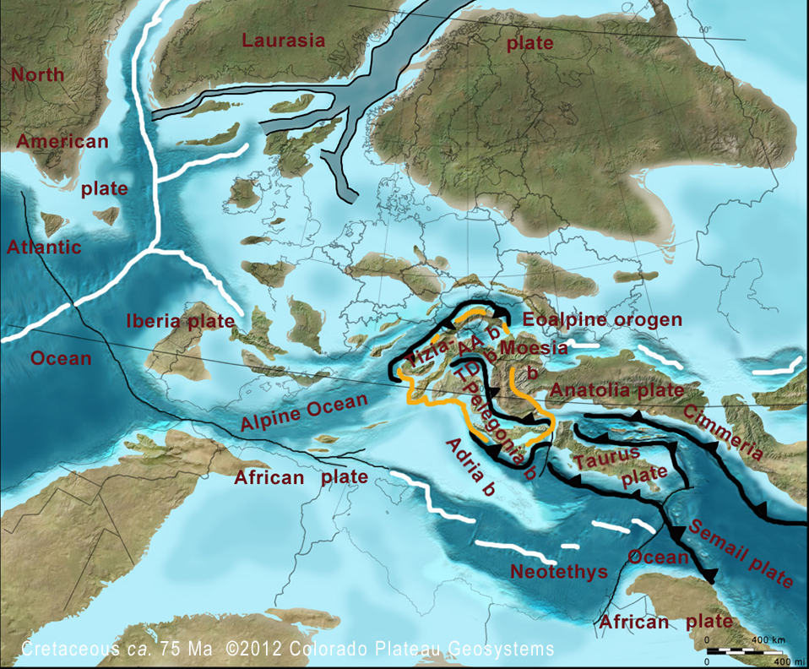
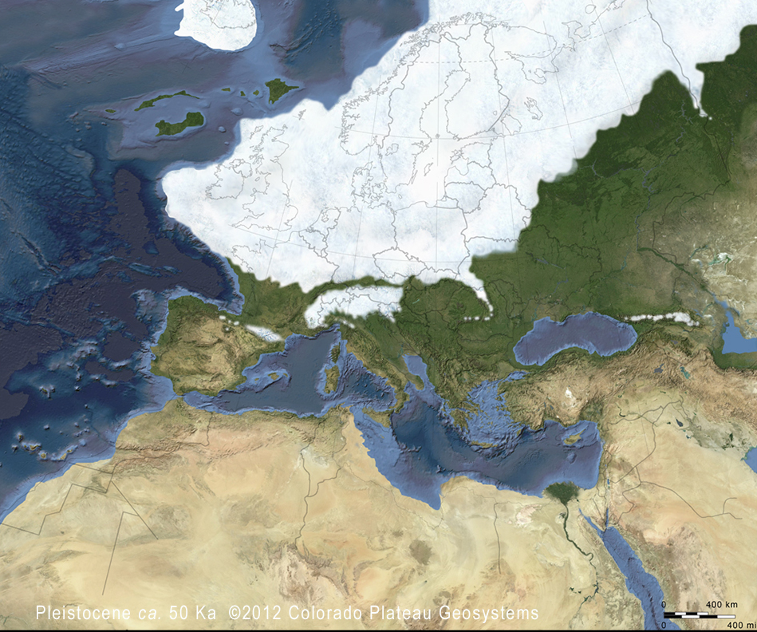
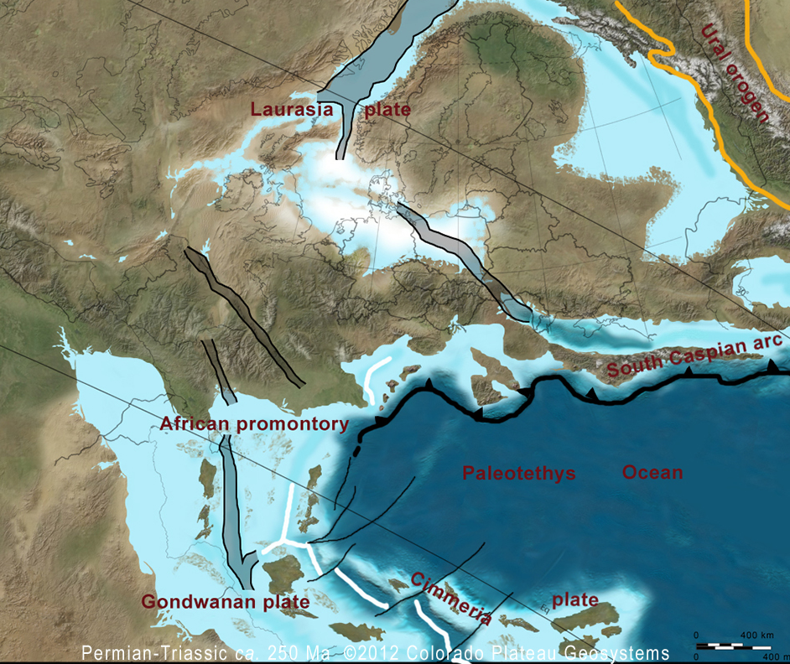
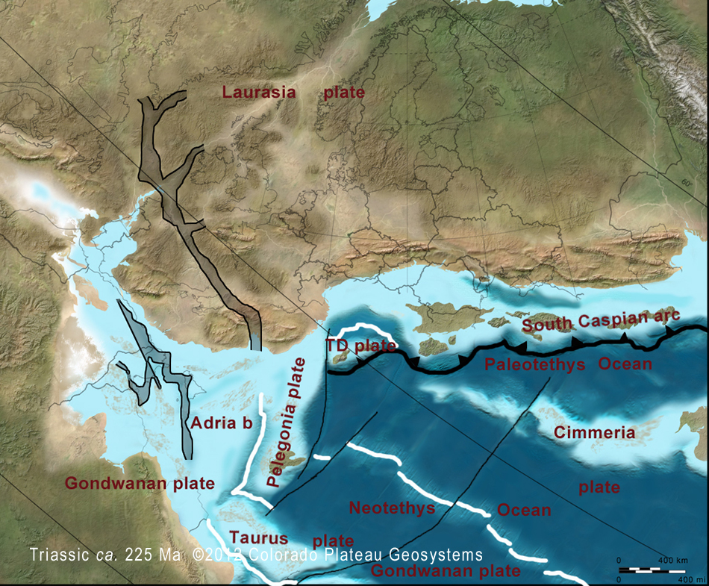
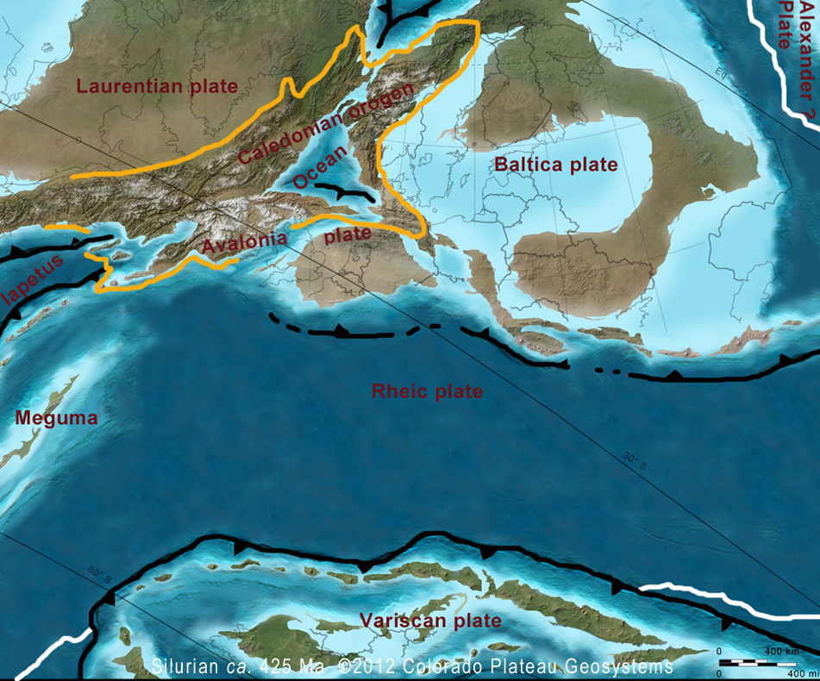
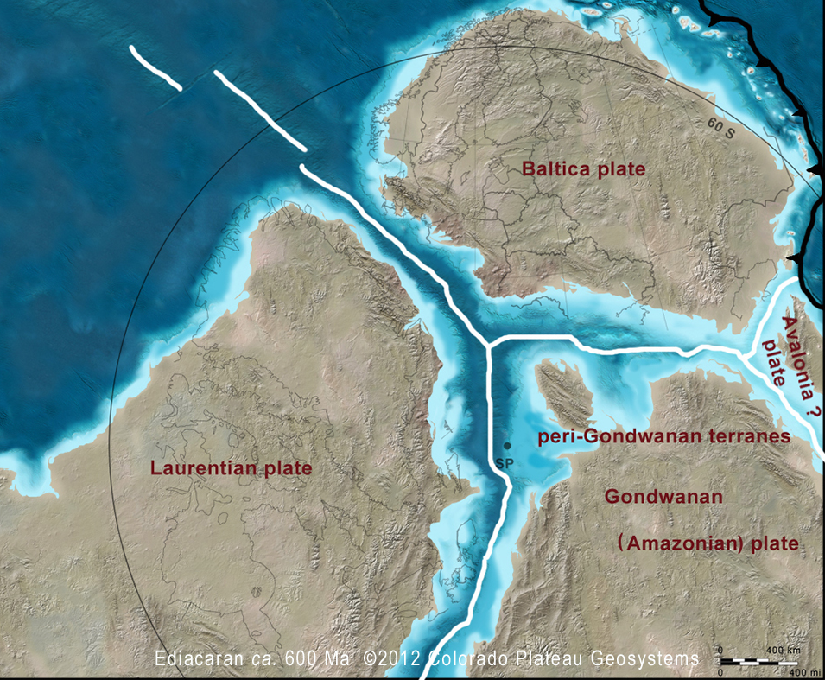
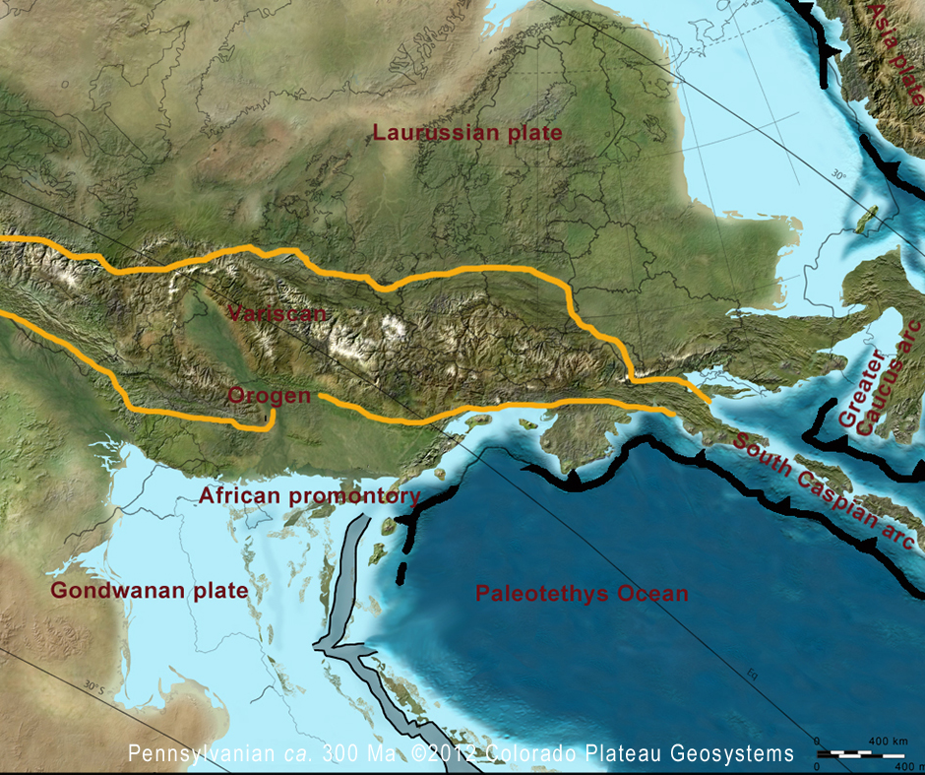
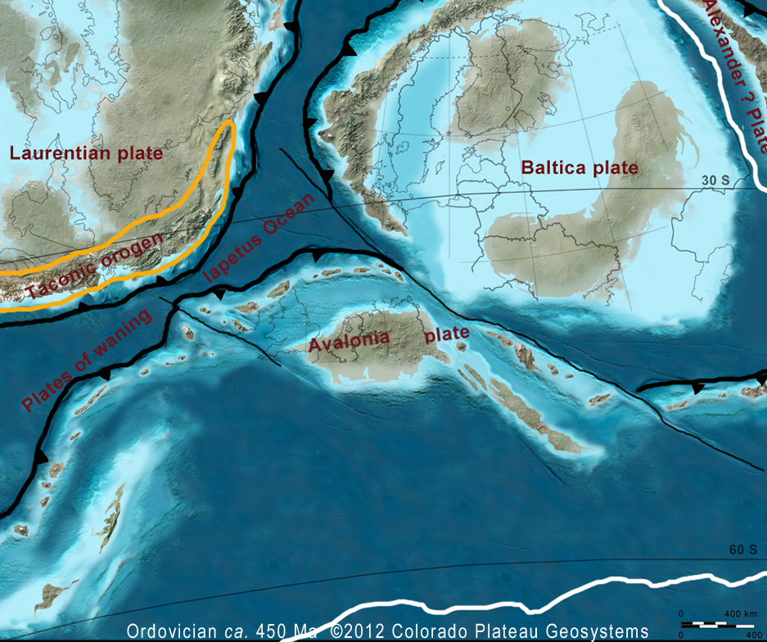
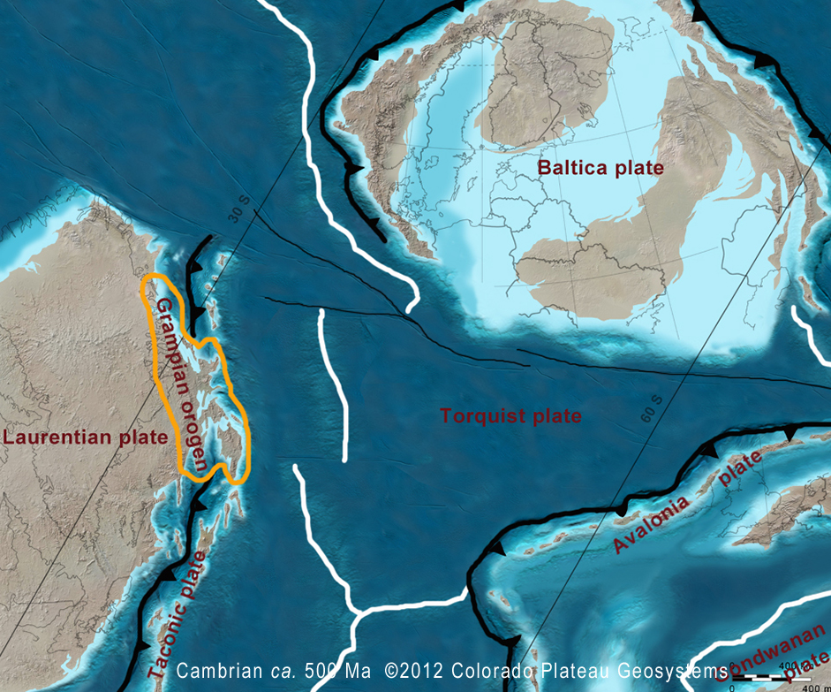
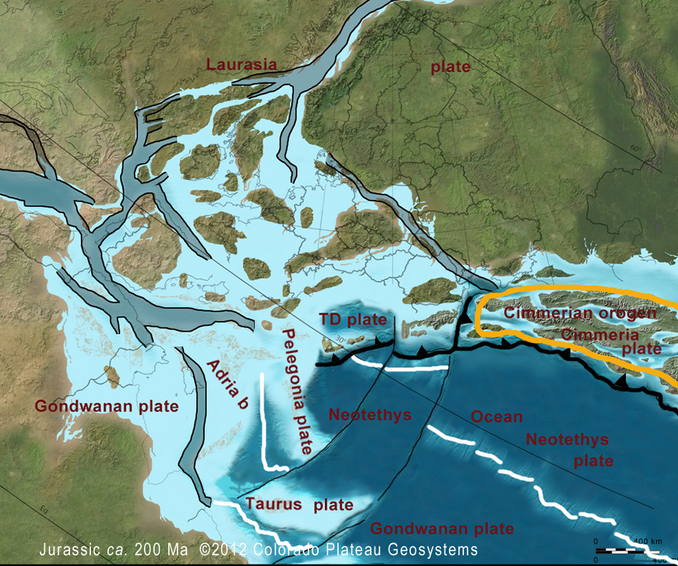
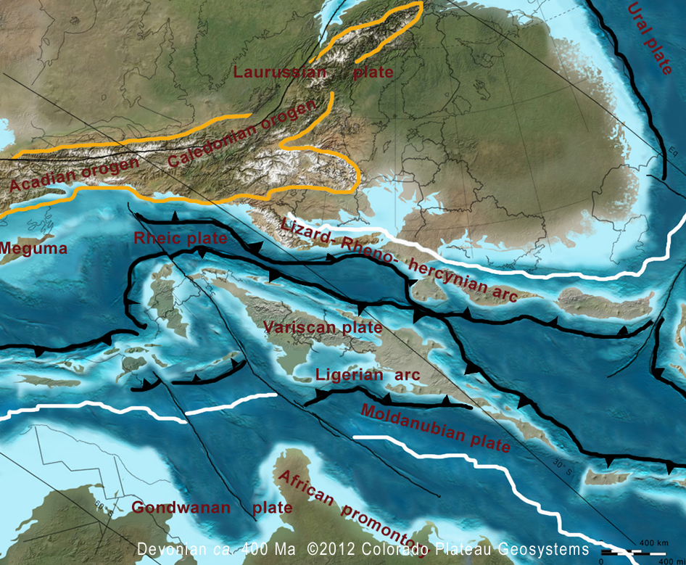
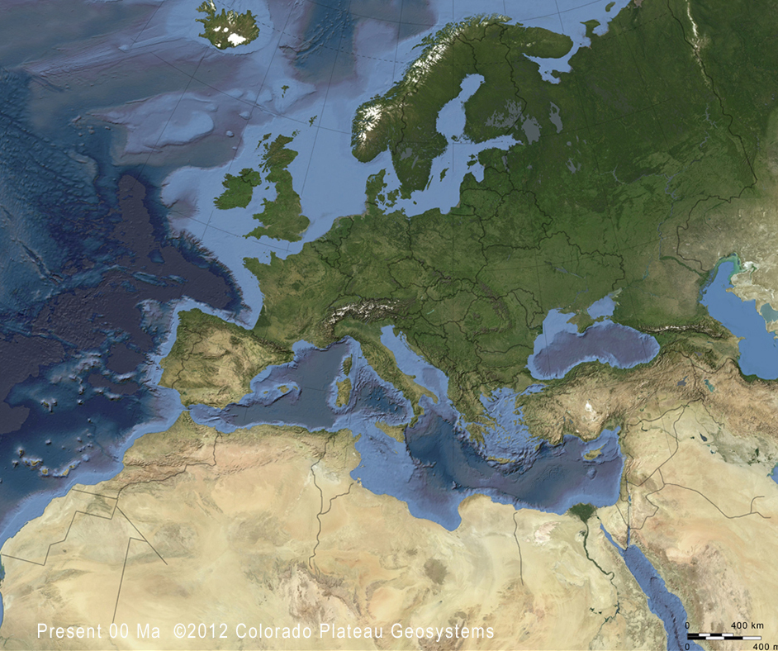
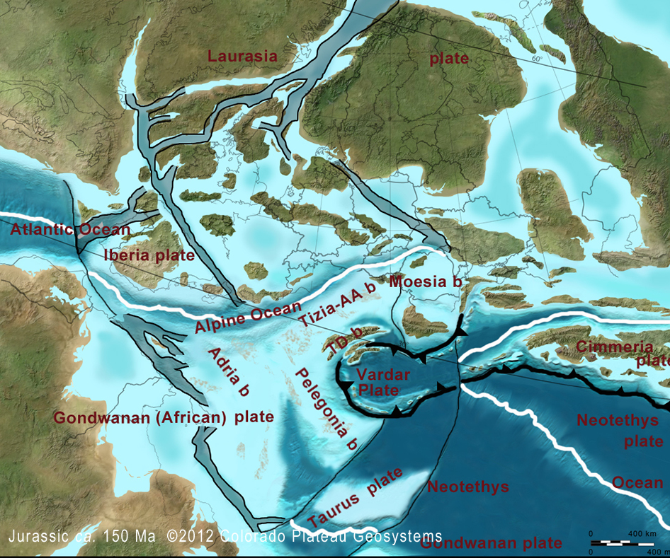
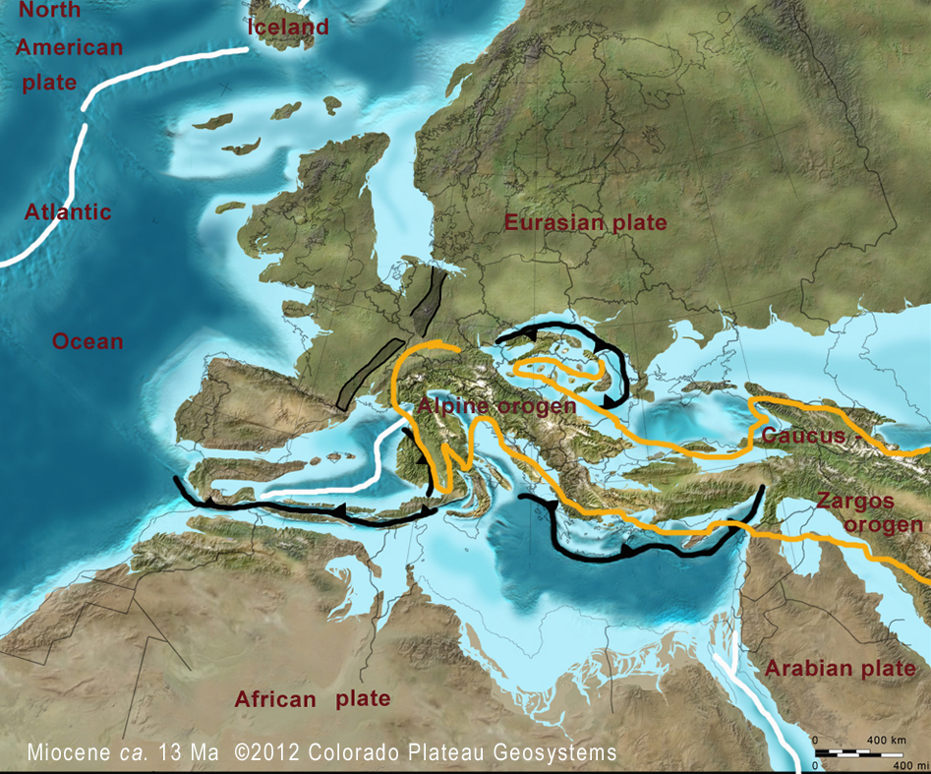
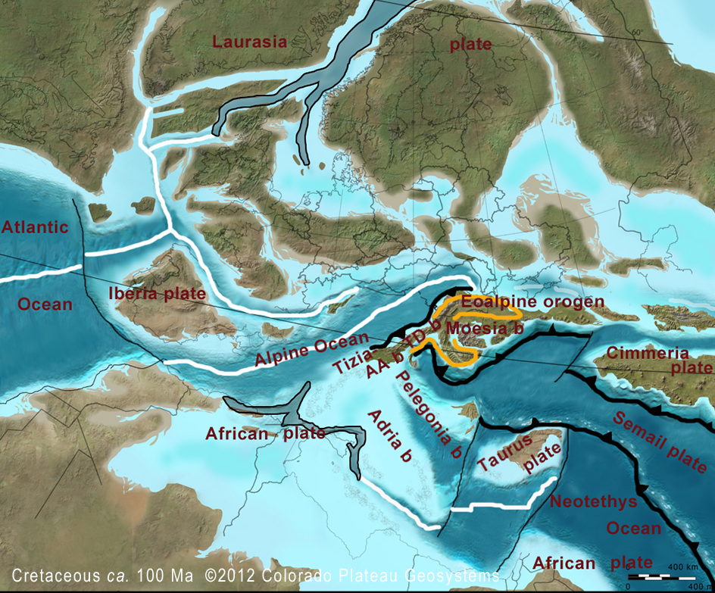
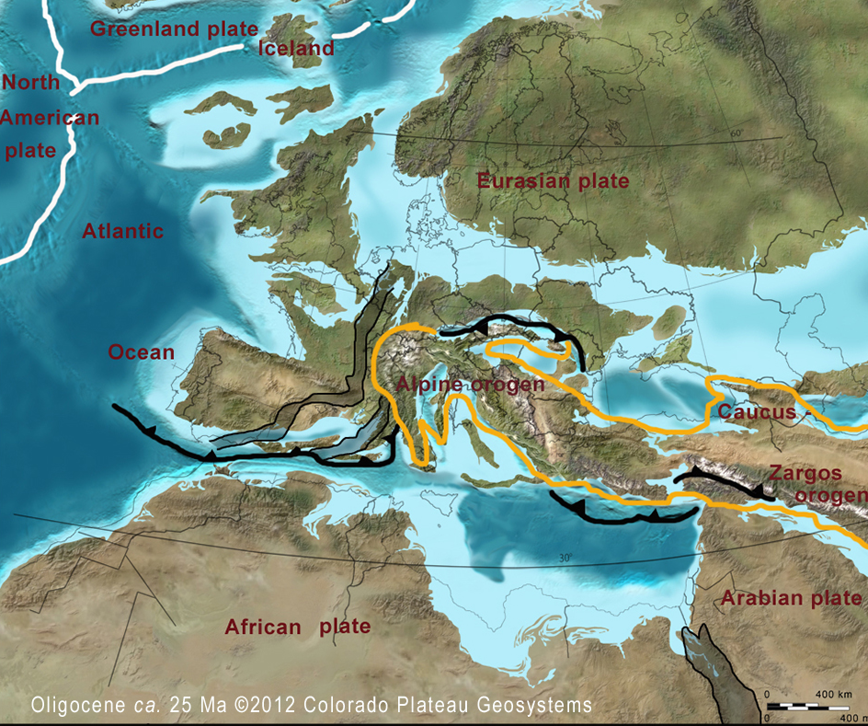
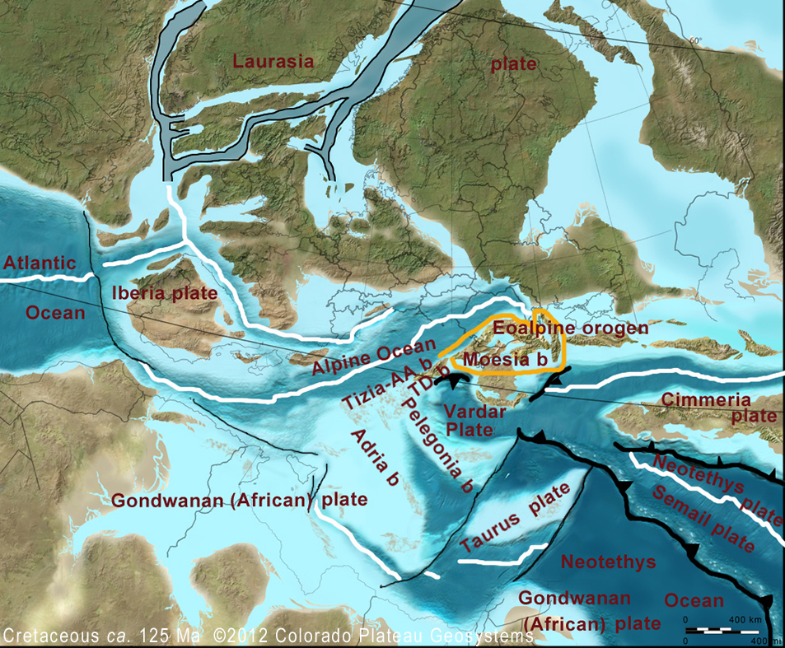
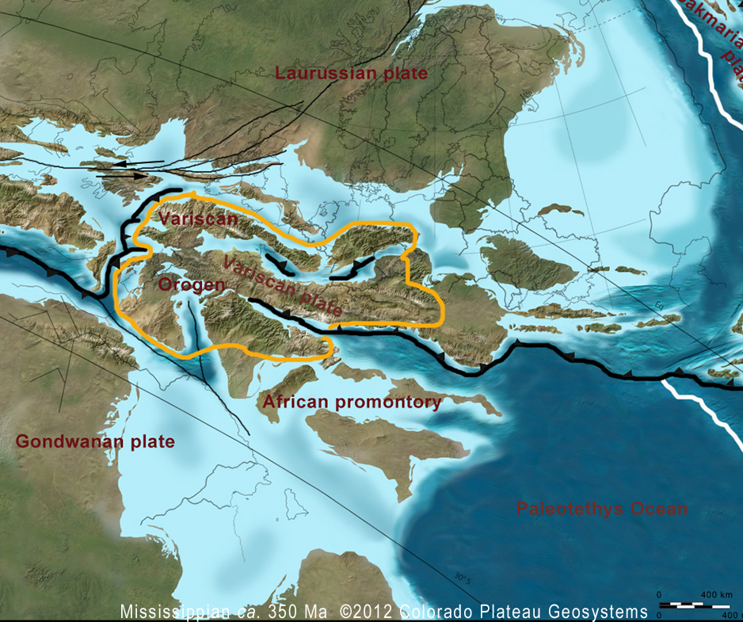

Slide 18
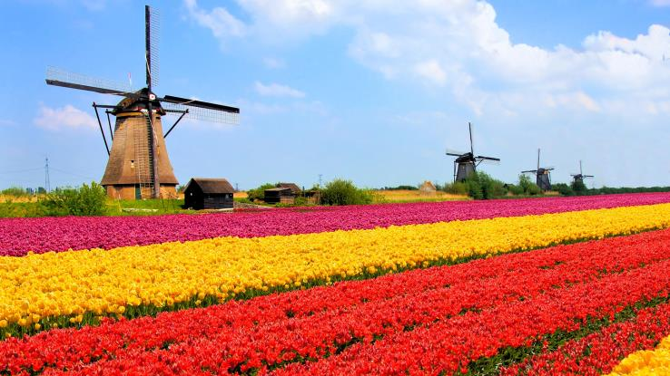
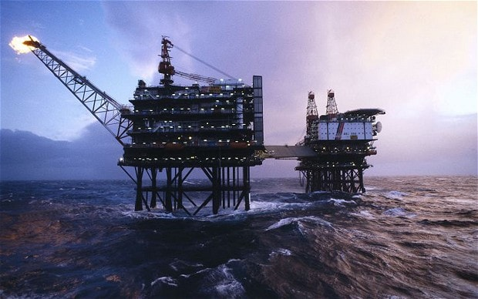
Next: Netherlands and North Sea
Lots of info in book available on brightspace.
Pay attention to resources: hydrocarbons (source, reservoir, seal), coal, salt etc..
nationalgeographic.com,
Also look at inversion tectonics
telegraph.co.uk

