Slide 1
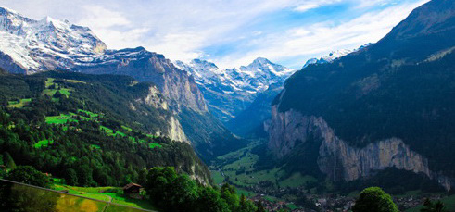
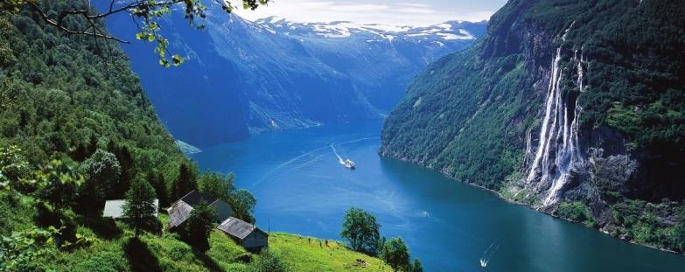
Scandinavia & the Alps
From old to young

Slide 2
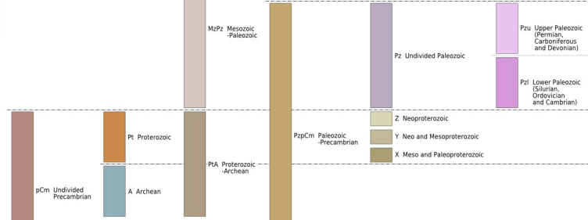
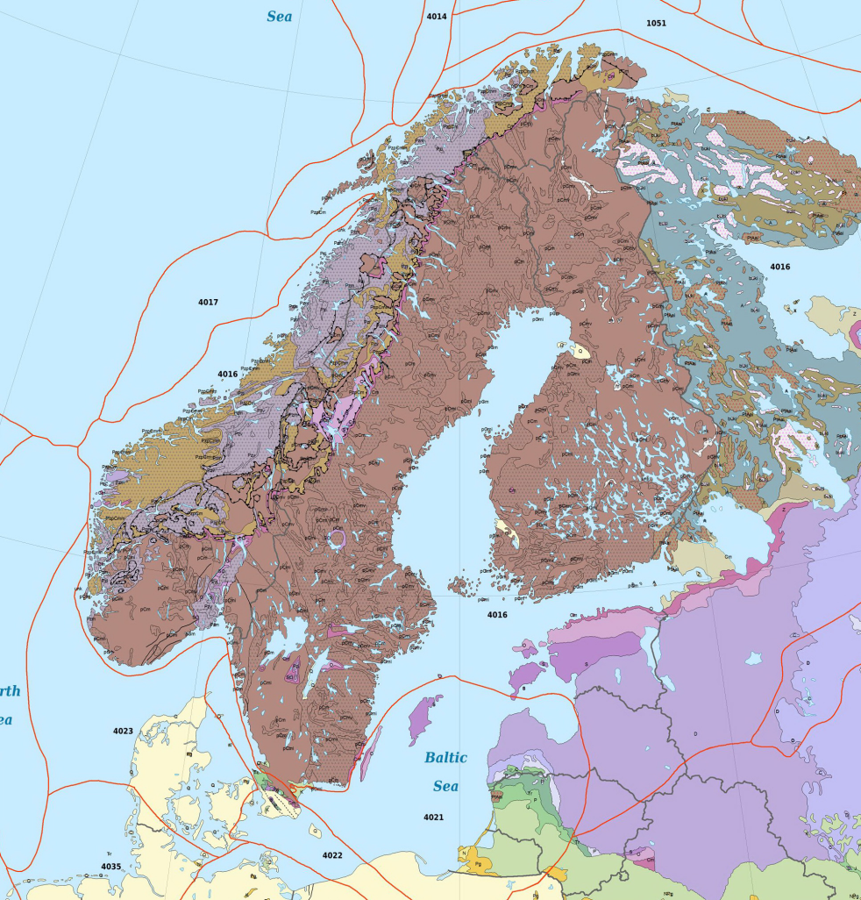
Fennoscandian Shield:
Really old, mainly Precambrian rocks.
Caledonian mountains along coast of Norway

Slide 3
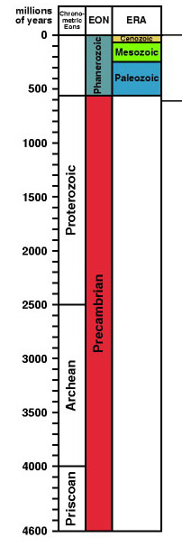
Precambrian
By far the longest part of Earth’s history
Consists of
Hadean (no remains) 4.6-4.0 Ga
Archean 4.0-2.5 Ga.
Found in Canada, Greenland, Australia, South America, Africa and Scandinavia, mainly strongly metamorphosed
Proterozoic, 2.5-0.57 Ga
Hadean

Slide 4
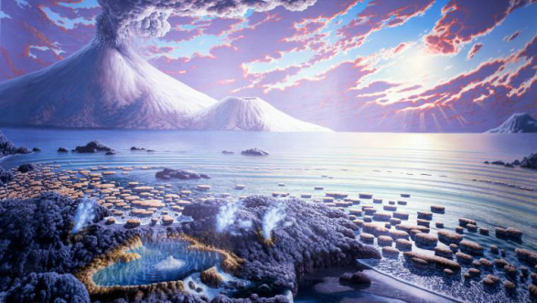
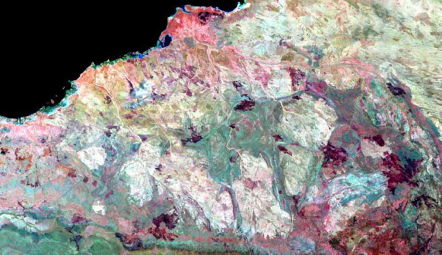
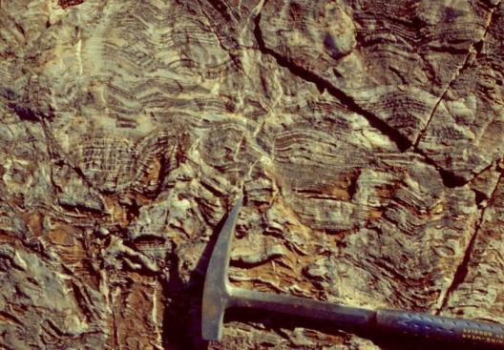
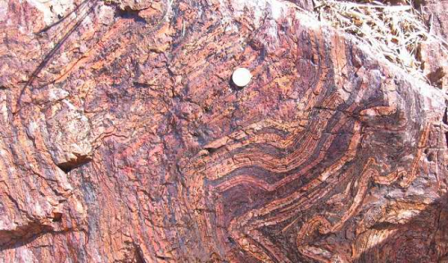
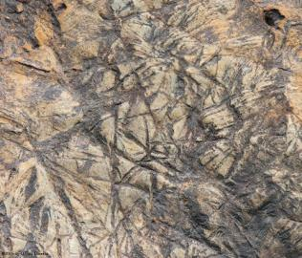
Archean
Earth was different planet
No oxygen in air
Higher heat flow, lots of volcanism
Plate tectonics????
Unusual structures
granite-greenstone terrains
Unusual rocks
banded iron formations (BIF)
Komatiite (high Mg basalt)
Earliest fossils
stromatolites

Slide 5
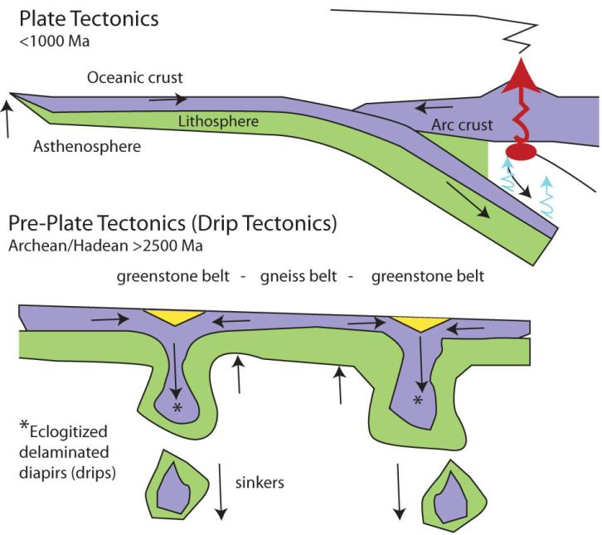
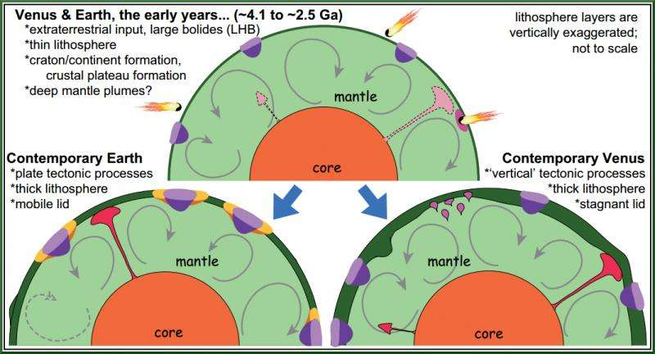
Archean vs post-Archean tectonics
Plate tectonics vs ???
speakingofgeoscience.org
Phys.org

Slide 6
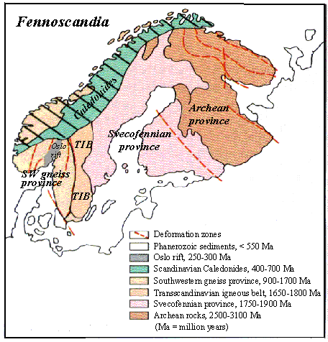
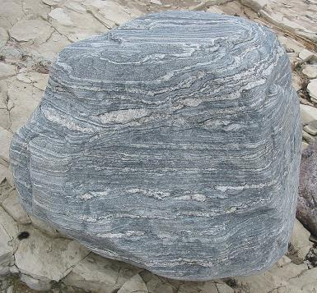
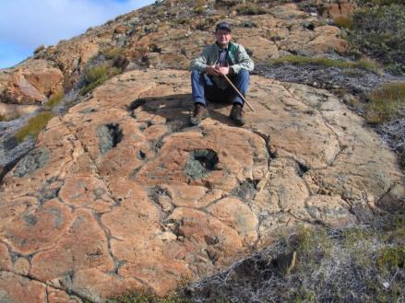
Scandinavia: Archean
Archean rocks in Finland and NW Russia (3.1-2.5 Ga)
Originally volcanic, now mainly gneiss & migmatites (mixture igneous & metamorphic rock, below left), with some greenstones (metamorphic volcanic & sedimentary rocks, right)
Complex structures

Slide 7
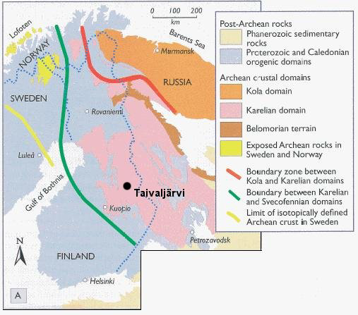
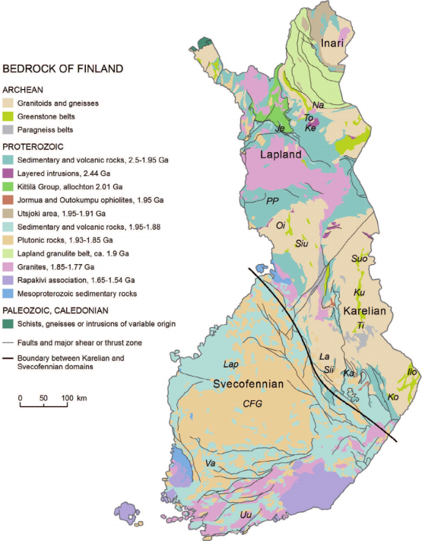
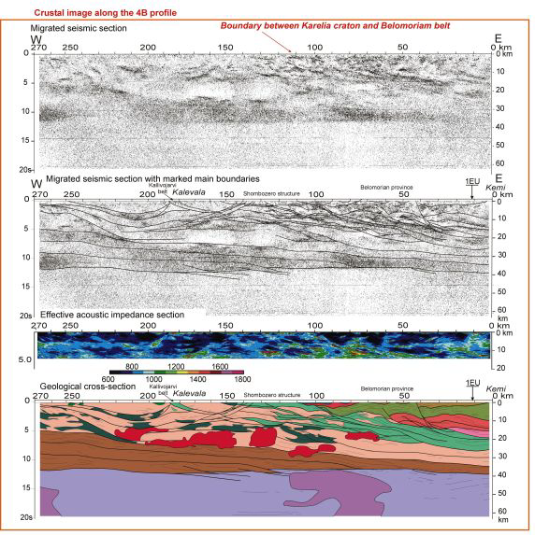
Finland: Archean
Different domains
Oldest parts ~3.1-2.9 Ga
Younger parts were added during Lopian Orogeny ~2.9-2.6 Ga
www.silver.fi
Huhma et al, 2011
Mints et al, 2005

Slide 8
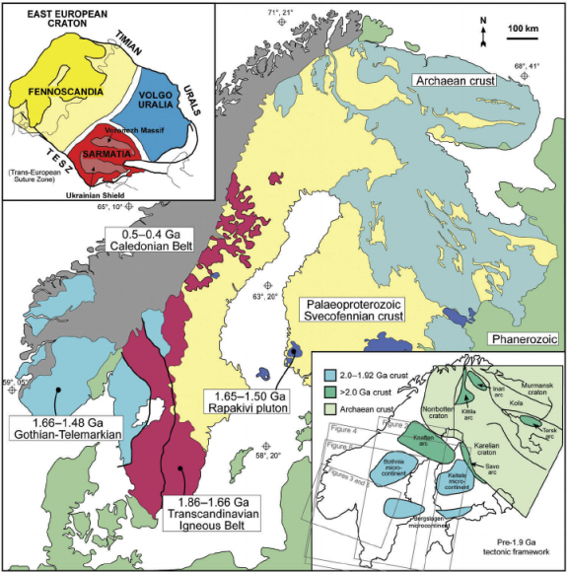
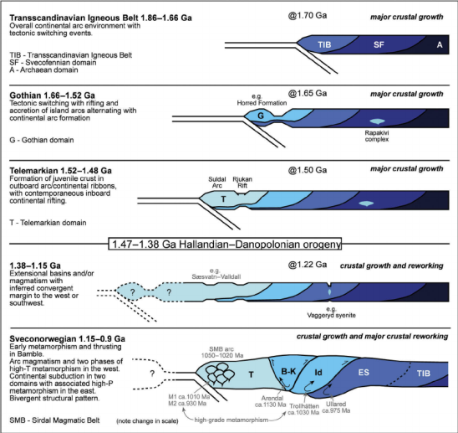
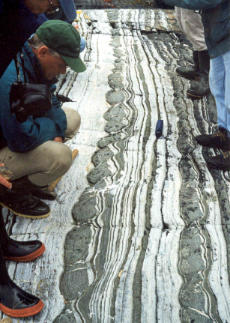
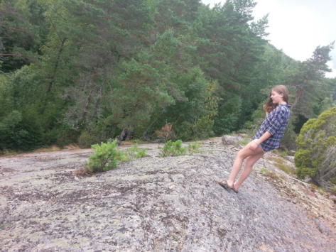
Scandinavia Proterozoic
Mainly metamorphic & igneous rocks
Svecofennian orogeny 1.9-1.8 Ga
Granite intrusion (TIB) 1.8-1.6 Ga
Sveconorwegian orogeny 1.1-0.9 Ga
Caledonian orogeny 510-400 Ma
Scandinavia more or less stable geology since caledonian times
Roberts & Slagstad 2014
Roberts & Slagstad 2014

Slide 9
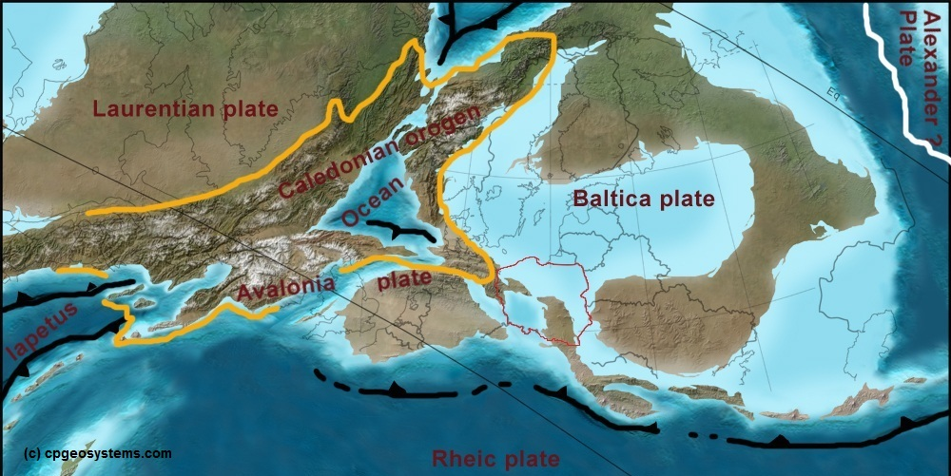
Caledonian Orogeny
Collision Baltica & Laurentia
Avalonia collides from south

Slide 10
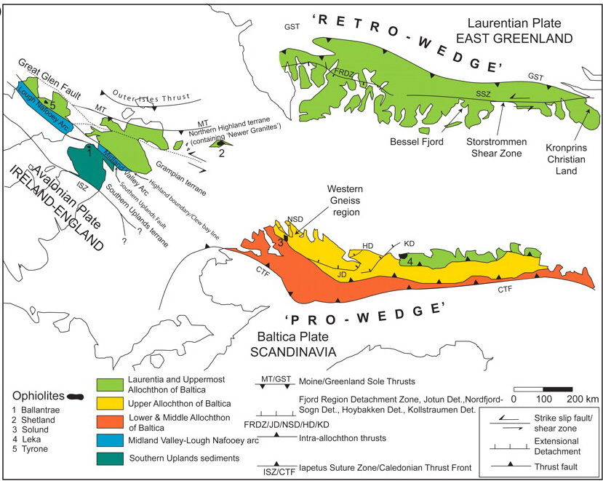
Caledonian orogeny
‘remains’ are found in Scotland, Greenland and Norway
All strongly deformed and metamorphosed

Slide 11
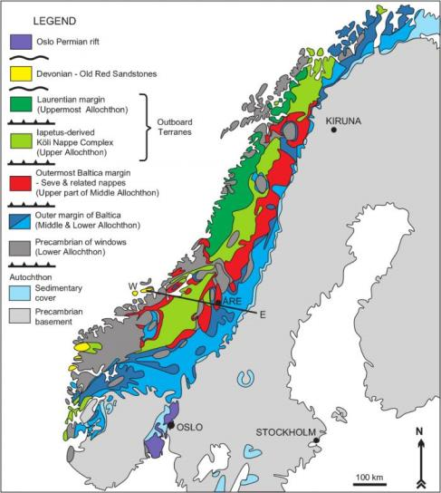
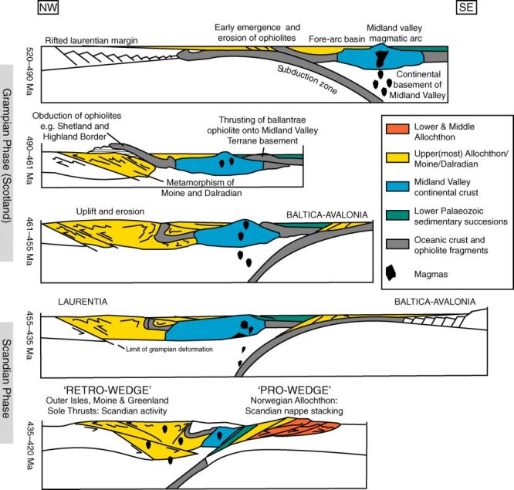
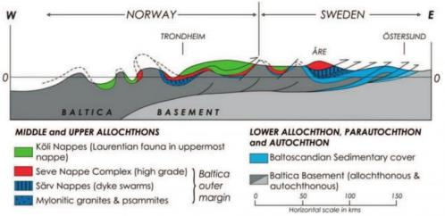
Caledonian Orogeny: Norway
First displacement toward the NW (Scotland, Moine thrust)
Second phase with displacement toward SE (Norway)
http://sp.lyellcollection.org
http://www.metproas.no

Slide 12
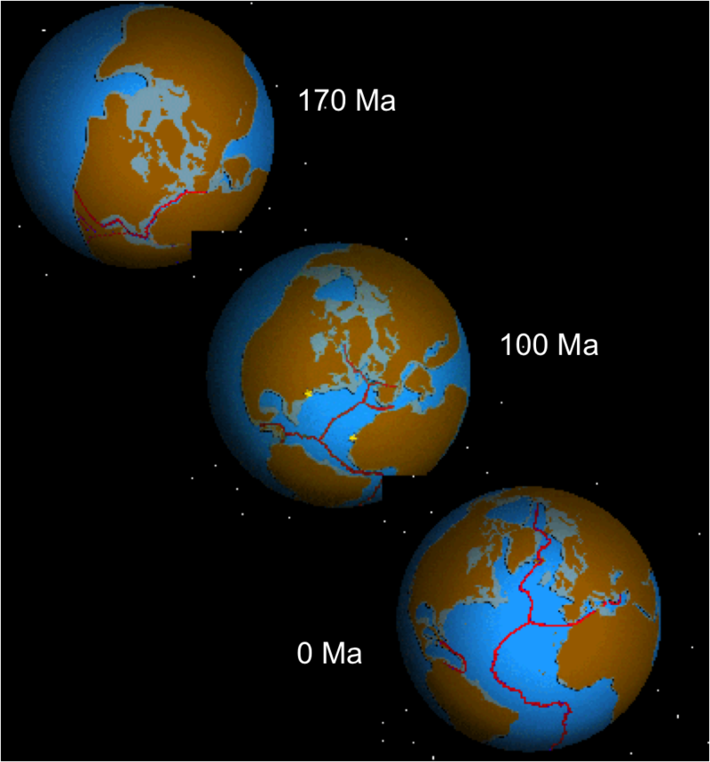
Scandinavia since Silurian
No tectonic events apart form opening North Atlantic that started in the Jurassic
This led to 1st phase of uplift and erosion of edge of Scandinavia

Slide 13
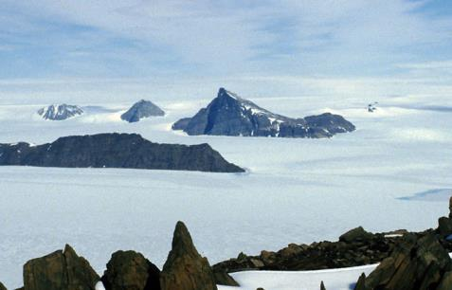
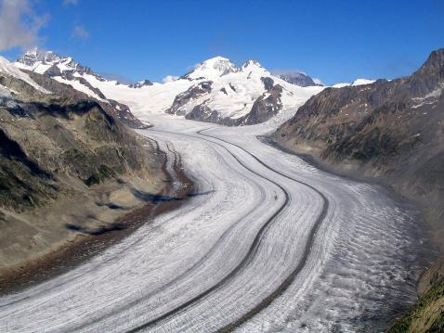
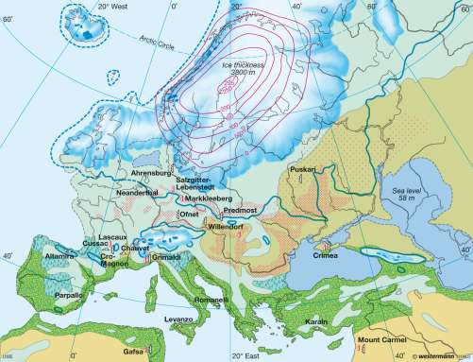
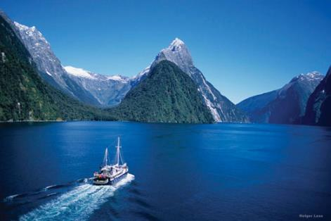
Ice age
Scandinavia was covered with ice several times during the different Neogene ice ages, reaching thicknesses of up to 4 km.
Glaciers eroded the landscape (fjords!), depositing material as far south as NL & D.
Scandinavia is rising as a result of post glacial rebound, max speed ~11 mm/year in Bothnian Gulf.

Slide 14
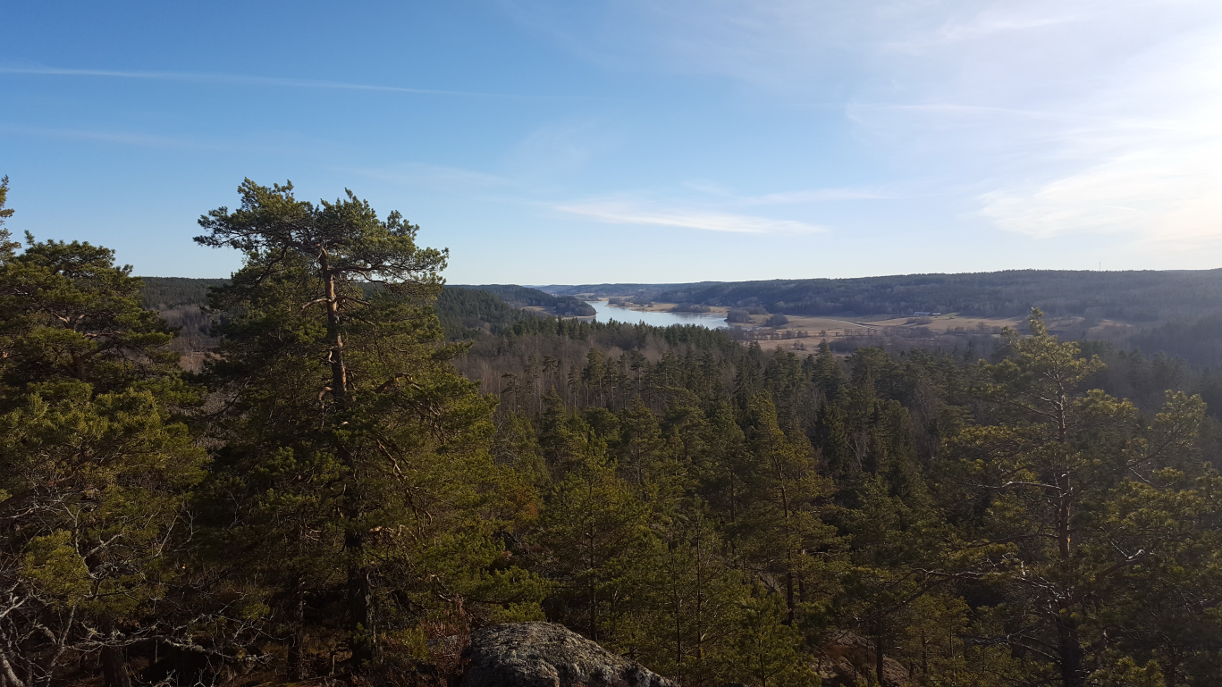
Sweden, Finland, at present
Relatively flat landscape due to glacial erosion, mainly metamorphic rocks, above sea level due to glacial rebound

Slide 15
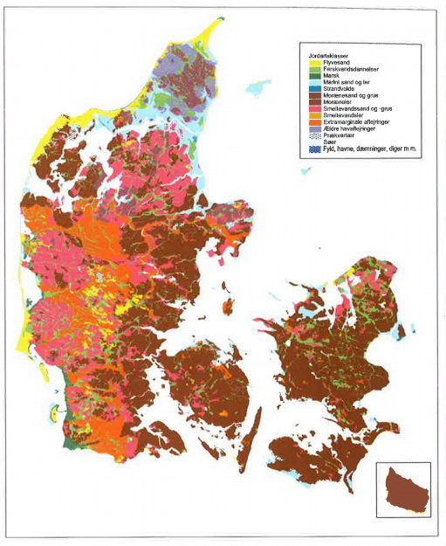
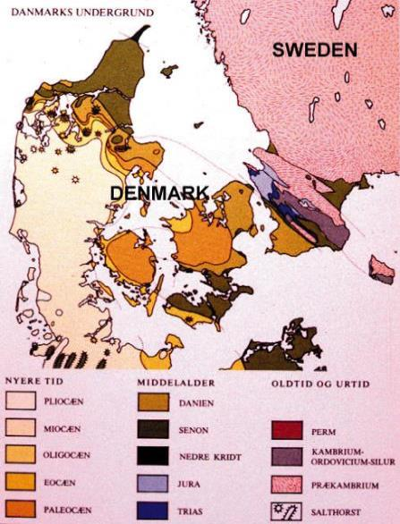
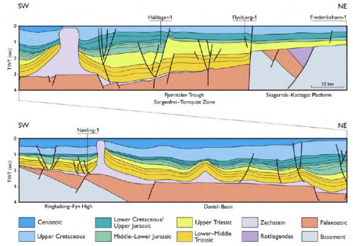
Denmark
Nearly all Cenozoic deposits, mainly recent glacial and post glacial deposits, like sand, till, gravel and peat.
Constant sedimentation since the Permian

Slide 16
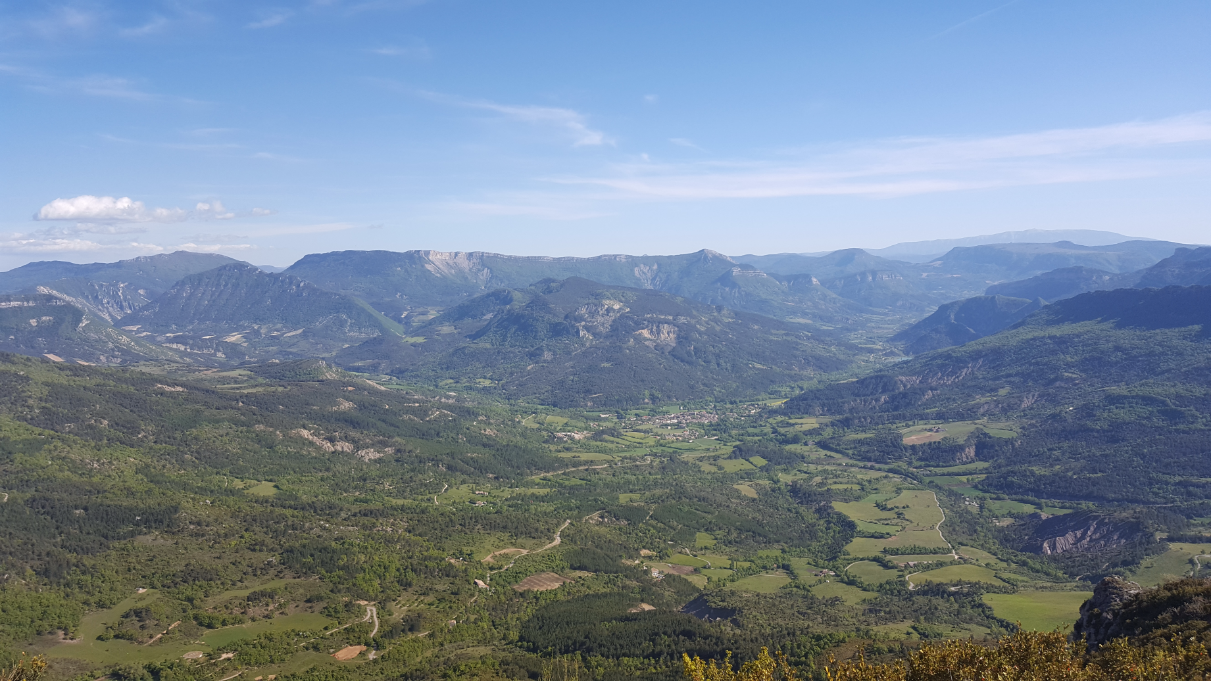
The Alps

Slide 17
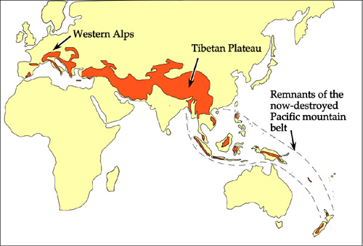
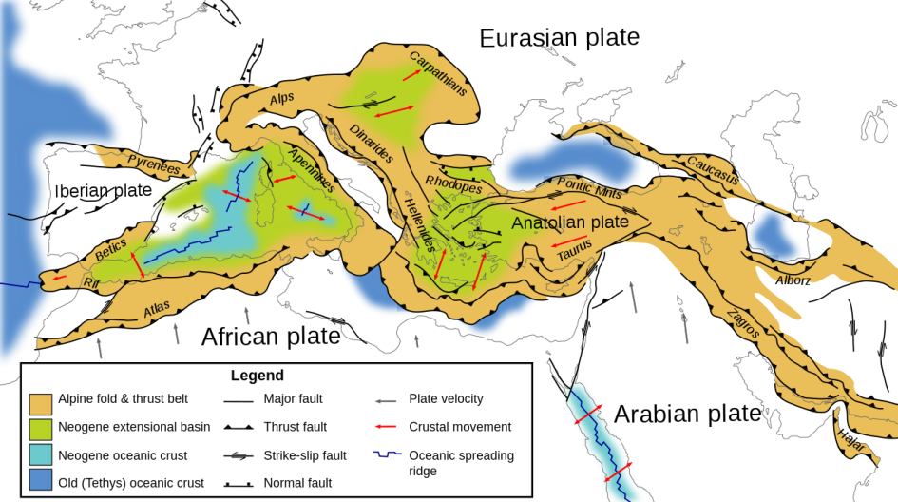
Alps
Part of large mountain belt between fragments of old Pangean continent
Form part of much larger European Alpide Mountain Belt, resulting from collision African & Eurasian plates

Slide 18
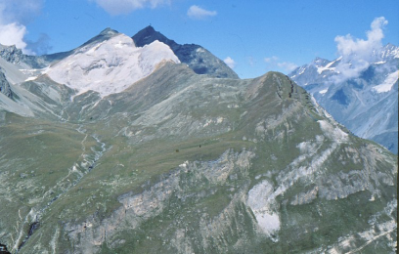
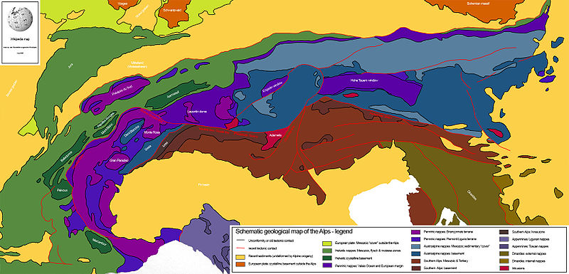
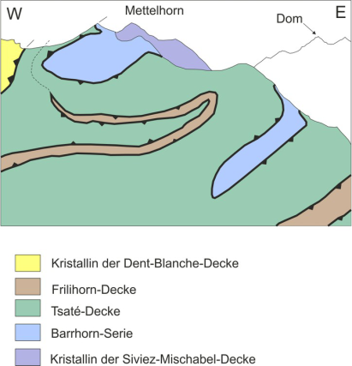
Geology of the Alps
Complex geology
Series of thrust sheets (nappes) that have been thrusted on top and over each other.
Sheets are strongly deformed internally

Slide 19
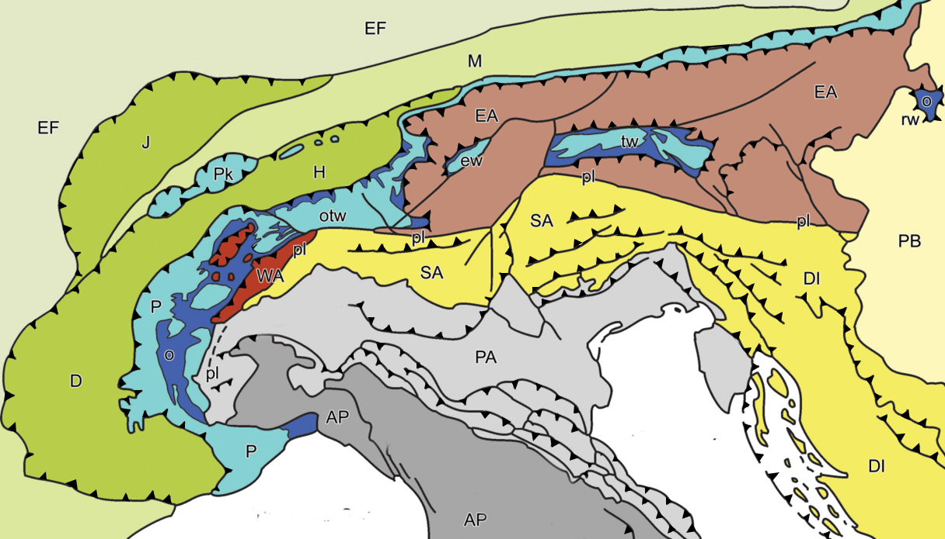
Alps: Large scale structure
http://www.virtualexplorer.com.au
J: Jura mountains; M: Molasse Basin; H/D: Helvetic/Dauphinois Nappes;
P: Penninic nappes; WA/EA: West/East Alpine nappes; SA: South Alpine nappes: AP: Apenninnes; PA: Po plain; DI: Dinaric Alps.
k=klippe, w= window, o= ophiolites, pl = periadriatic line

Slide 20
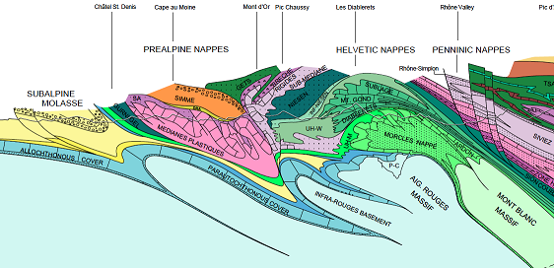
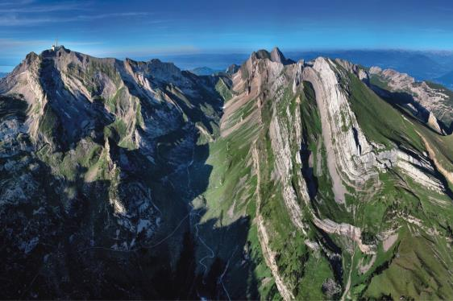
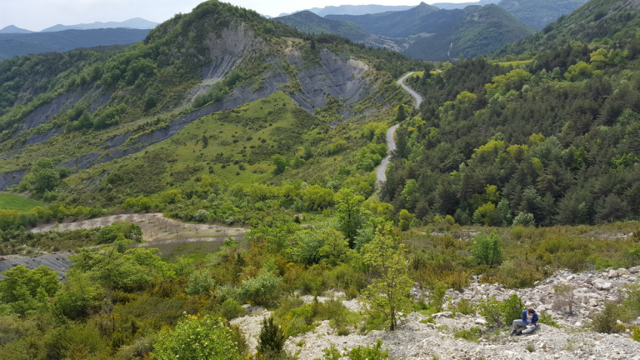
Helvetic nappes
Northern part of Alps
Mainly Mesozoic sediments, thrusted toward north and west (France)
Classic fold and thrust belt, not metamorphosed
Fieldwork France takes place in these nappes
http://rechalp.unil.ch
imaggeo.egu.eu

Slide 21
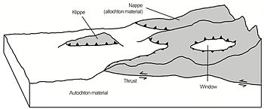
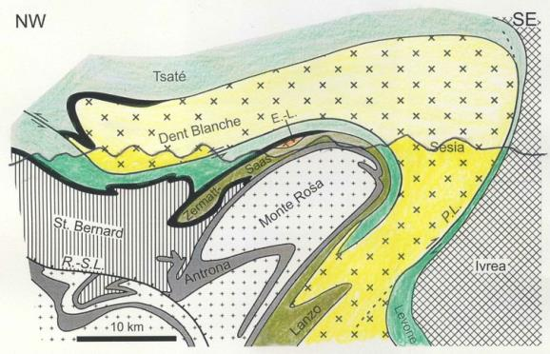
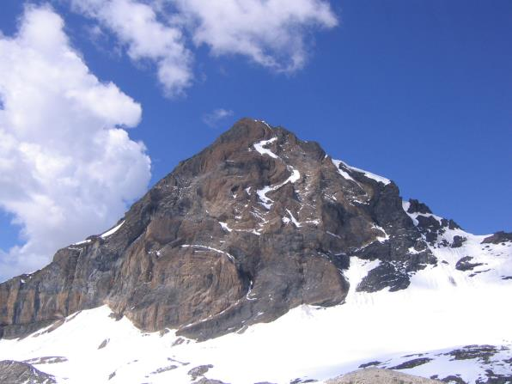
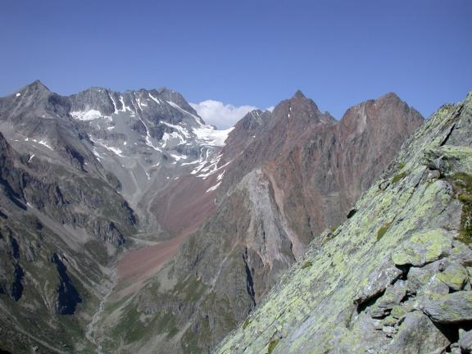
Penninic nappes
wikipedia
Highest metamorphic grade
Originally sediments, but also ophiolites, strongly deformed
Now phyllites, schists and amphibolites
Part is visible through Tauern Window
http://bio-geo-terms.blogspot.nl
http://www.virtualexplorer.com.au
http://bio-geo-terms.blogspot.nl

Slide 22
Eastern Alpine Nappes
Mainly in eastern part of the Alps
On top of two other thrust sheets
Material of old Adriatic plate
Continental basement and sediments
Little metamorphism

Slide 23
Southern Alps
Also part of Adria, but southern half.
Thrusted toward south, in contrast to rest of Alps.
Almost no metamorphism, mainly involves sediments, some old basement rocks
thousandwonders.net
earth.unibas.ch
www.pieroweb.com

Slide 24
Structure
A
C
B
A
B
C

Slide 25
Metamorphism
Highest in core of mountain belt:
Penninic nappes

Slide 26
Development over time

Slide 27
Landscape
Present day landscape caused by glaciers
Deep U shape valleys and steep cliffs eroded by glaciers.
Ice was up to 1 km thick
Large lakes are glacial valleys that filled with water
cpukforum.com
alterra.cc

Slide 28
And the 2nd year field work area?
Triassic: Extensional phase and deposition of evaporites in the future AES-Delft fieldwork areas

Slide 29
Jurassic
By the late Jurassic, the area has flooded, and a thick pile of deep marine marls is being deposited in the Oxfordian.
Toward the end of the Jurassic, these slowly change with drop in sea level to massive limestones that are being deposited by turbidites and debris flows

Slide 30
Cretaceous
Sea level rises again, giving alternations of pelagic limestones and marls in Early Cretaceous
Renewed drop leads to phase of extensive coral reefs (Vercors (1), Ventoux)
Renewed sedimentation of deep marine marls (2), followed by final phase of limestones (3).
Is uplifted due to Alpine orogeny by the end of the Cretaceous
1
2
3

Slide 31
Deformation
The basement, originally extended during basin formation, was inverted during the Alpine Orogeny, leading to detachment along Triassic evaporates (present in some areas!) and a second detachment along Oxfordian marls.
Two phases: Pyrenean (N-S) and Alpine (E-W)
Roure et al. 1994

