Slide 1
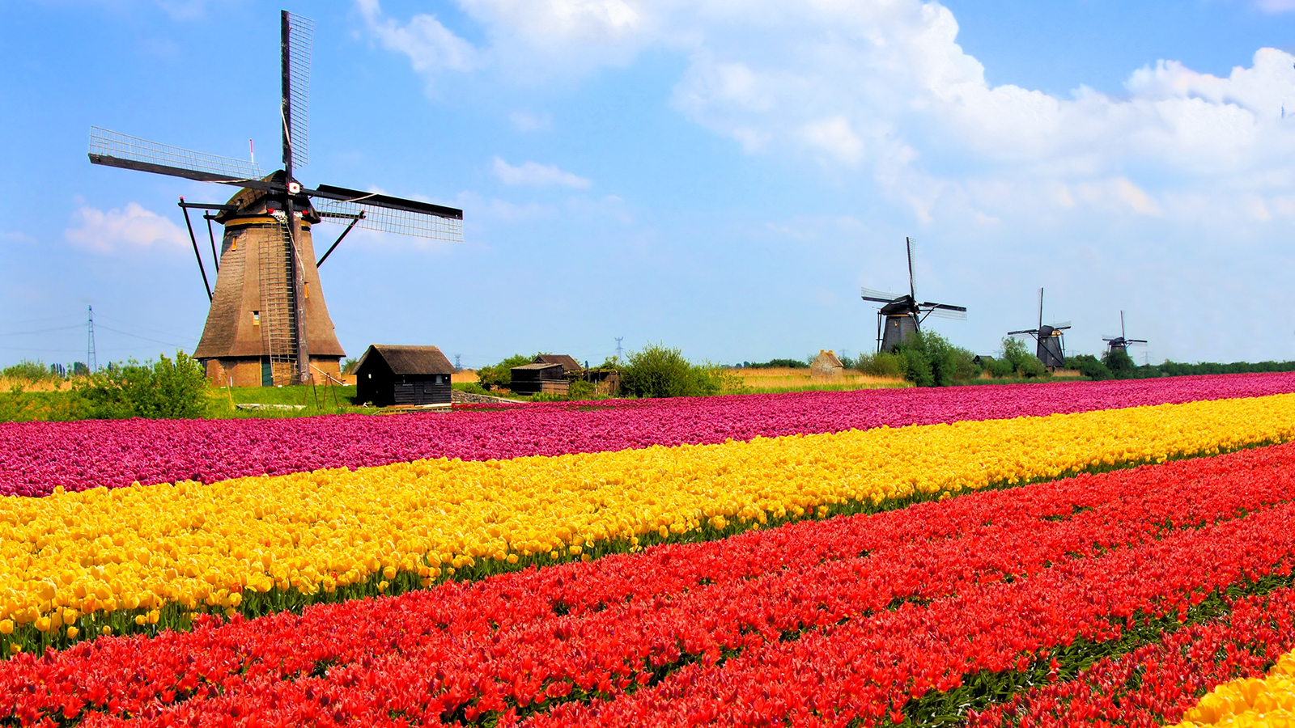
The Netherlands & The North Sea:
Jan Kees Blom AESB1230

Slide 2
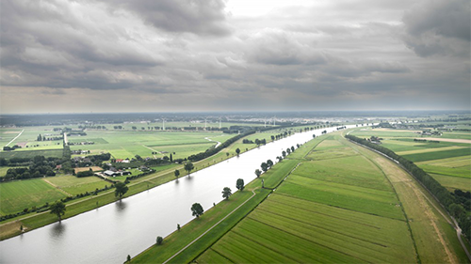
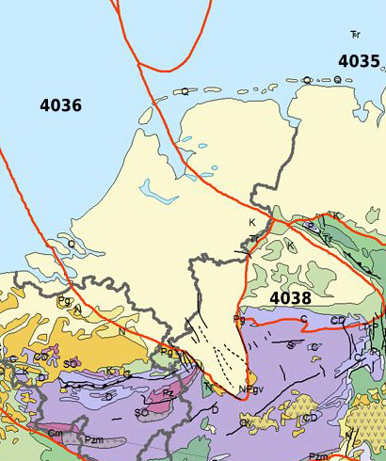
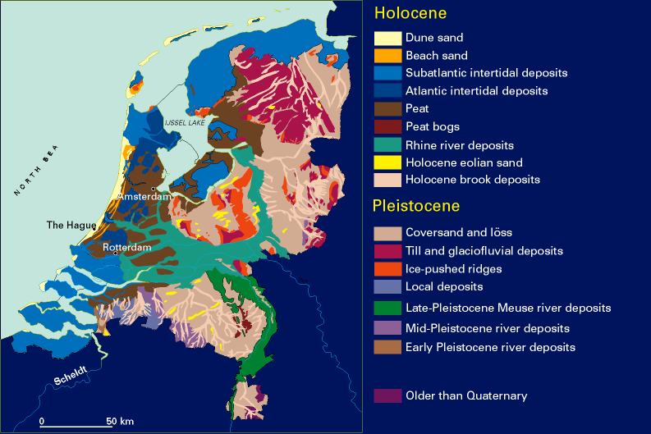
A young country

Slide 3
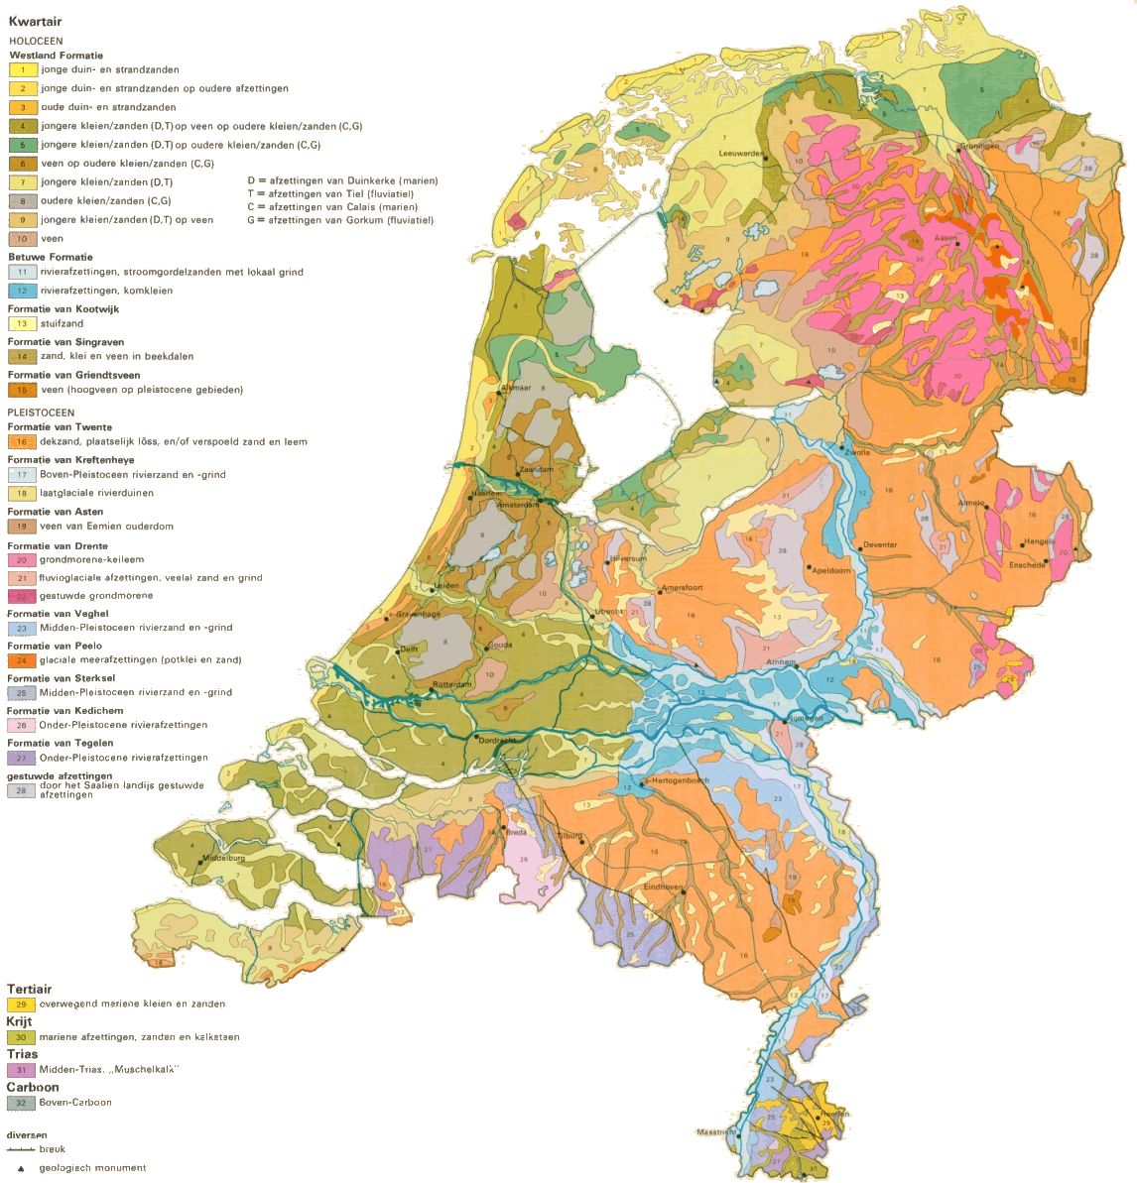

Slide 4
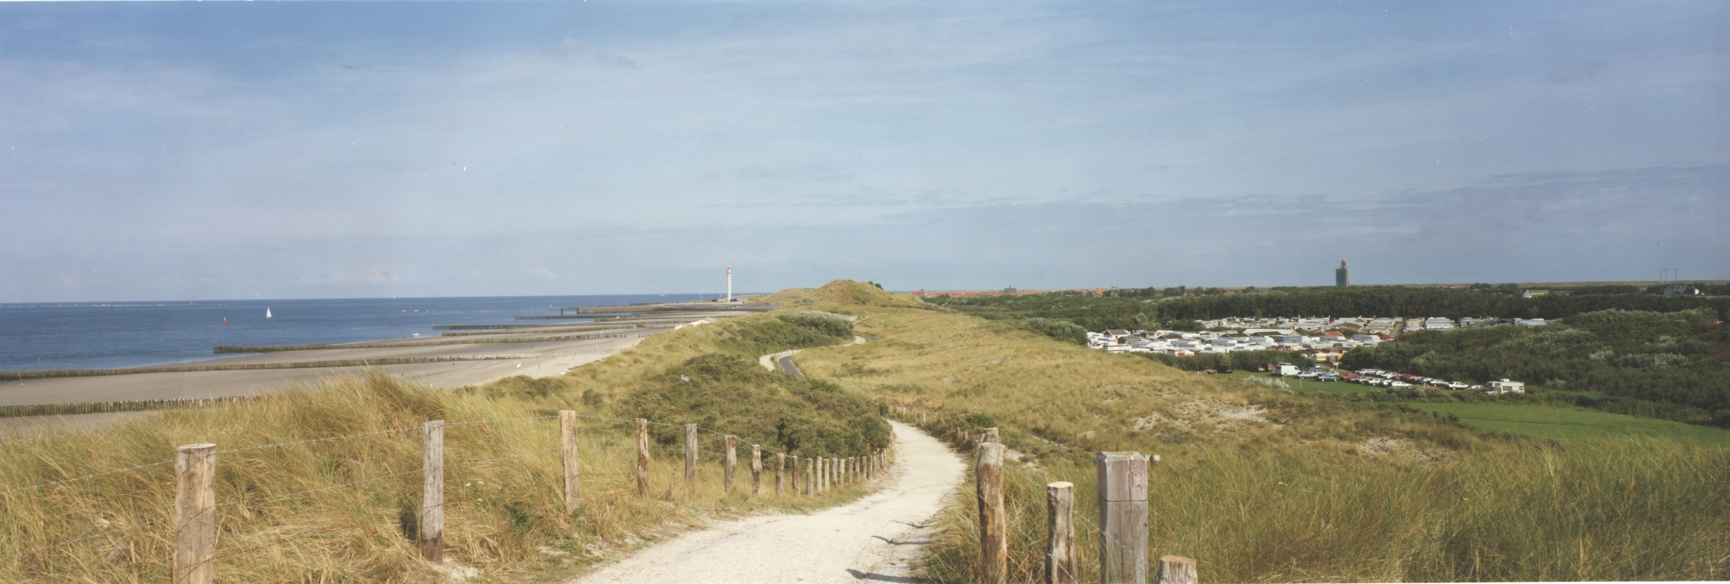
Interesting topography
Flat and below sea level

Slide 5
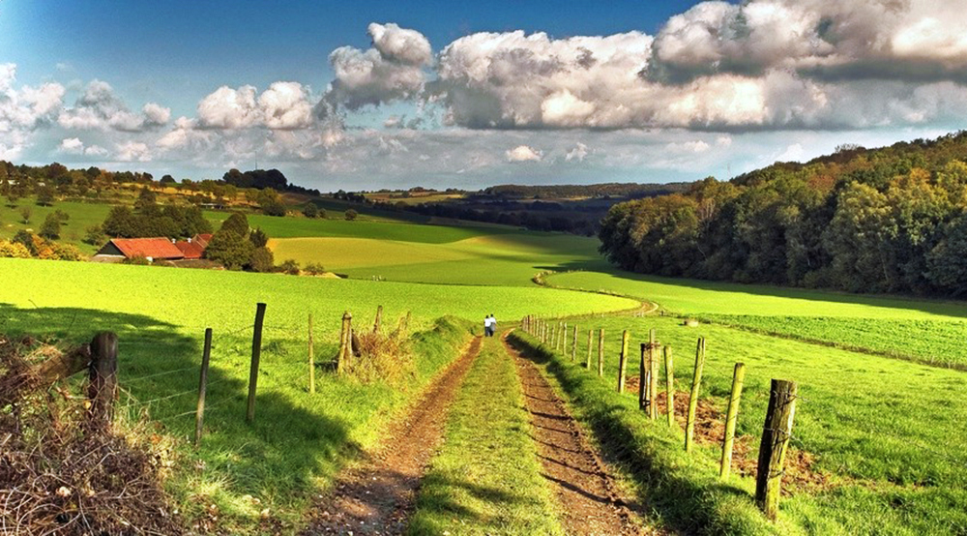
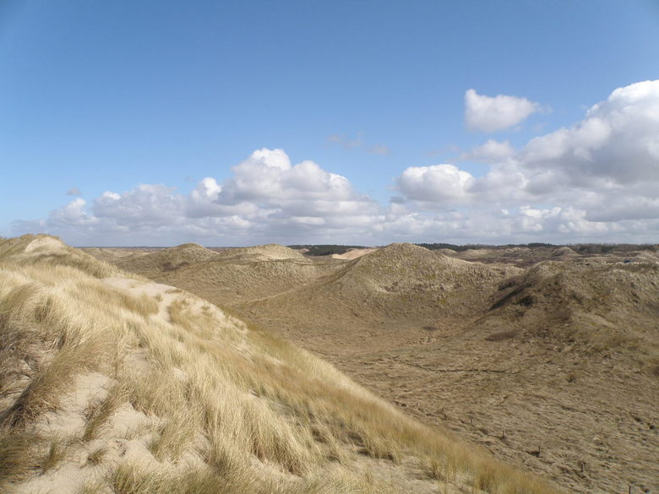
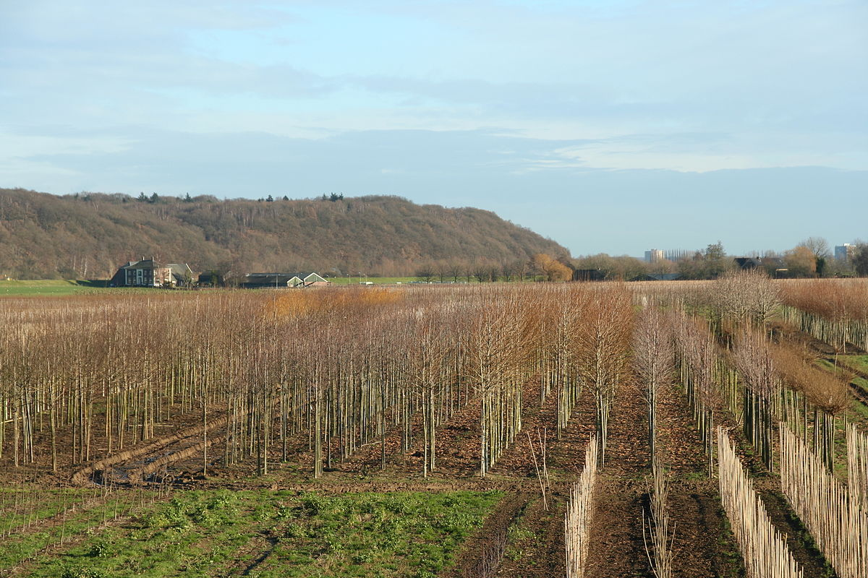
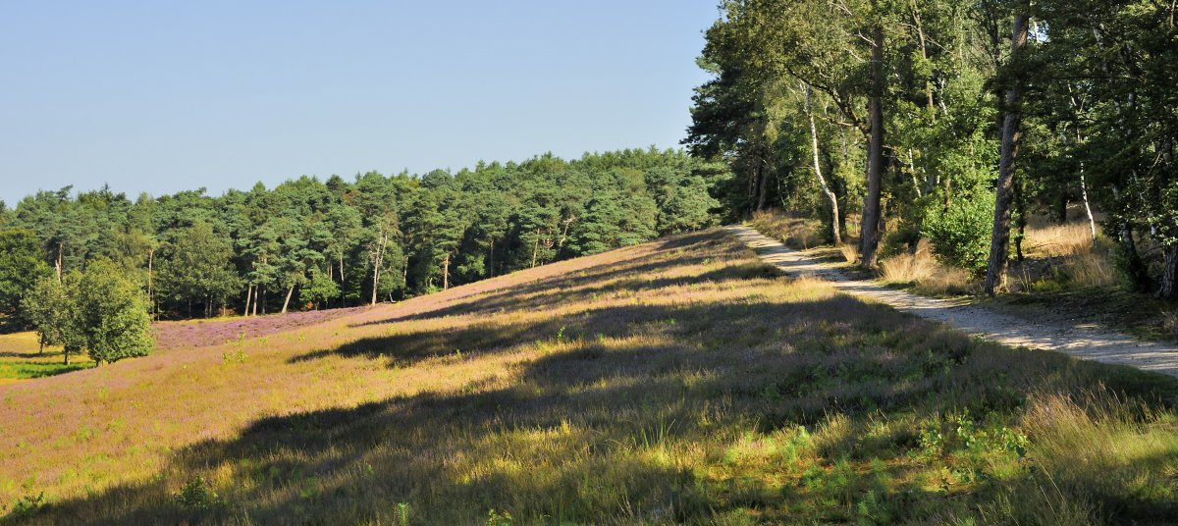
Dutch mountains
Dunes, Limburg, Grebbeberg,
Utrechtse heuvelrug

Slide 6
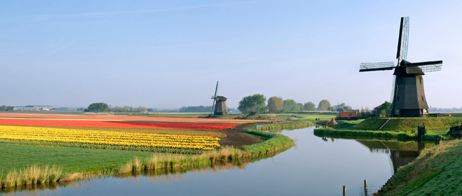
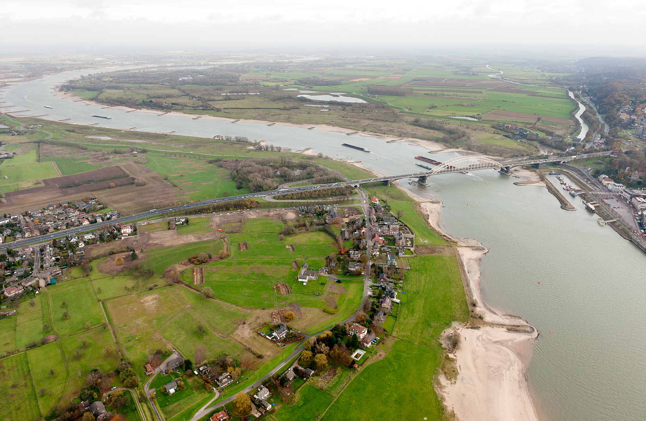
Rivers & polders

Slide 7
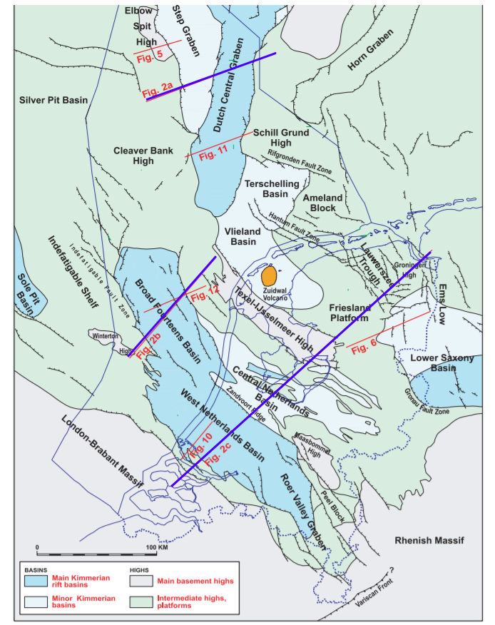
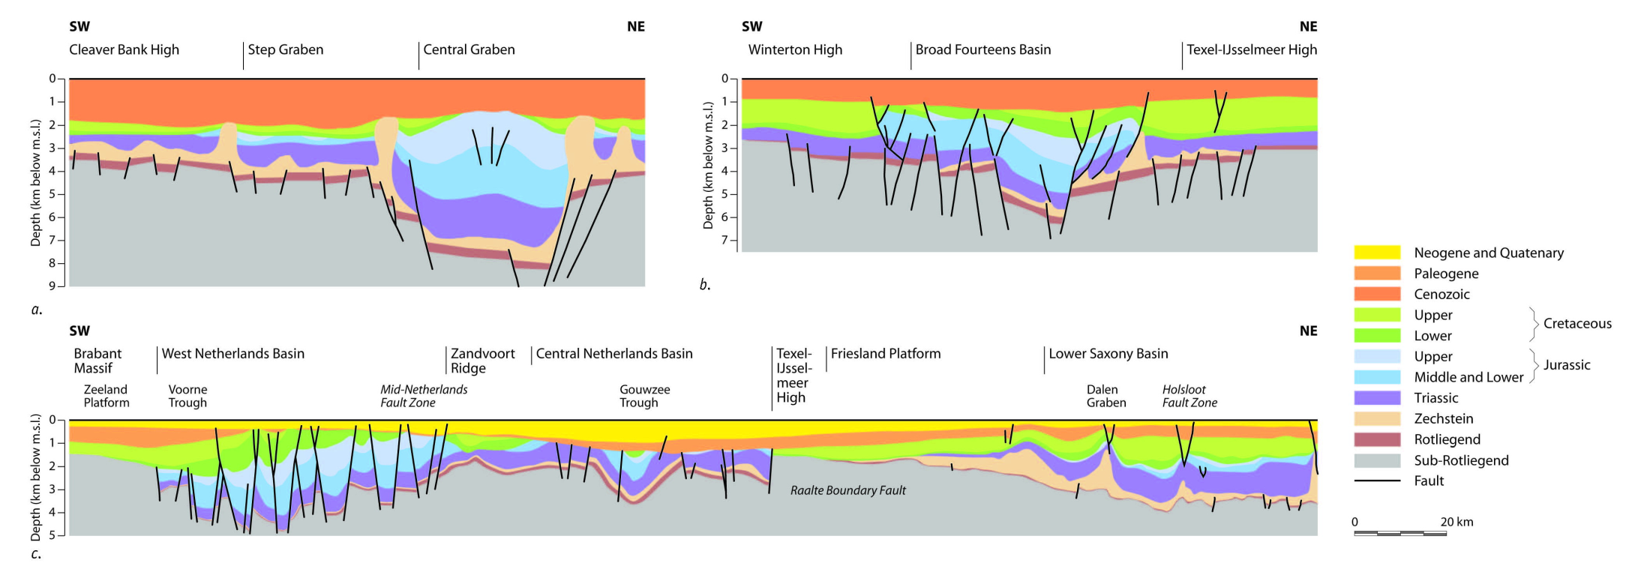
However, below our feet
Map of pre-Tertiary structure of the Netherlands
System of basins and highs,
Faults, folds, unconformities...
Much more excitement!

Slide 8
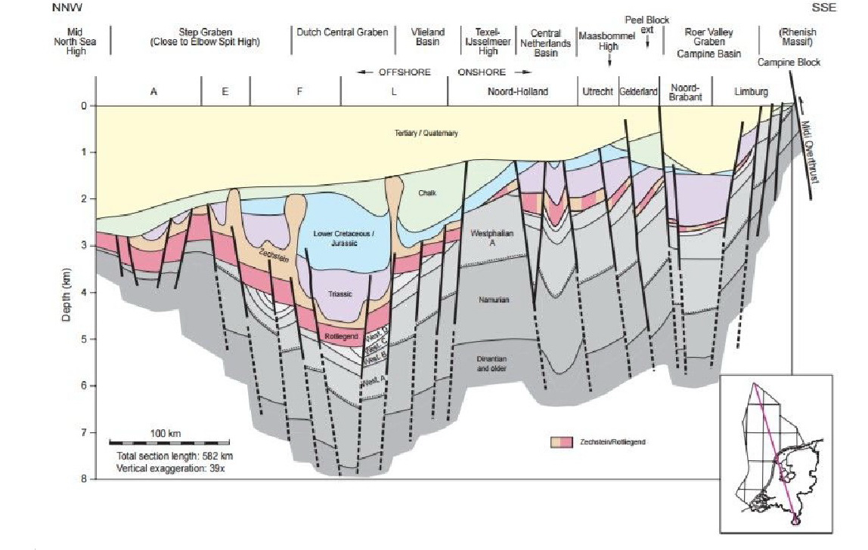
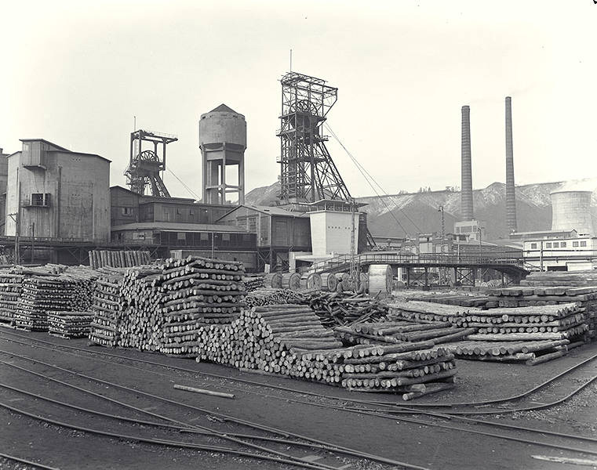
Back in time
Sub-rotliegend in sections:
Mainly Carboniferous and older rocks
Deformed during first Caledonian (Silurian) and then Variscan orogenies (late Carboniferous:
Unconformity with Permian.
Carboniferous: coal!
Coal mines in Limburg closed in 1974 in NL. (why mining only in Limburg??)
AES originally Mijnbouwkunde.
Coal also source rock for gas

Slide 9
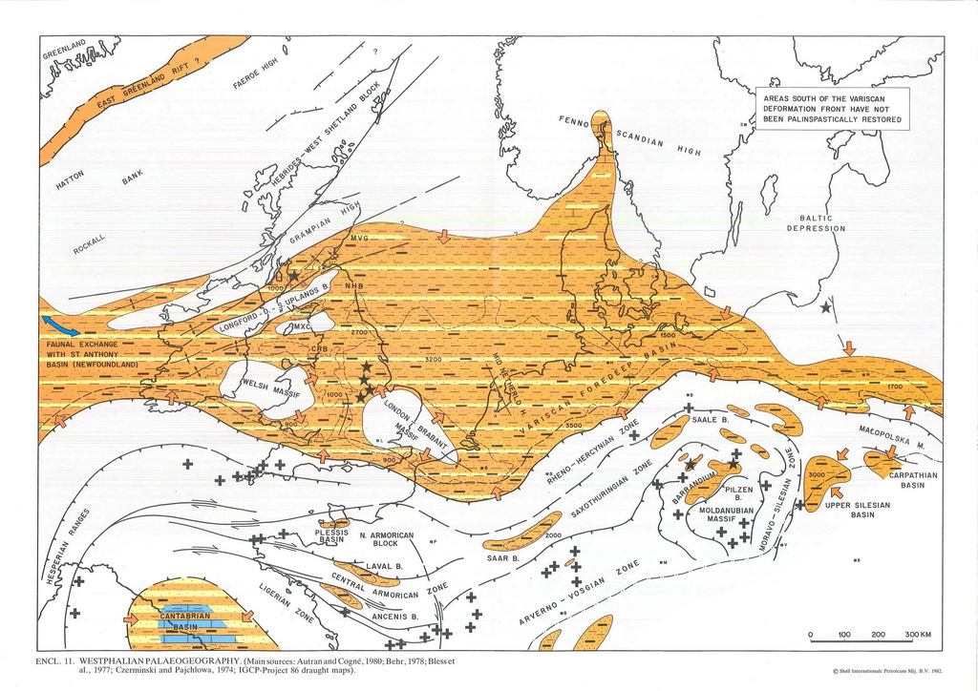
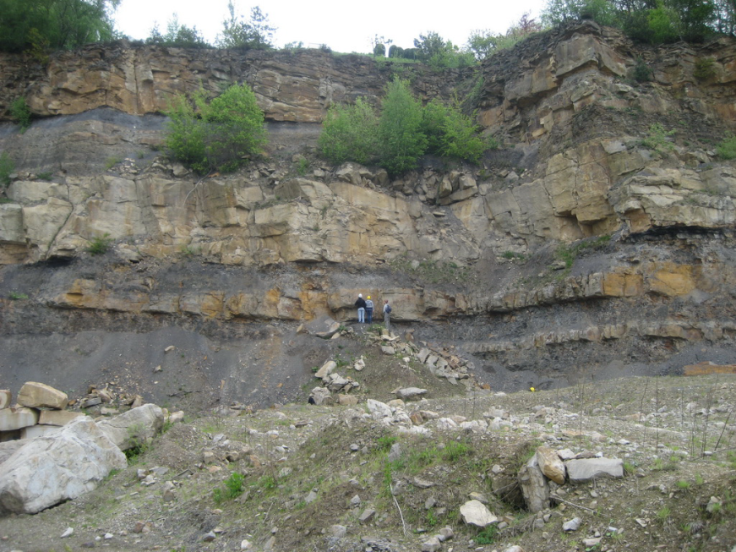
Late Carboniferous
Original open basin south of Caledonian mountains is cut off from oceans, becomes continental
Large tropical rainforests: coal
Sedimentation very fast due to emerging mountains in south
Ziegler 1990

Slide 10
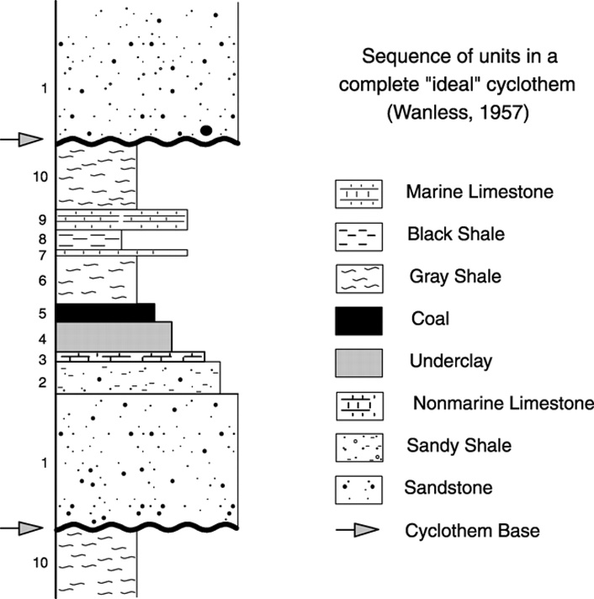
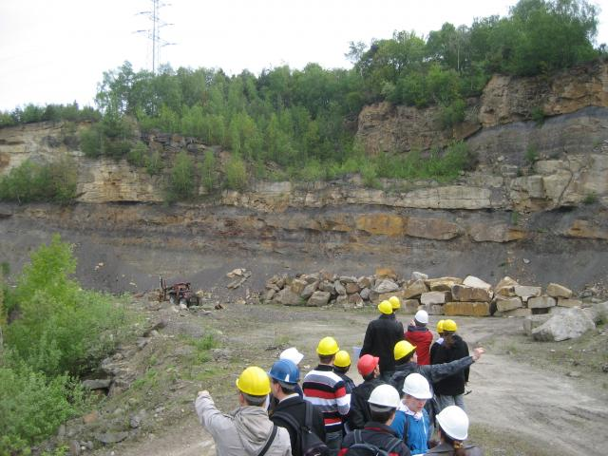
Cyclothems
Coal is found in thin layers that form part of regular cycles: Cyclothems
cyclothems are alternating stratigraphic sequences of marine and non-marine sediments, sometimes interbedded with coal seams.
Possibly related to variations in ice growth of Carboniferous icecaps

Slide 11
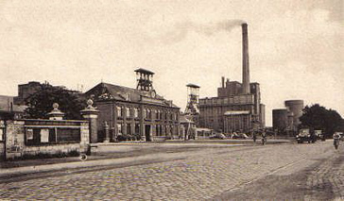
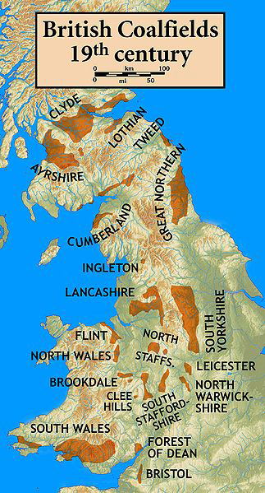
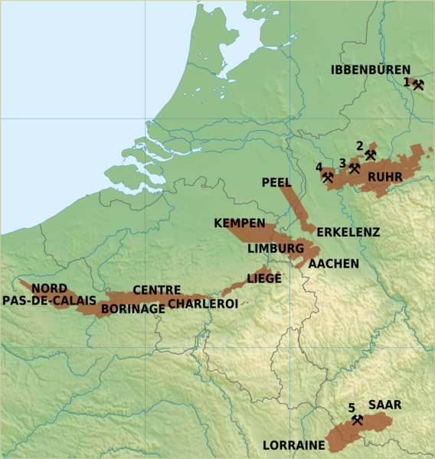
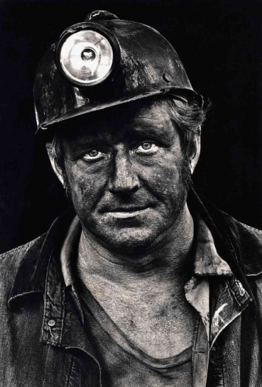
Coal
Carboniferous has extensive coal reserves along the old continental margin
Has been mined extensively in Europe and US: industrial revolution
Coal is also important as source rock for gas fields in NW Europe
graaffoto.com
wikipedia
http://www.npr.org
wikipedia

Slide 12
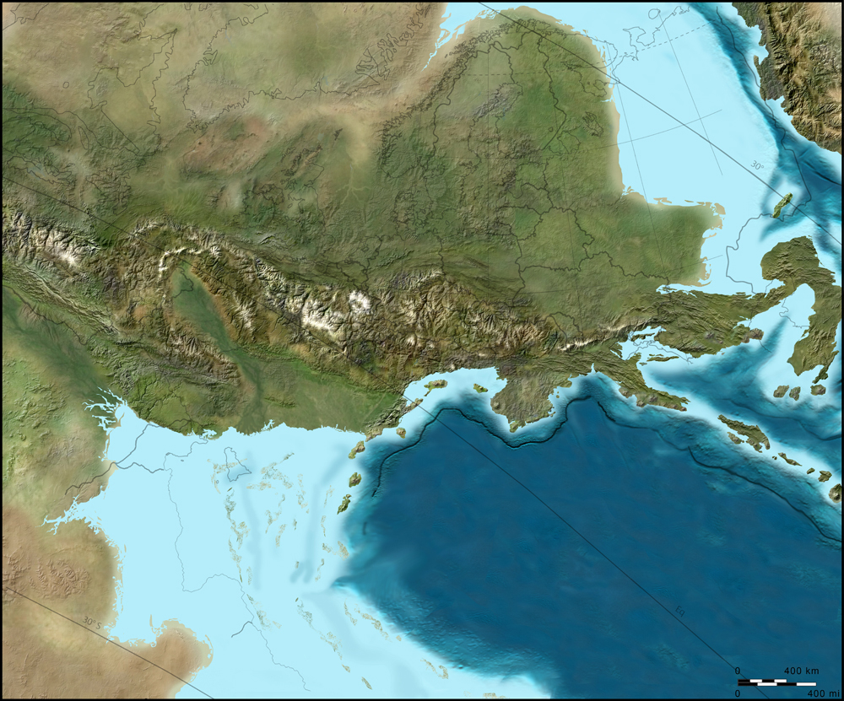
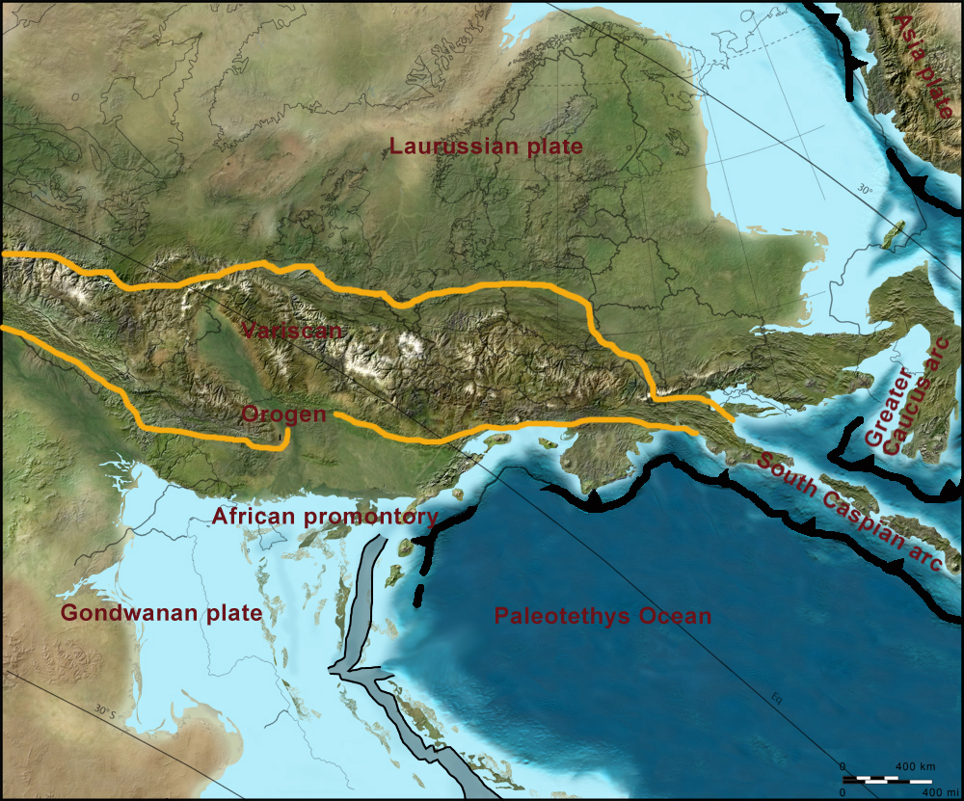
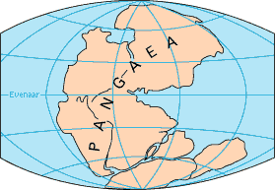
End of Carboniferous (300 Ma) Hercynian / Variscan orogeny
Collision between Gondwana and Laurasia
Both names are used.
Led to formation of one large continent: Pangea
Surrounded by large ocean: Panthalassa
Ural will be formed a bit later
http://cpgeosystems.com

Slide 13
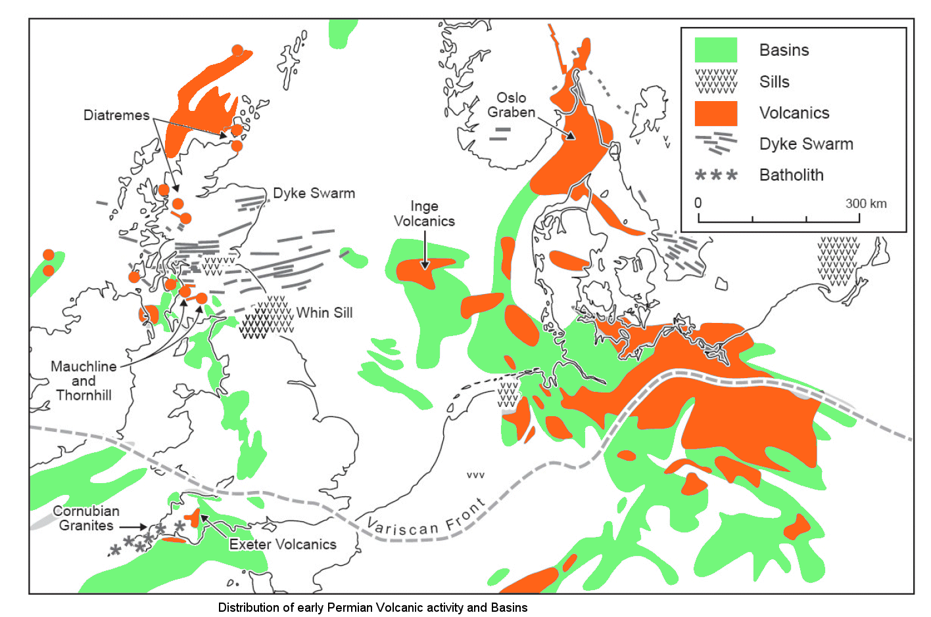
Permian: volcanism
Started late Carboniferous
Related to extension in front of orogen
Continued after stop of orogenic activity into Permian
Mainly mafic volcanism

Slide 14
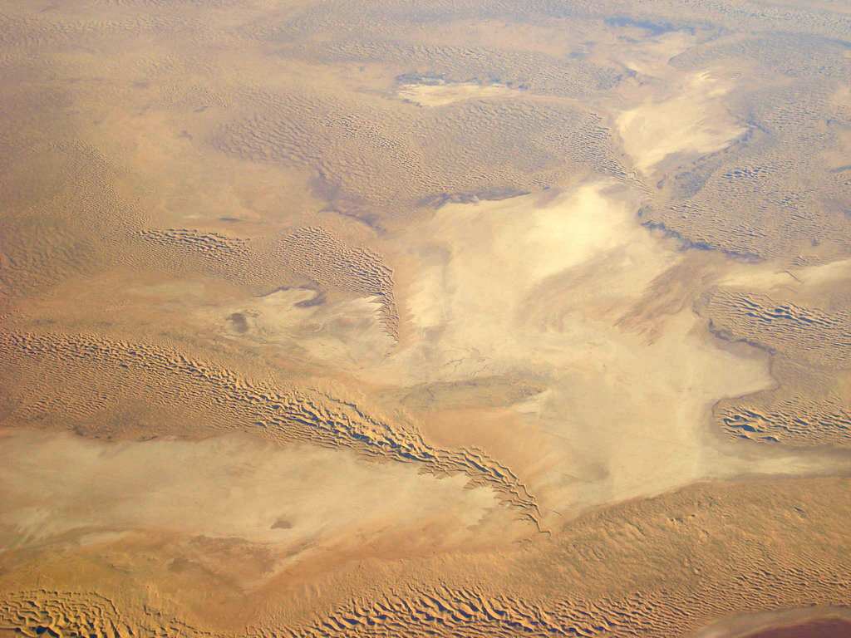
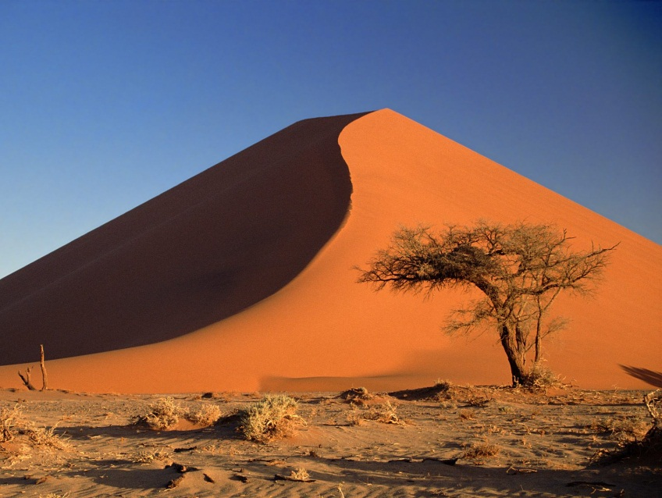
Early Permian: Rotliegendes
Two small basins north of hercynian mountain ranges:
Northern and Southern Permian Basin
Ice caps on the poles but in NW Europe desert conditions: sand dunes

Slide 15
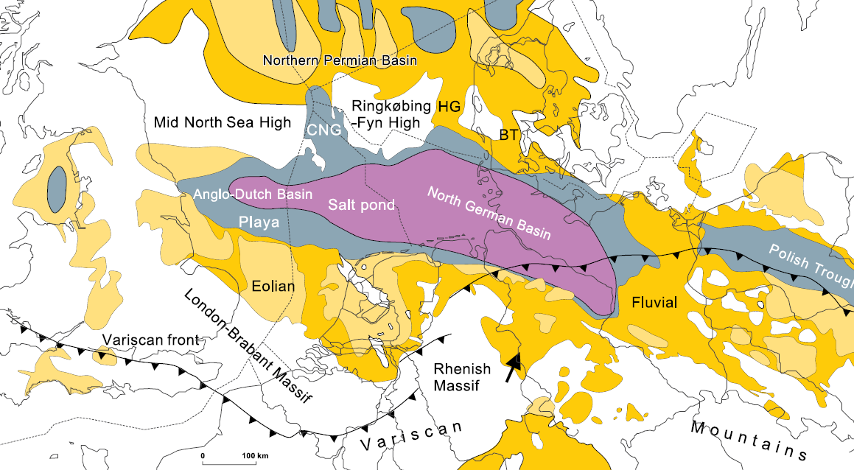
Rotliegend facies distribution

Slide 16
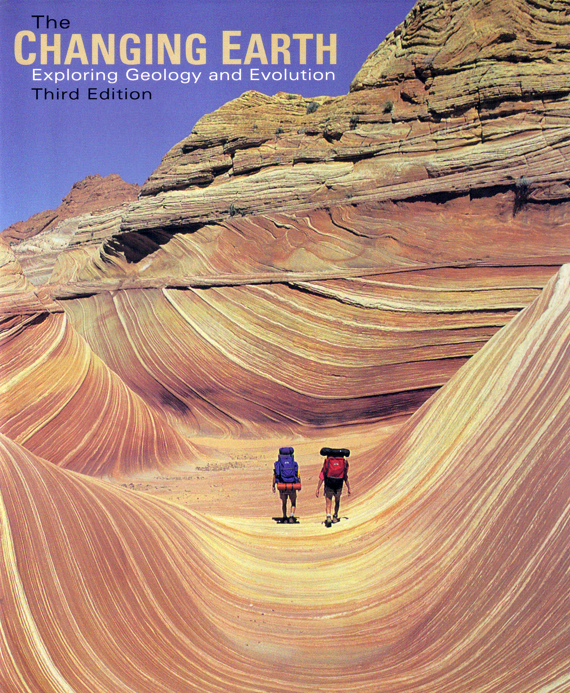
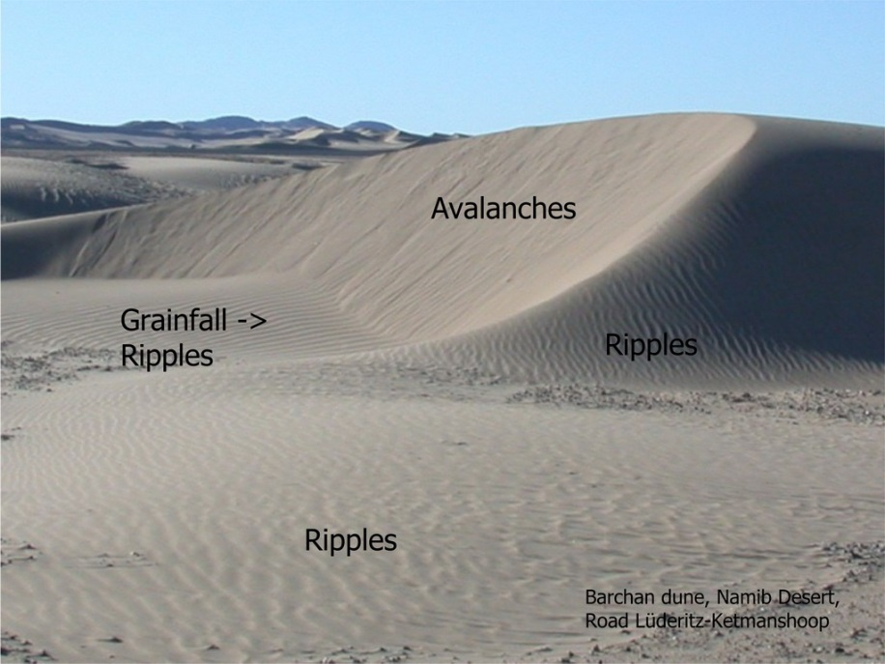
Analog
Jurassic sanddunes of Navajo Fm, Zion, Utah
S. Luthi

Slide 17
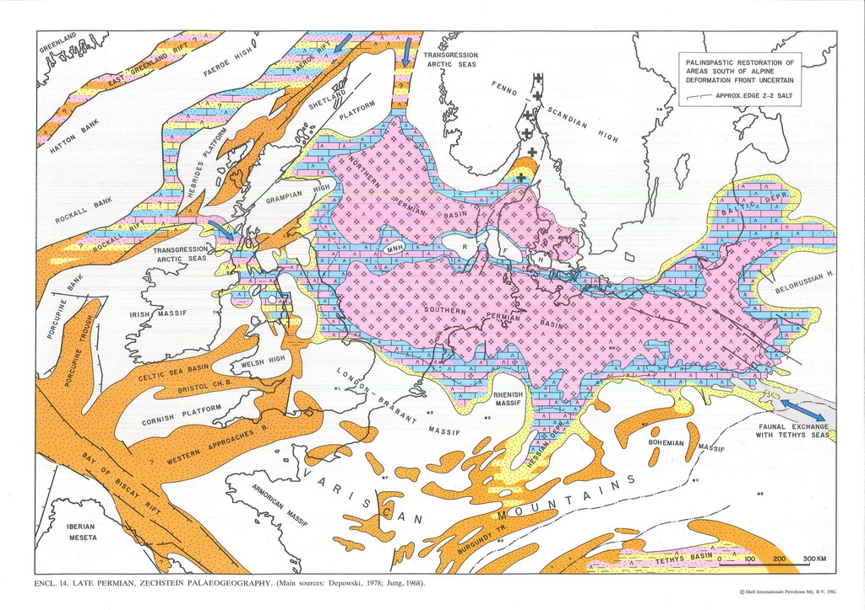
Late Permian trangression: Zechstein sea

Slide 18
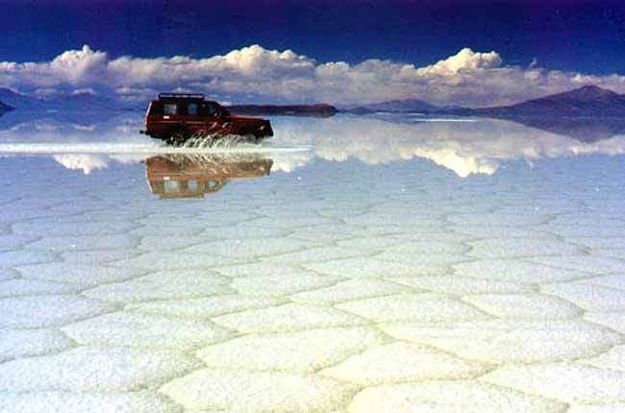
Zechstein
Shallow inland sea in desert conditions
High evaporation, cut off from open ocean
Salt deposition
http://www.atlantisbolivia.org

Slide 19
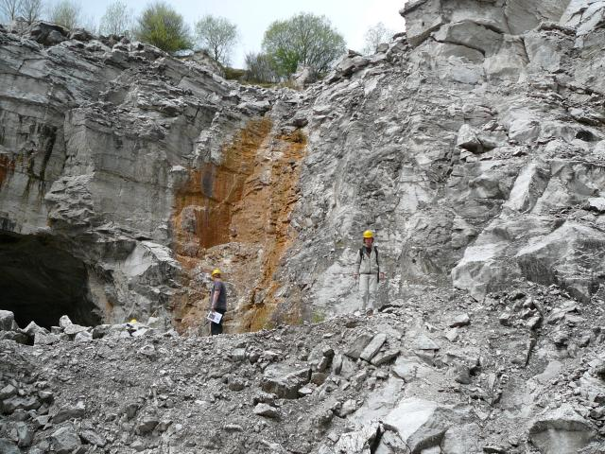
Zechstein
Massive anhydrite near Harz
Maximum thickness Zechstein in North Sea is well over 2 km.

Slide 20
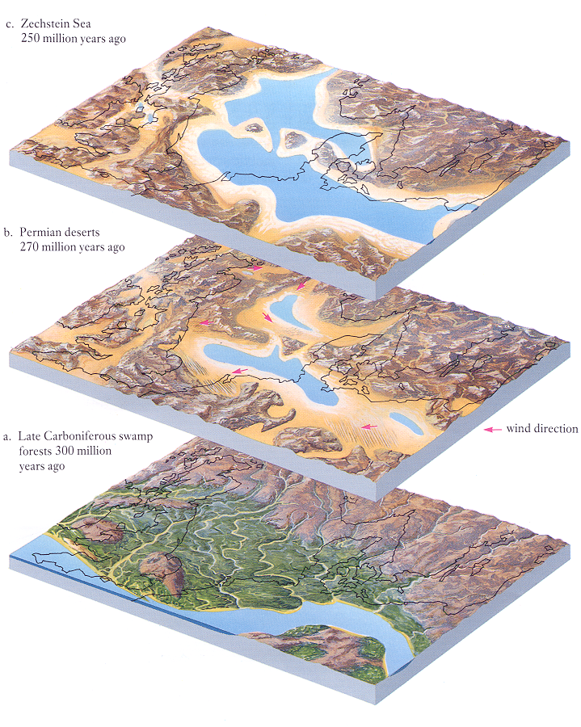
Economic importance Permian: Gas
Zechstein:
Salt lake (seal)
Rotliegendes:
wadi’s & sand dunes in desert (gas reservoir rock)
Carboniferous:
Peat in delta’s
(gas source rock)

Slide 21
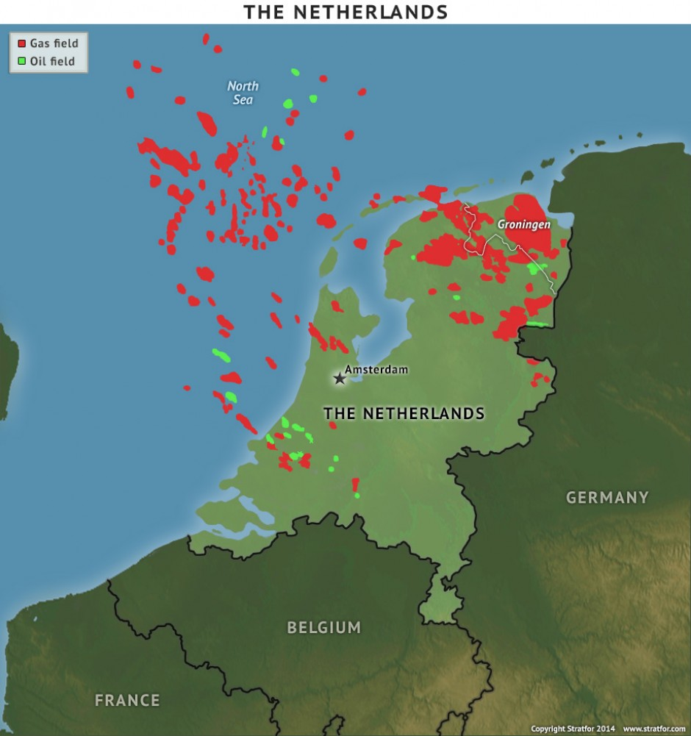
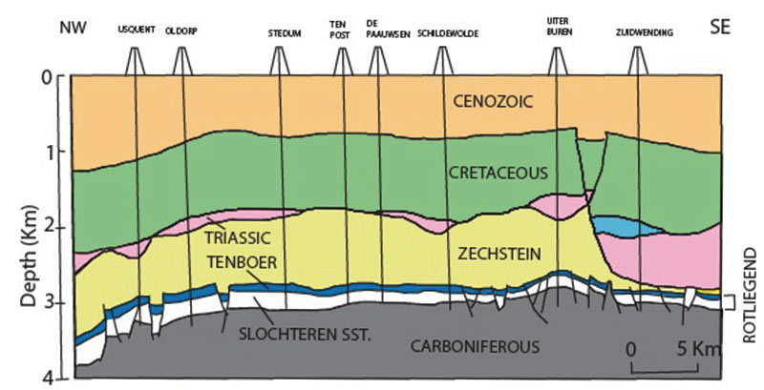
Gas fields Netherlands & North Sea
Groningen gas field:
9th largest field in the world
2100km³ gas
Source: Carboniferous coal
Reservoir: Rotliegend
Seal: Zechstein
www.stratfor.com

Slide 22
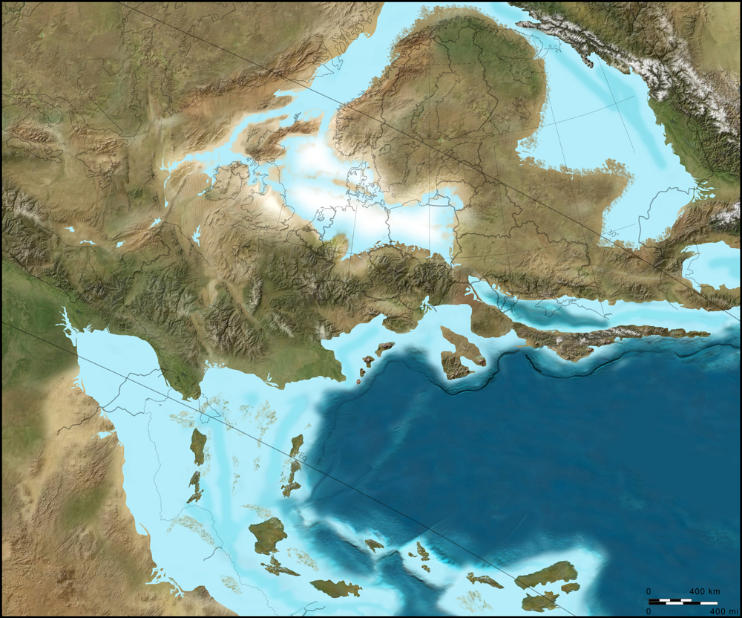
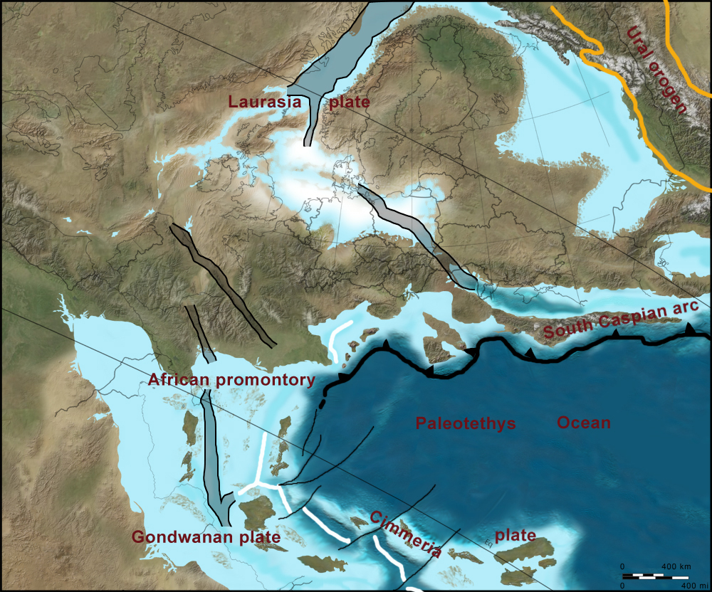
Early Triassic
Continental conditions
Zechstein sea dries up
Graben forms in North Sea area
Tethys Ocean at location of Mediterranean

Slide 23
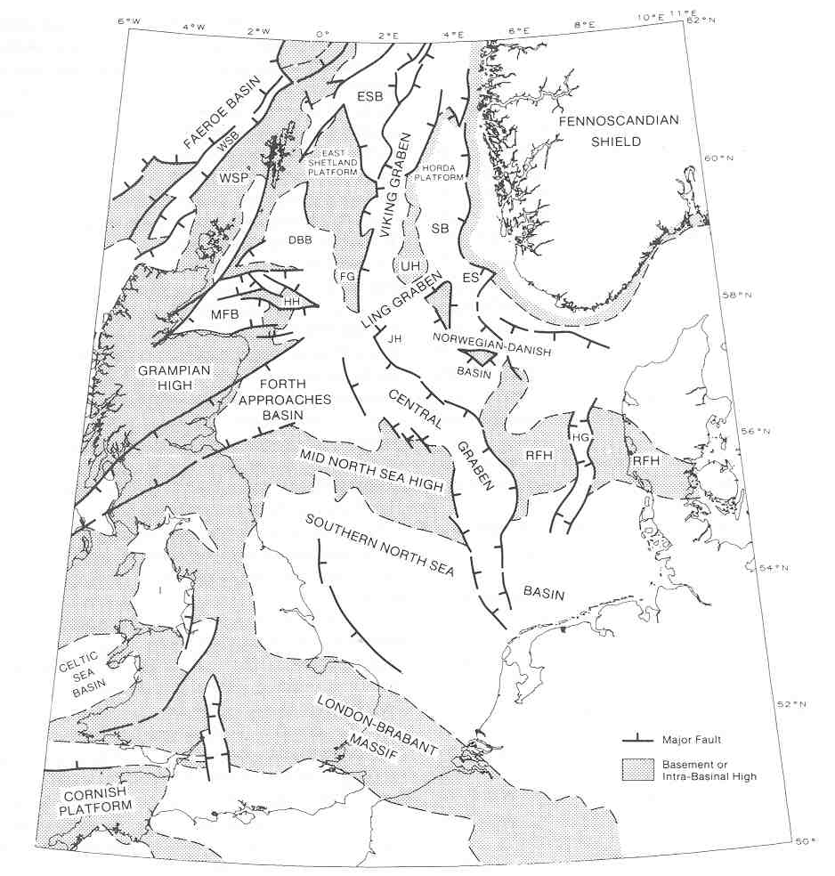
Graben formation in Triassic

Slide 24
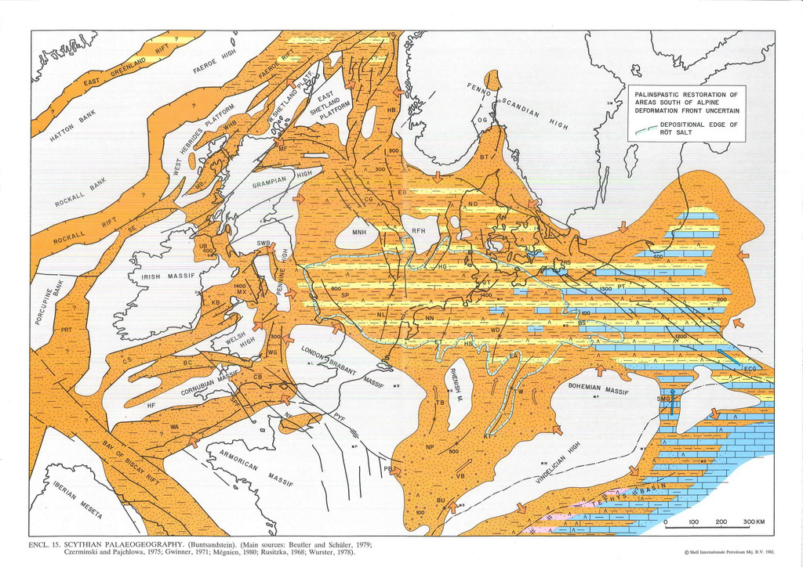
Paleogeography Buntsandstein

Slide 25
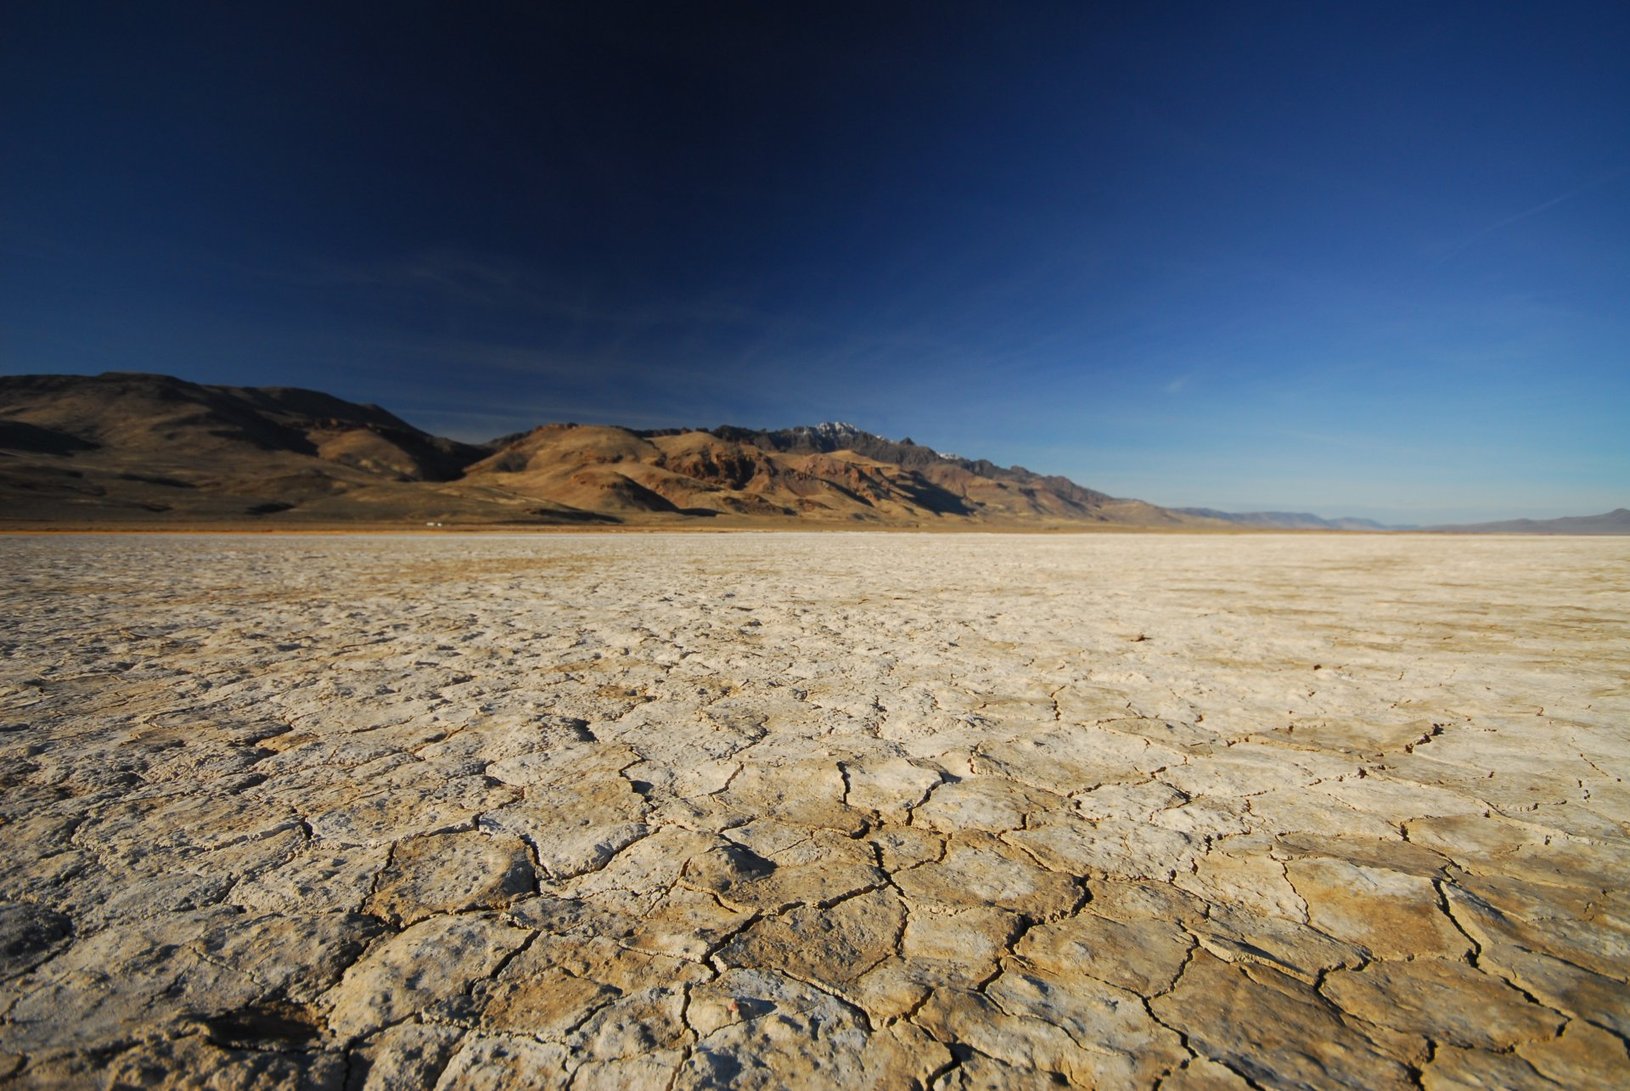
Buntsandstein analog: Playa deposits
outdoorproject.com
Alvord Desert & Steens Mountain, SE Oregon. Steens Mtn goes up to 3000 due to recent tectonic activity

Slide 26
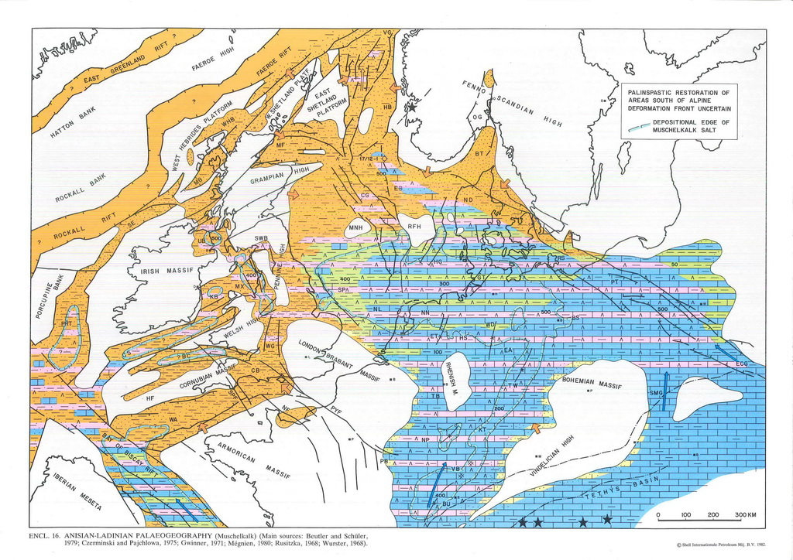
Muschelkalk Paleogeography
Trangression from the east, shallow sea

Slide 27
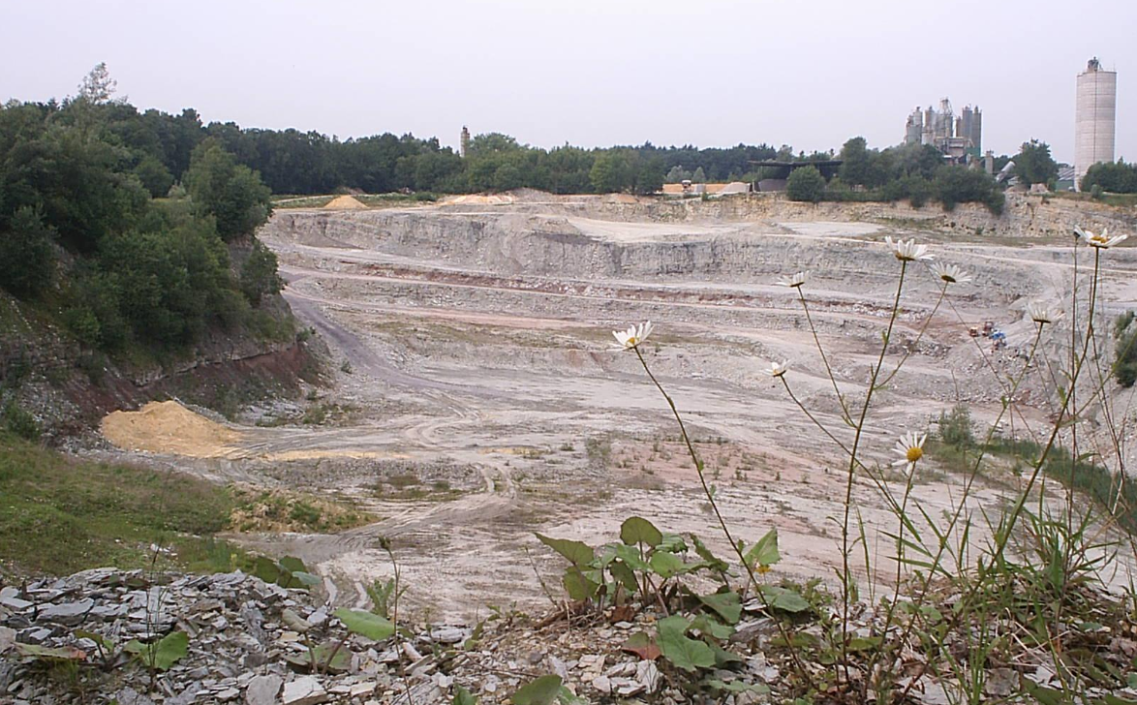
Muschelkalk quarry, Winterswijk, NL

Slide 28
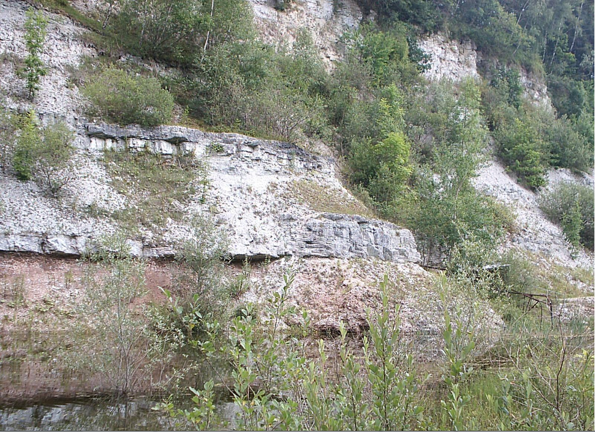
Rhythmic alternations in Muschelkalk

Slide 29
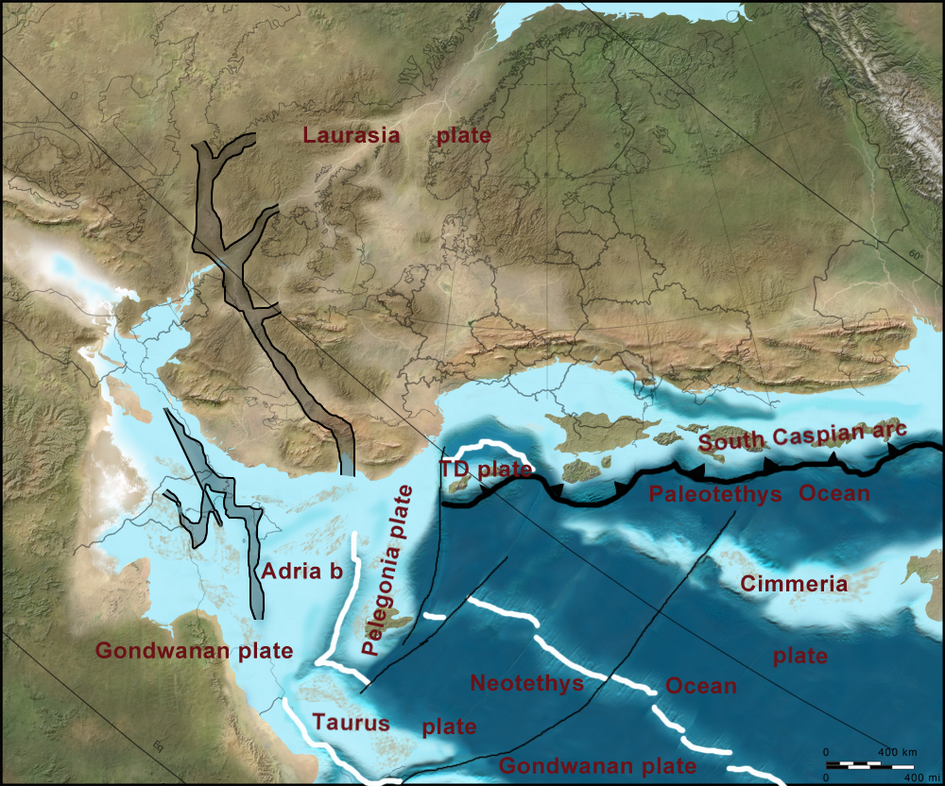
Keuper (225Ma)
Continental conditions as passage to Tethys closes
NW Europe inland lake that often dried up
Sandstones along margins, shales, limestones & evaporites in centre of basin

Slide 30
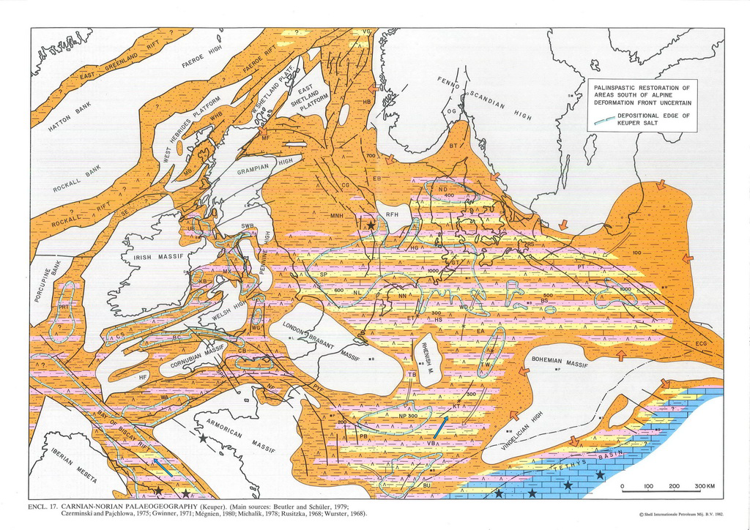
Keuper paleogeography
Regression
Tectonic uplift gave extra sediment, and partly closed off the basin
Deposition of shales, shaly limestones and dolomite and evaporites
Start of Paris Basin

Slide 31
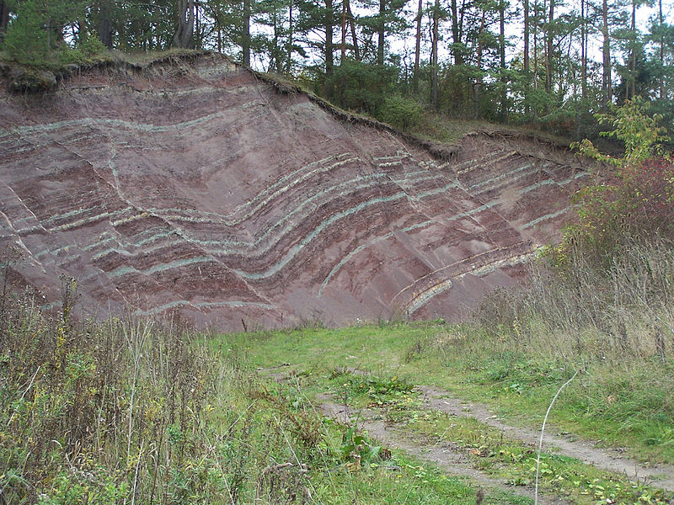
Keuper outcrops Germany
Very soft rocks
often used for agriculture
wikipedia
Triassic ends with
extinction (50% of
vertebrates disappear)
- transgression
www.muschelkalkmuseum.de

Slide 32
Structure Central Graben North Sea
Tertiair
Boven Jura
L & M Jura
Trias
Perm
Wong et al, 2007
Permian: Extensional faulting Rotliegendes level
Triassic: Quiet period, start formation Central Graben
Jurassic: Extensional faulting creates strong subsidence Central Graben
Zechstein salt diapirs active till base Tertiary
Inversion end Cretaceous
Tertiairy: tectonically quiet

Slide 33
Early Jurassic (Lias)
Open marine basin
Deposition of shales in large parts of North Sea area
Limestones in south (Paris Basin)
Sandstones in Luxembourg

Slide 34
Luxembourg sandstone
In the NE corner of the Paris basin, sand from the Eifel and Ardennes Paleozoic massifs were deposited in a shallow marine bay as a thick pile of sandstones: the Luxembourg sandstones
McCann 2008
http://www.sandatlas.org

Slide 35
Jurassic rifting (in North Sea)
Trilete rifting system starts in Jurassic
Three rifts: Central Graben, Viking Graben & Moray Firth
Exact direction of extension not well known
May have had strike slip component
http://www.jonbryon.com/nsea.html

Slide 36
Posidonia shale
Basinfloor becomes anoxic
Deposition of Posidonia shale
Important source rock for oil in NW Europe

Slide 37
Posidonia Shale
Liassic source rock known as Posidonia Shale (Early Toarcian)
Outcrops in North Germany (Vehrte) and S-Germany (o.a. Holzmaden, below)
Holzmaden famous for fossils (see stairwell 2nd & 3rd floor AES)

Slide 38
Posidonia source rocks

Slide 39
Other source rock:Kimmeridge Clay burning in 2000 at Burning Cliff

Slide 40
Up to 70% organic material...

Slide 41
Late Jurassic-Early Cretaceous source rocks

Slide 42
Cross section Netherlands SW - NE
West Netherlands
basin
Central
Netherlands Basin
Lower Saxony
Basin
L-Krijt
U-Jura
Chalk
L-M Jura
Carboon
Zechstein
Trias
far less subsidence and inversion
Jurassic thickest in basin =>
basin formed during Jurassic.
Strong inversion basin at base and end of Cretaceaous

Slide 43
Early Cretaceous tectonics
Strike slip component in North Sea area
After McCann 2008

Slide 44
Early Cretaceous Paleogeography
Regression
Continental / shoreface deposits in NL
Reservoir rocks of Vlieland sst & Bentheimer sst

Slide 45
Bentheimer sandstone quarry, Germany
(Valanginian, Early Cretaceous)
Oil reservoir Schoonebeek
Important building stone

Slide 46
Bentheimer building stone
Bentheimer sandstone
Limestone from Ardennes
Bricks

Slide 47
Palace on Dam square, Amsterdam
Bentheimer sandstone

Slide 48
West Netherlands Basin stratigraphy Early Cretaceous
Open Marine
Coastal sands
Marl
Coastal plain

Slide 49
Late Cretaceous
Rifting continues west of UK
Very warm period
Transgression
Most of Europe flooded
Iberia collides with S-France
Alpine orogeny takes off

Slide 50
Late Cretaceous
Very warm climate
Very high sea level
Little erosion
Massive limestone deposits worldwide

Slide 51
Chalk, Late Cretaceous
Deep marine pelagic limestones

Slide 52
Chalk
Chert

Slide 53
Maastrichtian marls Limburg
ENCI groeve

Slide 54
Late Cretaceous tectonics
Alpine orogeny has effect on northern Europe as well.
Original transtensional basins now suffer transpression: inversion along some faults
This leads to uplift and erosion
Inversion also creates anticlines: oil fields

Slide 55
Petroleum Systems Netherlands
Brent

Slide 56
North Sea: Netherlands,Norway & UK
Several oil- and gas fields in and around Central Graben
Most have Kimmeridge clay as source rock
All in extension related structures (example Gullfaks).

Slide 57
North sea oil example: Brent
One of the first and most productive fields in North Sea
Named after waterbird by Shell (Brent goose) but also acronym for reservoir formations: Broome, Rannoch, Etive, Ness & Tarbert
Regressive/transgressive delta sequence from the Late Jurassic
Classical setting in extensional tilted blocks
pg.geoscienceworld.org

Slide 58
North Sea gas example: Troll
Holds 40% of Norwegian gas (and some oil), 1410.9 billion m³ gas
3 fields in Jurassic sandstones in tilted blocks
Source: Draupne shales (kimmeridge eq)
Water depth 300 m, Troll A platform largest structure ever moved (432 m high)
http://www.naturalbornbirder.com
Bretan et al 2011
http://www.amusingplanet.com
Eiken et al, 2008

Slide 59
Ekofisk
Oil field in Norwegian sector
Reservoir in Late Cretaceous chalk
High porosities, but with continued production, porosity became much less and led to subsidence
Platforms had to jacked up by 6 m, a 1 billion $ operation in 1987
offshoreenergytoday.com

Slide 60
Piper Alpha
Worst offshore disaster in North Sea, 1988
Production platform operated by Occidental Petroleum over Piper oilfield
Due to error during maintenance, gas escaped and ignited causing a large explosion and fire, killing 167 people on the platform
Bbc.co.uk
Future?
It is estimated that about 60-70% of the North Sea Oil has been produced
New fields are harder to find, old fields are reworked with new techniques

Slide 61
Paleogene/Neogene:
Starts with mass extinction
Dinosaurs, ammonites and many other disappear
In Netherlands/North Sea mainly marine sedimentation, lots of shales

Slide 62
Paleogeography Oligocene
Deep marine
shallow marine
fluviatile
coast

Slide 63
Miocene in SW NL & NE Germany
Peat deposits
Fluviatile
Coastal sands
Marine clay
Silver sand

Slide 64
Miocene silversand-mining (South-Limburg)
Heksenberg Formation
Foto: H.J.A. Berendsen
Notes:
64

Slide 65
Browncoal, Miocene, Germany

Slide 66
Pleistocene geography
Eridanos river
“Baltic river”
After Berendsen 1997

Slide 67
Glacial retreat Europa
Dutch 2003

Slide 68
Isostatic rebound
Ice
Crust
Mantle
Notes:
Glacio-isostasy

Slide 69
Early Holocene sea level rise and coastal displacement
Late Preboreal, 9000 BP
Early Boreal, 8700 BP
Late Boreal, 8300 BP
Early Atlantic, 7800 BP
Notes:
The present day Doggersbank used to be an island in the Middle North Sea

Slide 70
Till
Sands
Tidal
Peat
Beach ridge
Netherlands
2600 yr BP
De Mulder et al. 2003
Notes:
Paleogeography of the Netherlands, 2600 yr BP (De Mulder et al. 2003).

Slide 71
Meandering rivers
Rivers transport sand and clay to delta/Netherlands
http://siebeswart.photoshelter.com

Slide 72
Conclusions Holocene in NL
Seal level has risen over 50 metres since last ice age, on average 50 cm/1000y (decreasing in time)
Present prediction by KNMI is 30-90 cm in next century
Temperature rise last 10.000yearswas ~0.15ºC/century
Prediction next century~ 2-6ºC rise.
Costline hardly changed last 6000 years because sand was added by sea and rivers.
The river channel-belts constantly changed during the Holocene due to avulsion.
Currently controlled by civil engineers

Slide 73
Next week
Alps & Scandinavia
Study Strike slip & Inversion
General questions about all subjects

