Slide 1
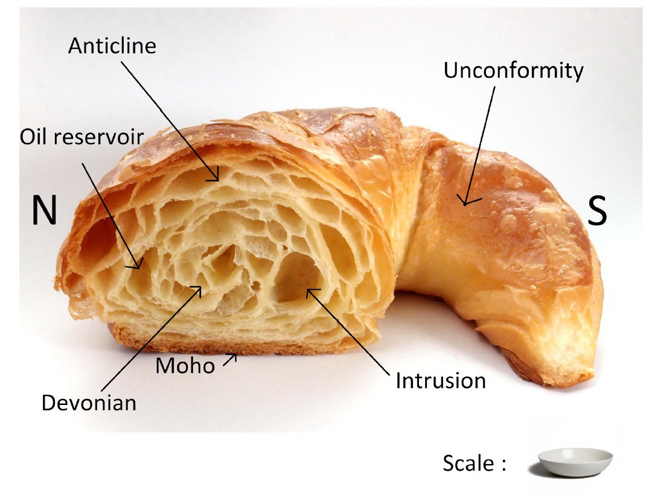
Geology of France

Slide 2
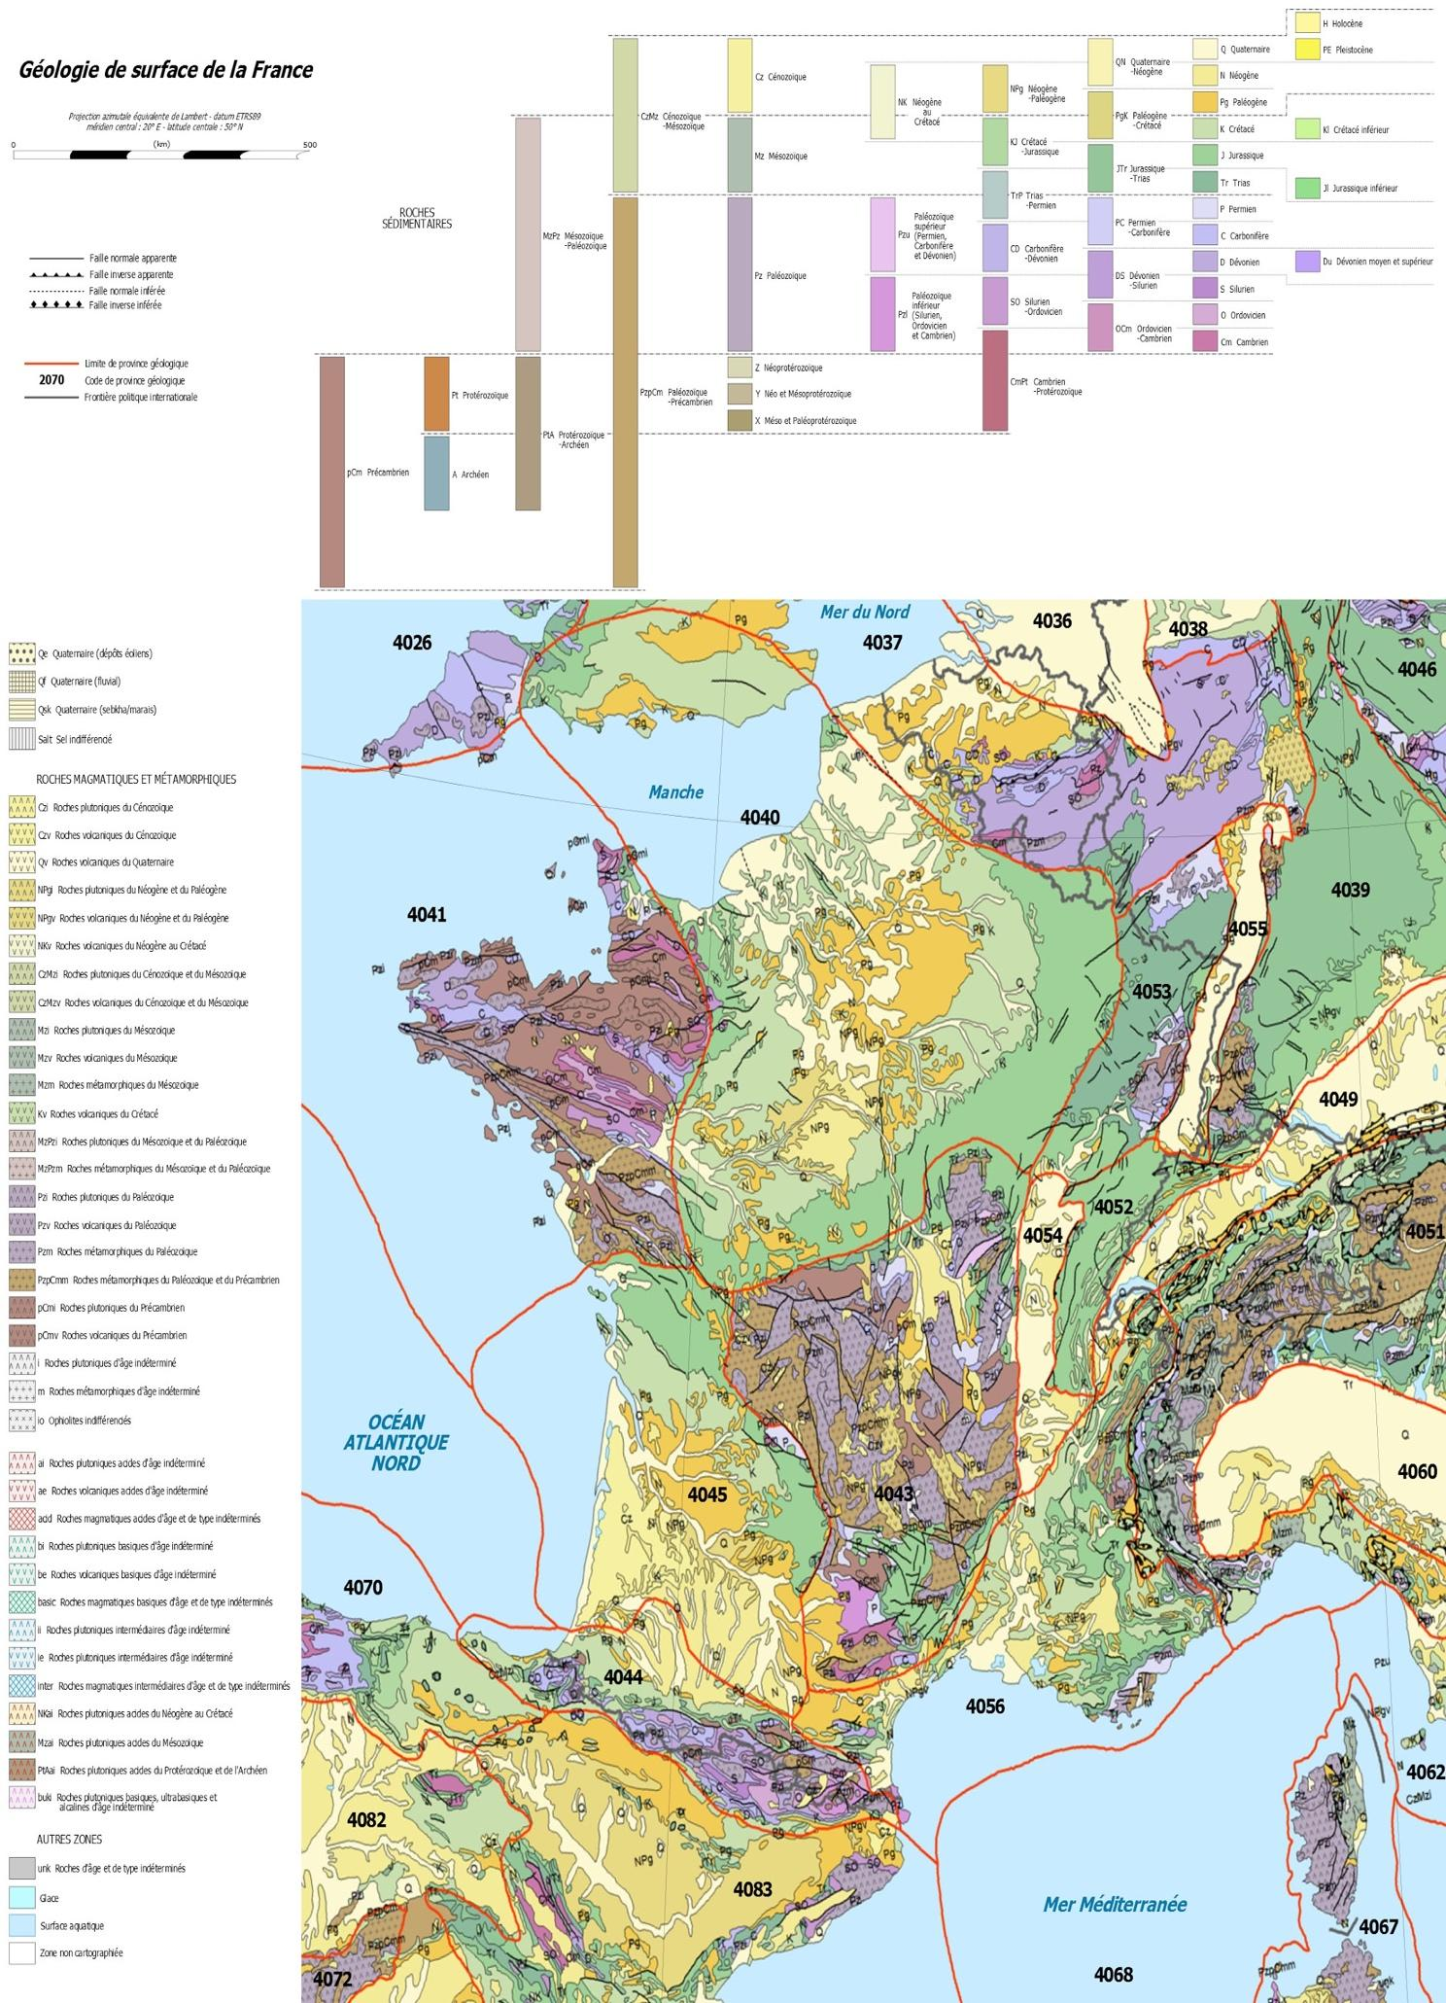
Google Geologic Map France

Slide 3
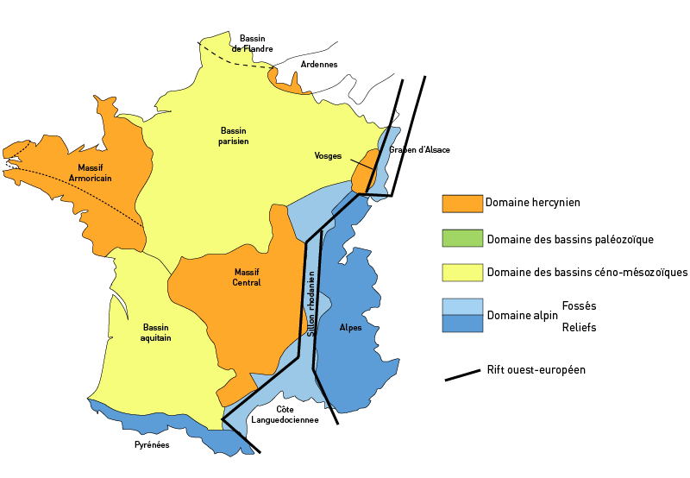
Basically 3 different types:
Old: Hercynian
Middle: Meso/Cenozoic basins
Deformed: Fosse: Ditch (Graben)
Relief: Mountains

Slide 4
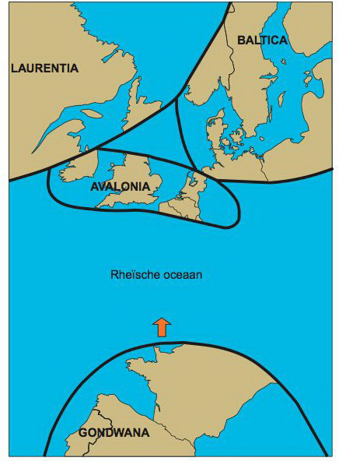
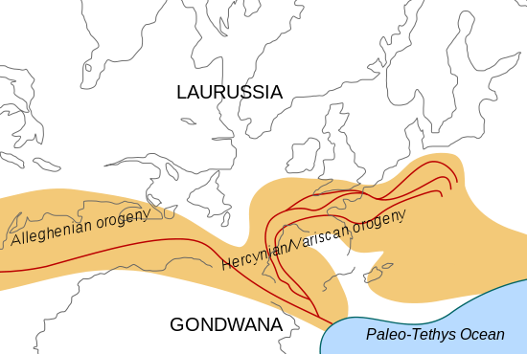
Variscan / Hercynian Orogeny
Belgium was on northern edge of mountain range
France in the middle!

Slide 5
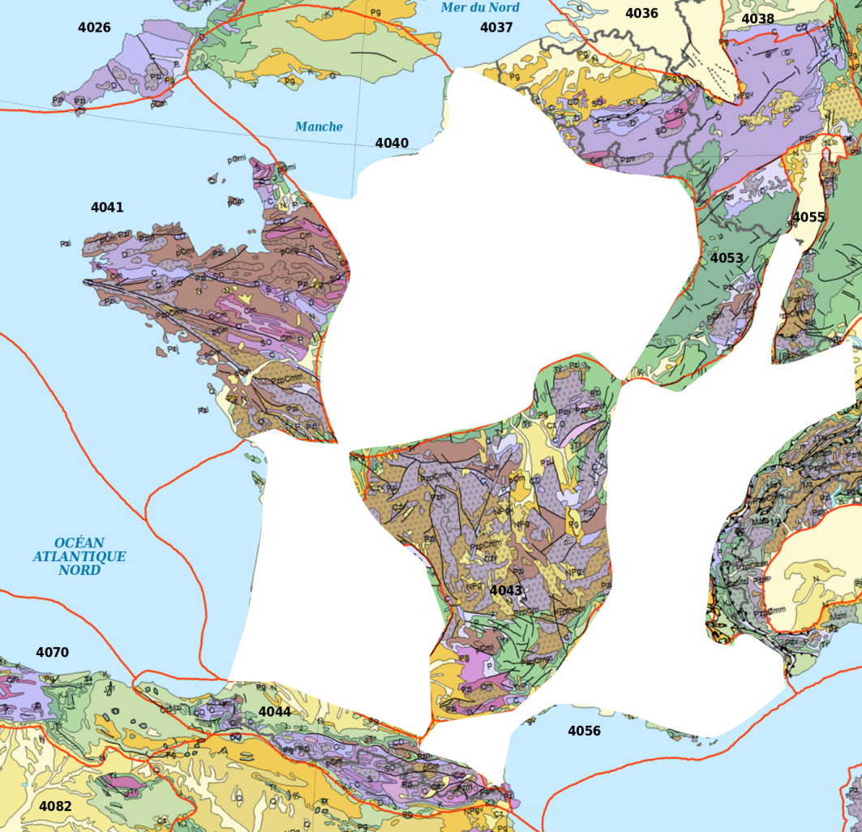
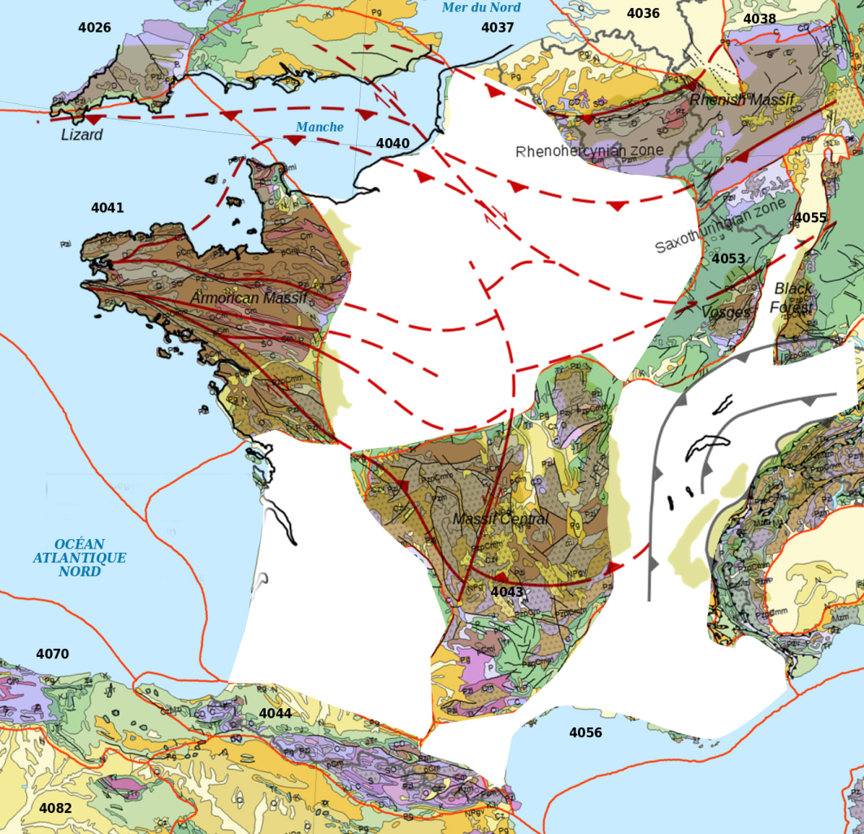
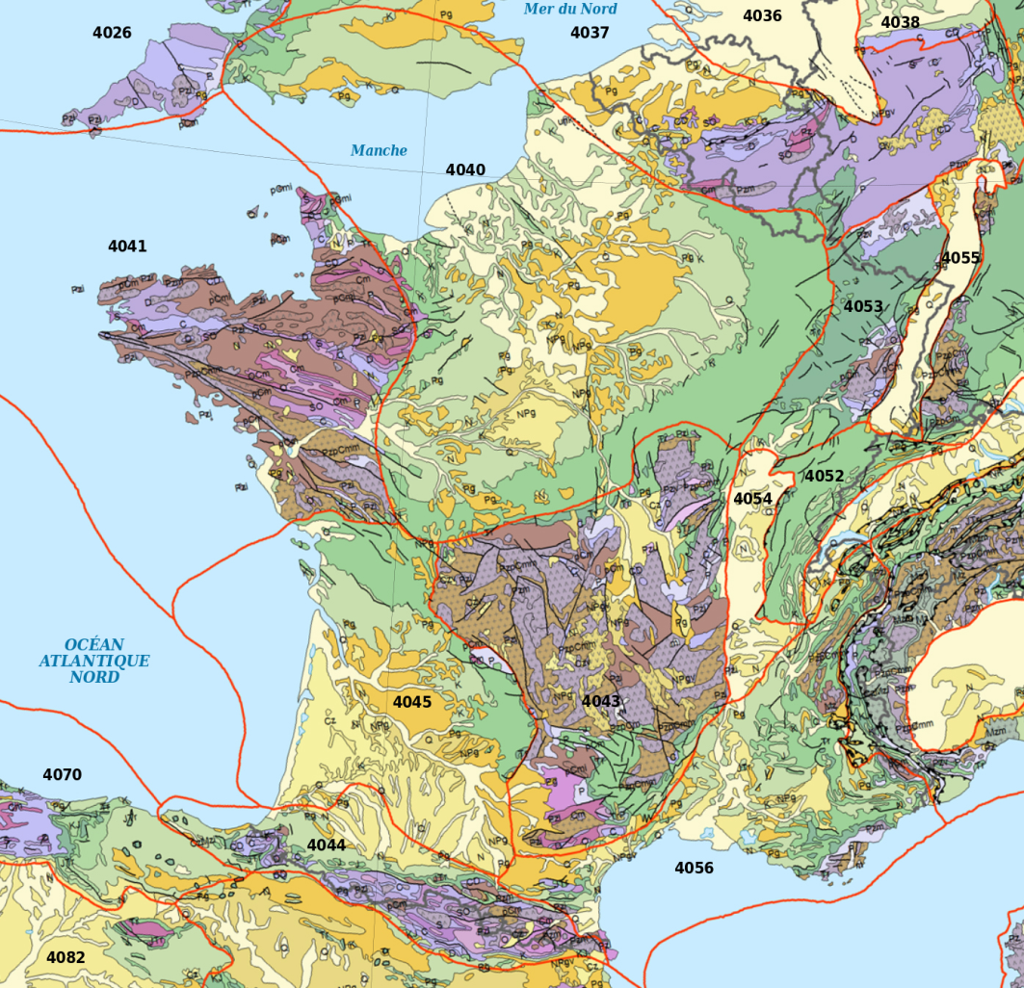

Slide 6
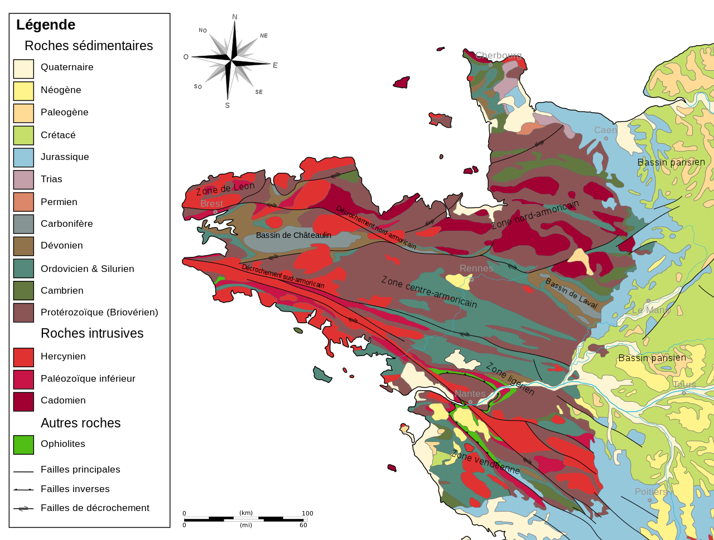
Massif Armoricain

Slide 7
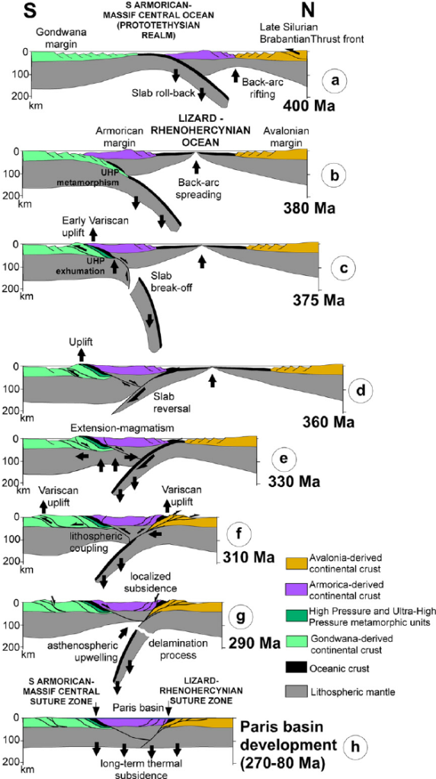
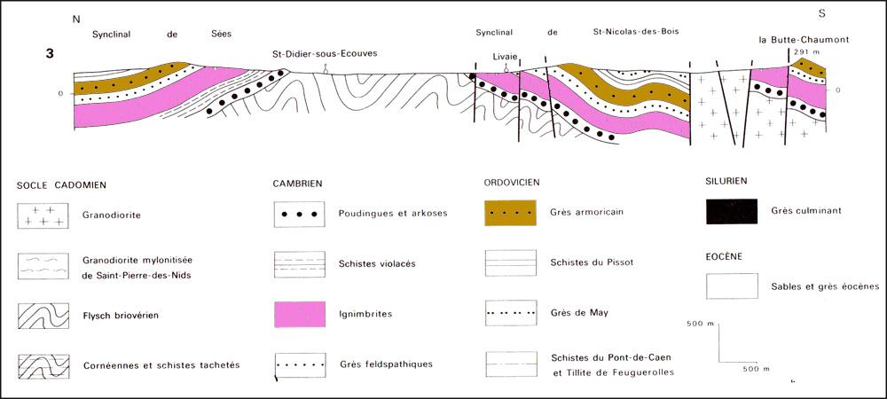
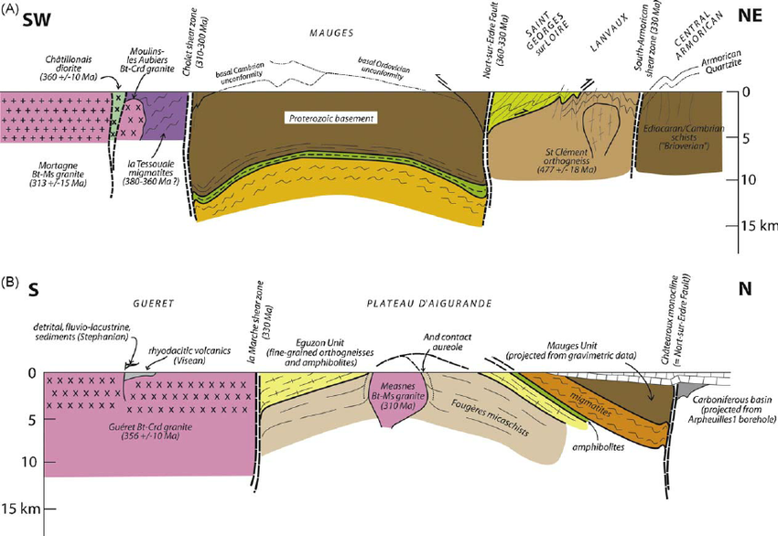
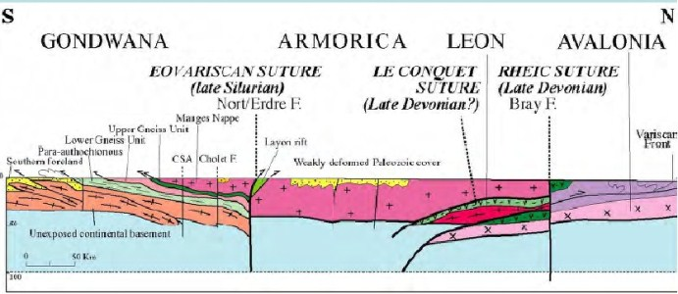

Slide 8
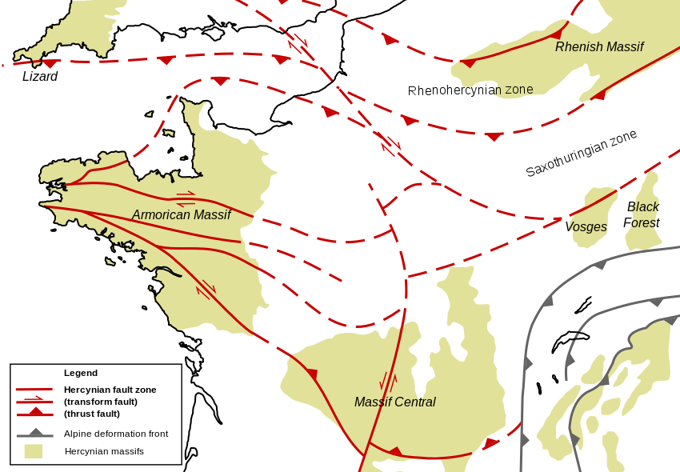

Slide 9
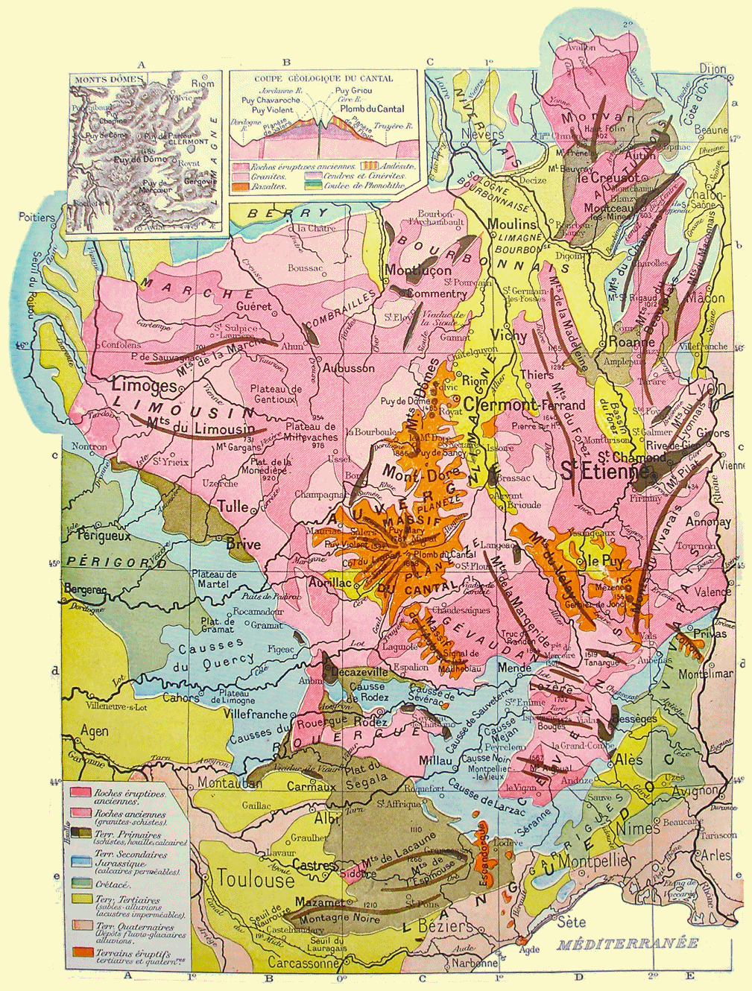
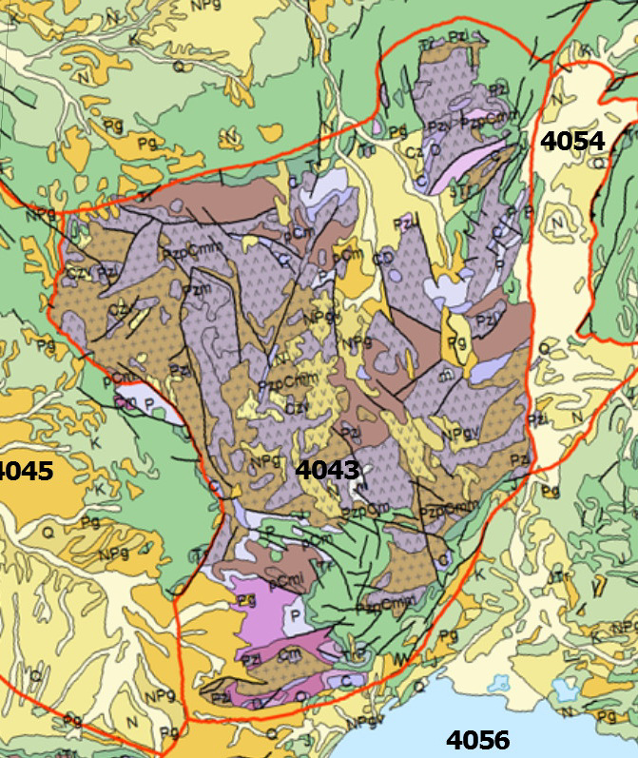
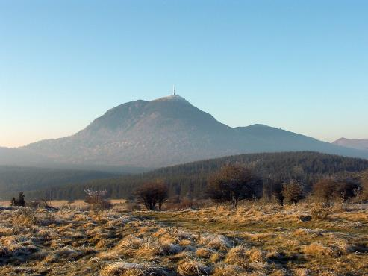
Massif Central

Slide 10
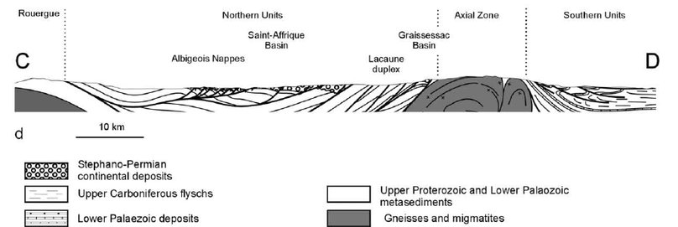
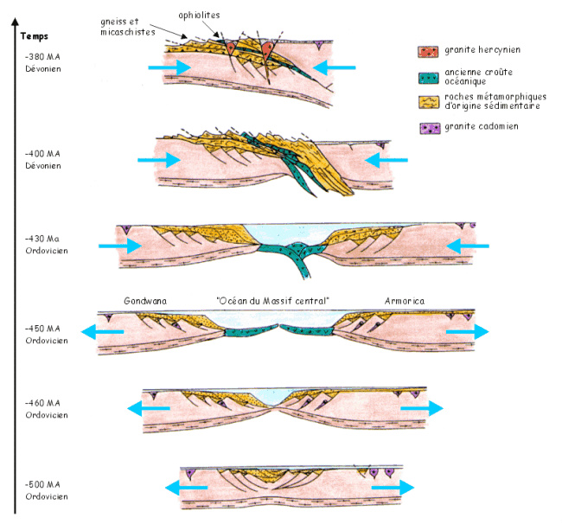

Slide 11
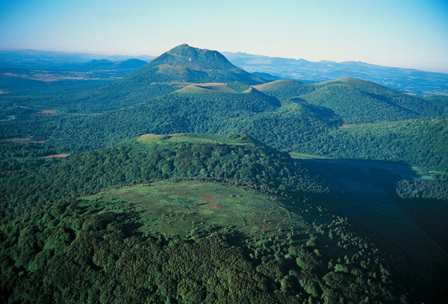
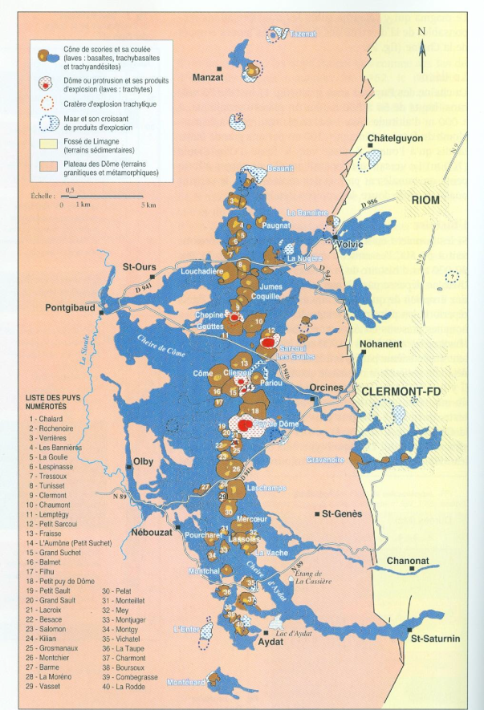
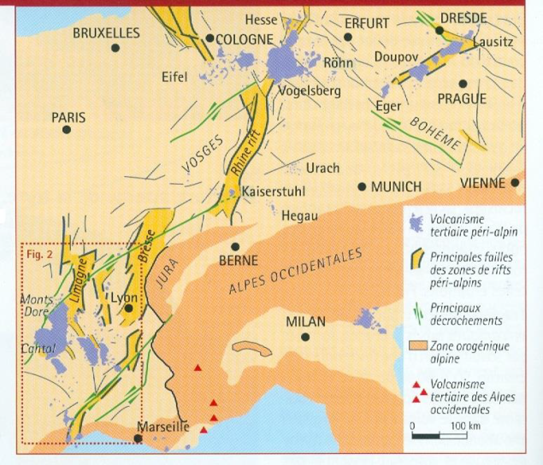
Massif Central: Volcanoes!!

Slide 12
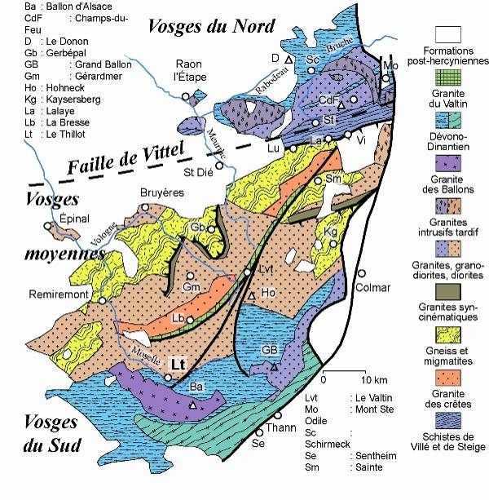
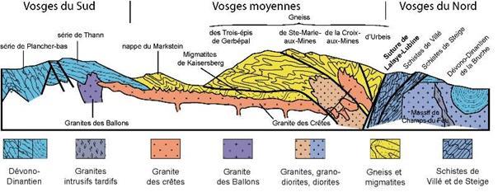
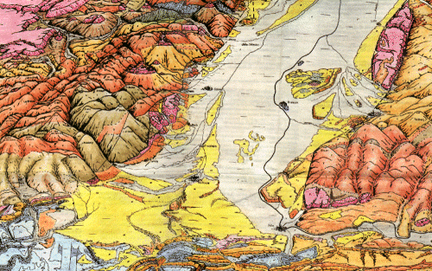
Vosges
Rhine Graben

Slide 13
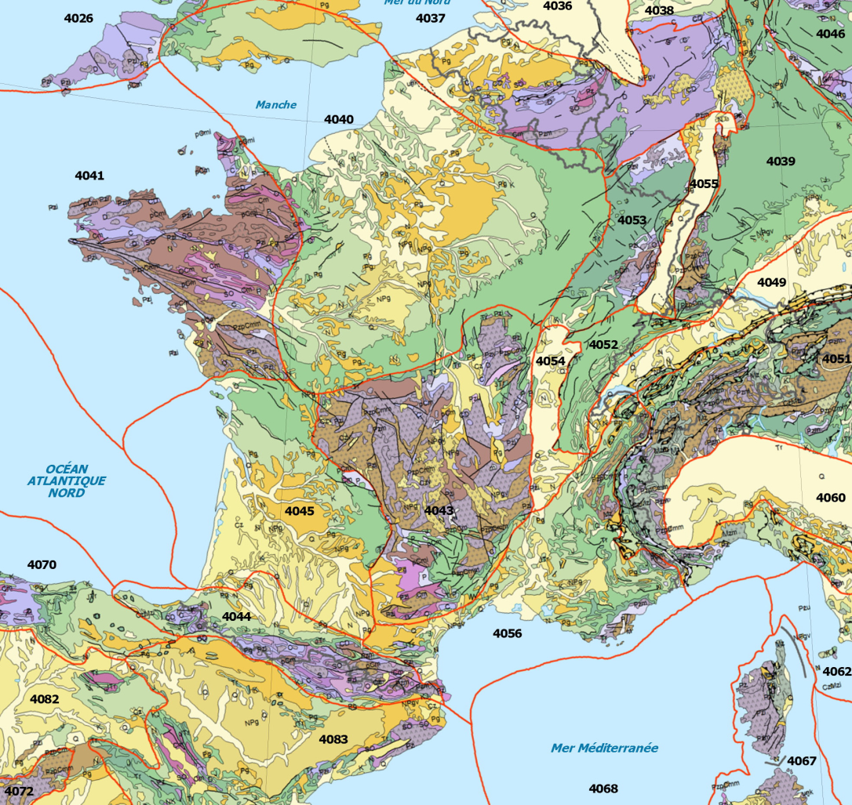
Basins
Paris Basin
Aquitaine
Basin

Slide 14
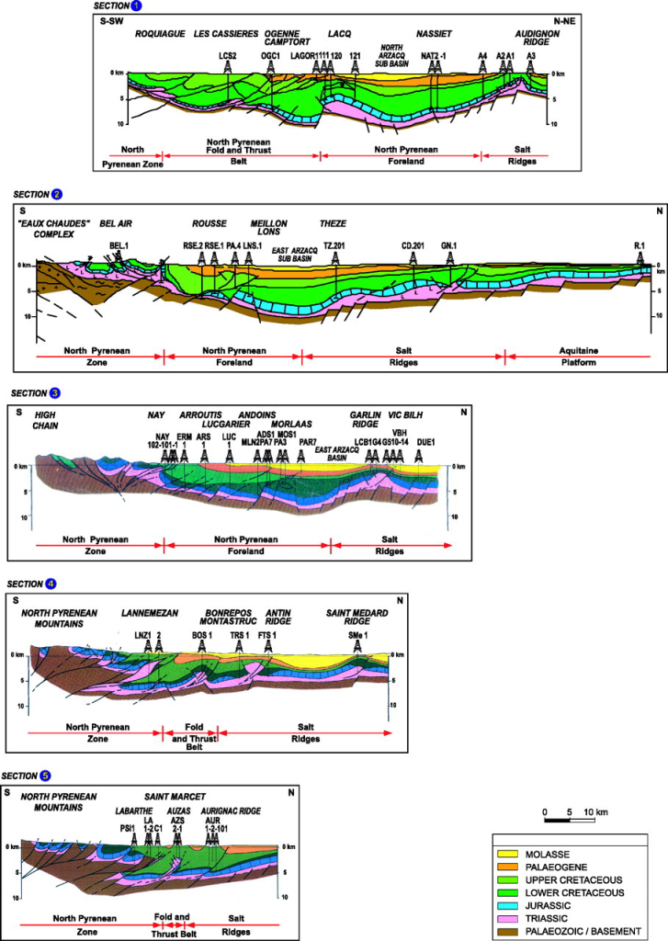
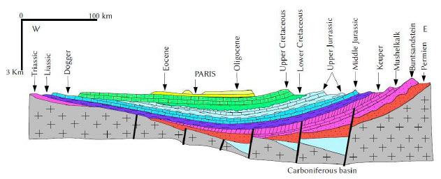
Aquitaine & Paris
Basins

Slide 15
Mountain Belts
Jura
Alps
Pyrenees

Slide 16
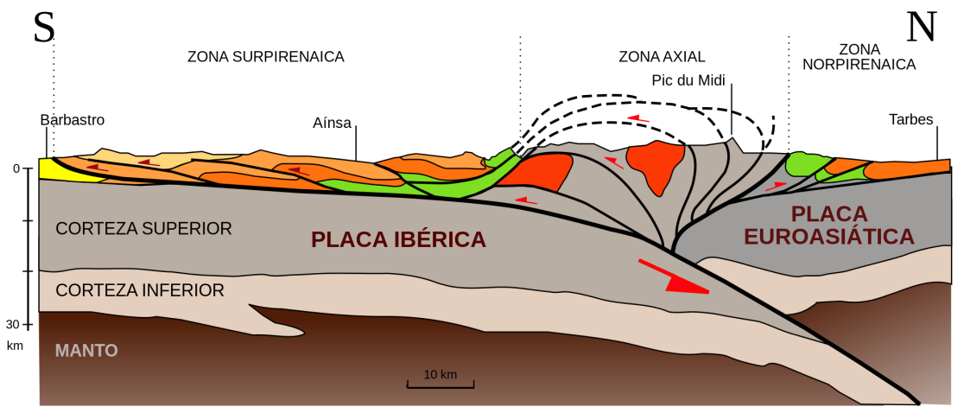
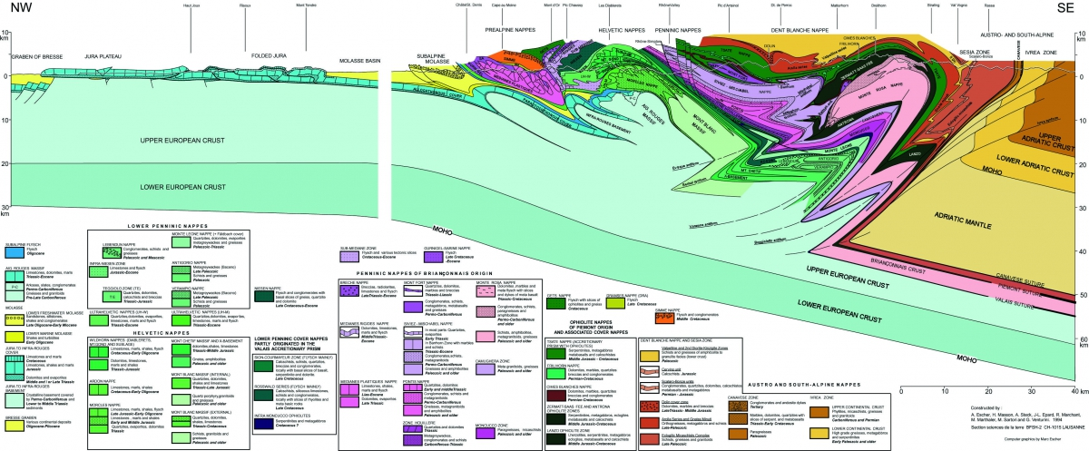
Pyrenees
Alps

Slide 17
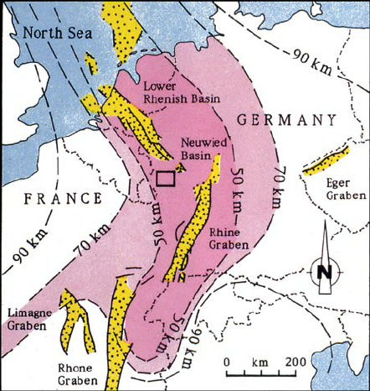
Grabens
Part of West European rift zone
Rhine Graben
Rhone Graben

Slide 18
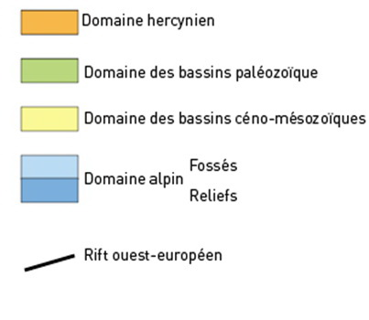
you can state that from the looks of the geologic map, France can be subdivided into three regions: The Variscan (Hercynian) areas, the Ceno-Mesozoic basins and the Alpine area.
The oldest is the Variscan area, which consists of older material which was deformed during the Variscan Orogeny that took place in the Late Carboniferous. It shows (look on the real geologic map) traces of intense deformation (see if you can see direction of the fold axes and determine what they tell you about the deformation!)
After these mountains were eroded part of them were covered by shallow seas, which left basins with subhorizontal sediments deposited during the Meso- and Cenozoic (Paris & Aquitaine Basin).
In the late Mesozoic and Cenozoic, a new Orogeny started, the Alpine Orogeny, due to the collision of Africa, with Iberica and Adria (Italy etc) against Northern Europe. This led to the formation of the Alps and Pyrenees (and to the slight uplift of the Ardennes and possibly the Massif Central and Armorica as well, causing the synclinal shape of the PB).
A second aspect of the Alpine orogeny is a phase of extension in front of the Alpine mountain range, which now is the West European Rift visibly on the map. This caused uplift of its edges, including the Vosges and Massif Central, and the formation of volcanoes along its edges (Massif Central, Eifel in Germany, Kaiserstuhl in Rhine Graben).
This Alpine Orogeny is still ongoing, as is erosion all over France.

Slide 19
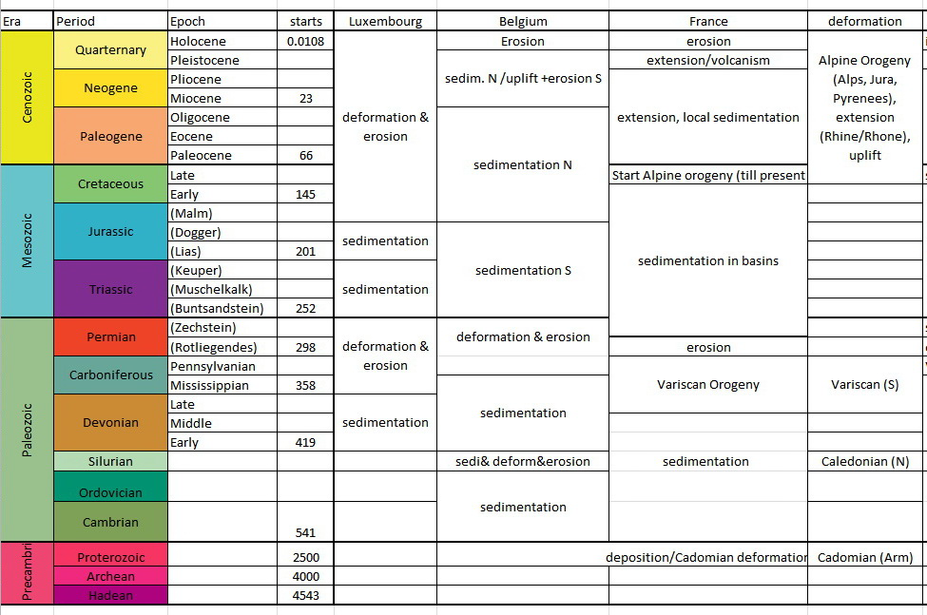

Slide 20
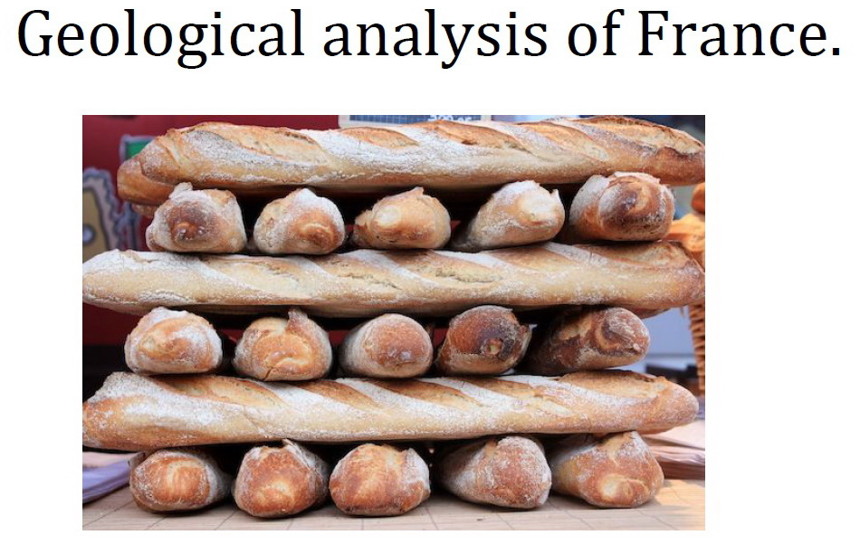

Slide 21
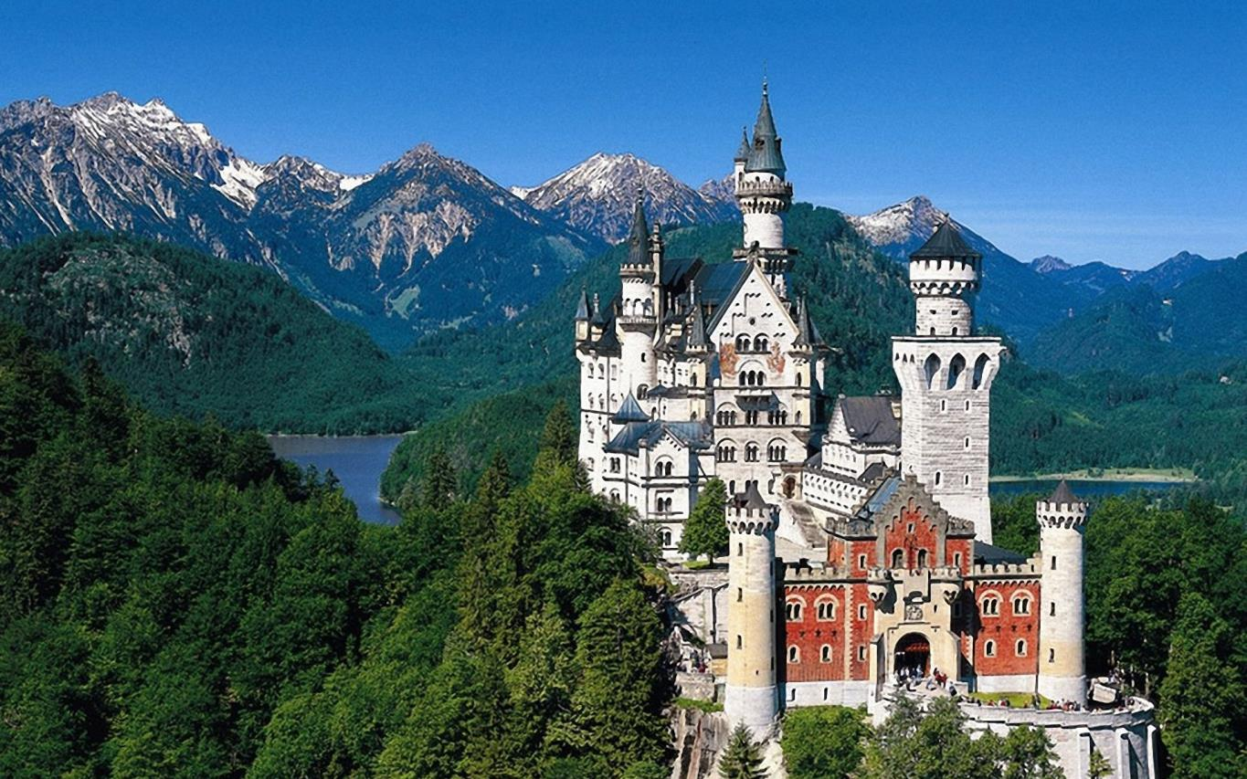
Next week: Germany + Contraction

