Slide 1
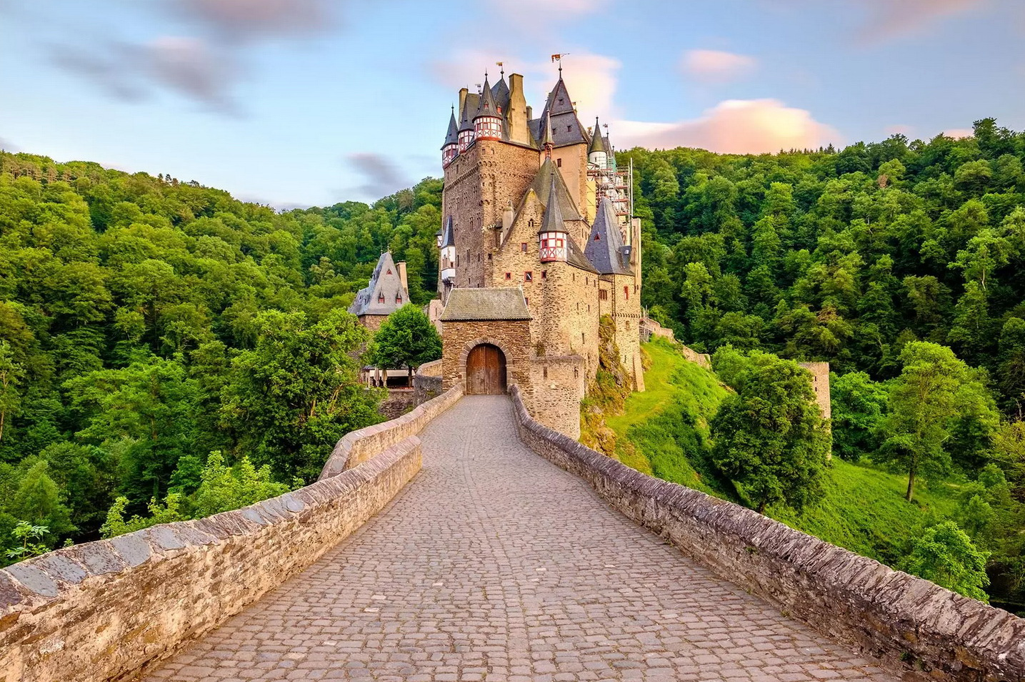
Geology of Germany

Slide 2
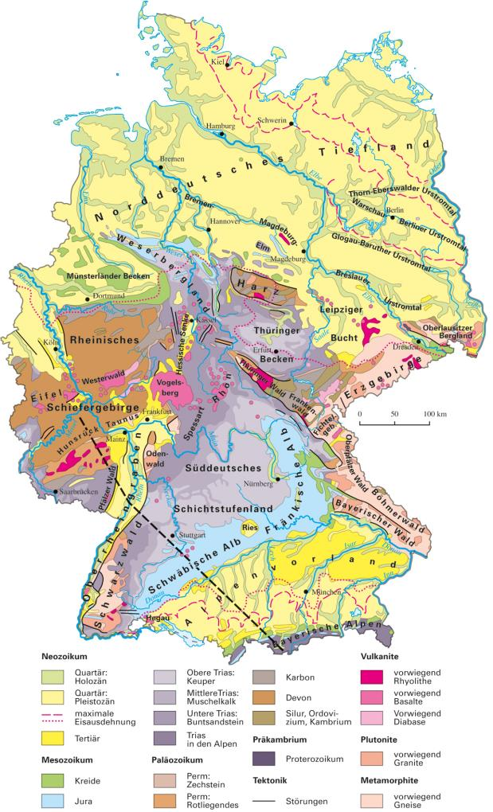
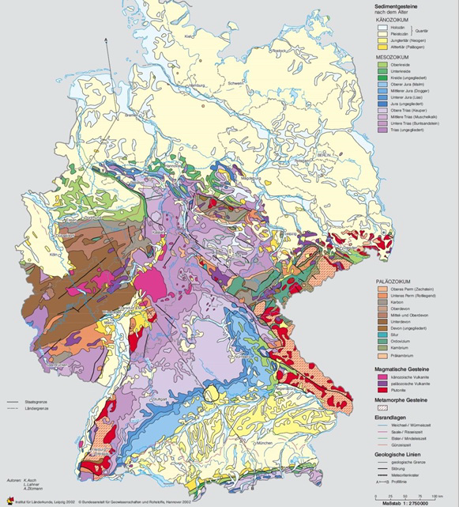
www.mr-kartographie.de
www.bgr.bund.de

Slide 3
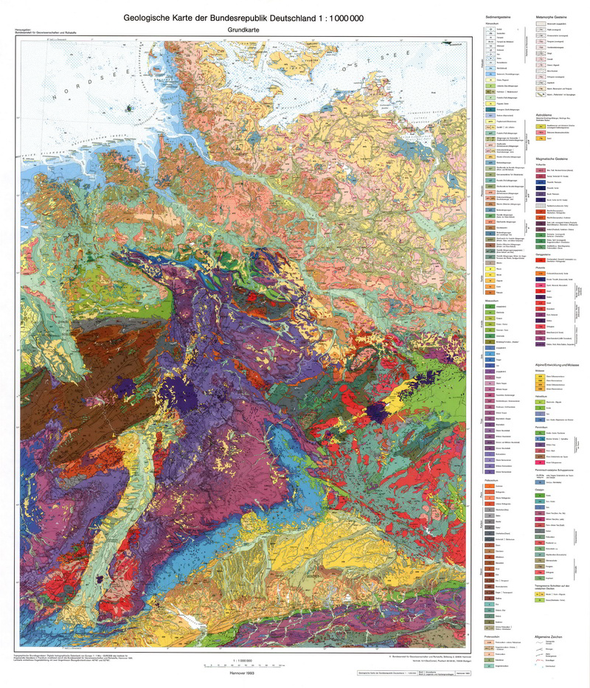
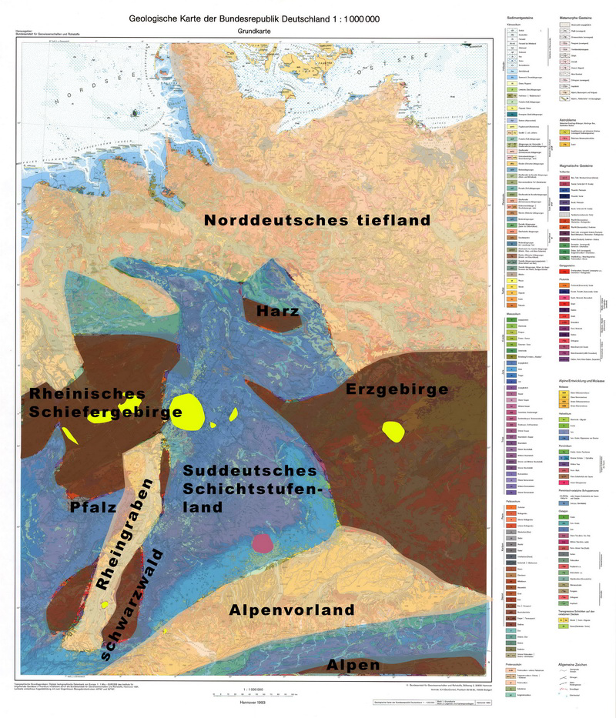
www.bgr.bund.de

Slide 4
www.mr-kartographie.de
www.oberrheingraben.de

Slide 5
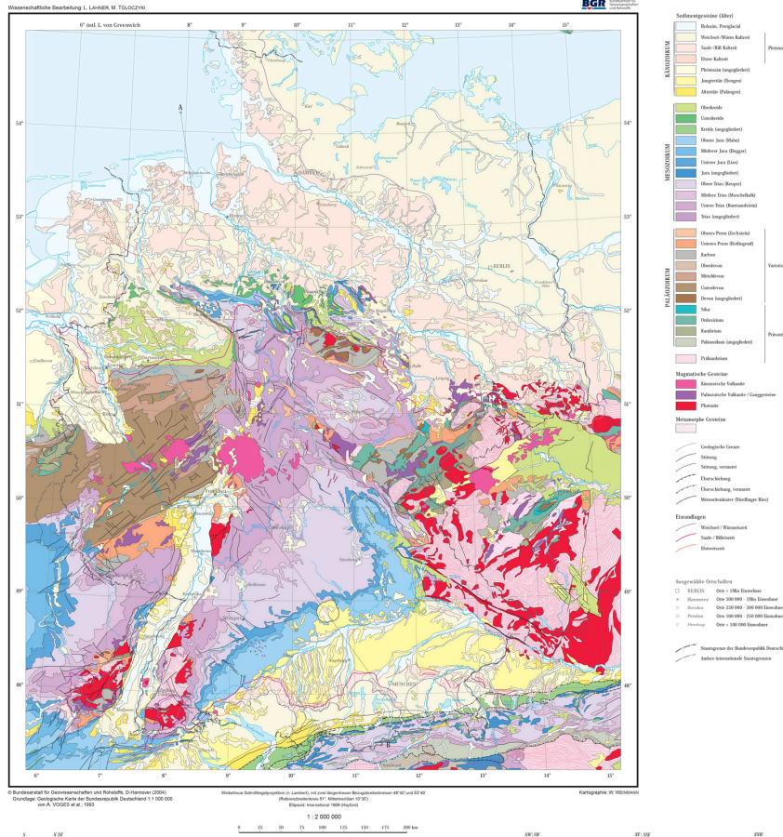
www.bgr.bund.de

Slide 6
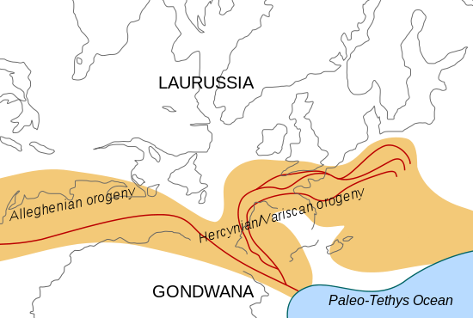
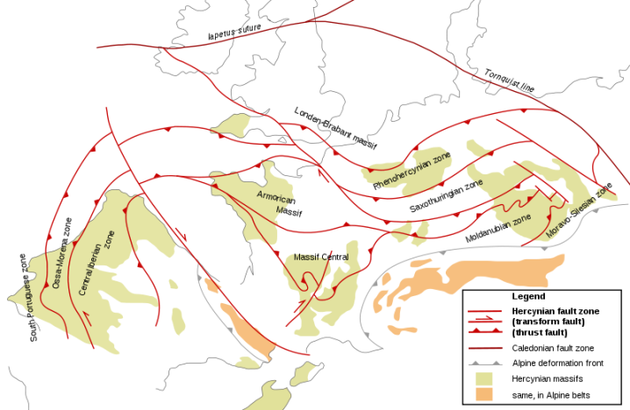
Old parts: Variscan mountains
Large mountain range, from Russia to the US
Most of central Europe involved
Northern limit of deformation just south of Netherlands.
Variscan parts of Germany:
Rheinisches Schiefer Gebirge
Harz
Erzgebirge
Schwarzwald
wikipedia
wikipedia

Slide 7
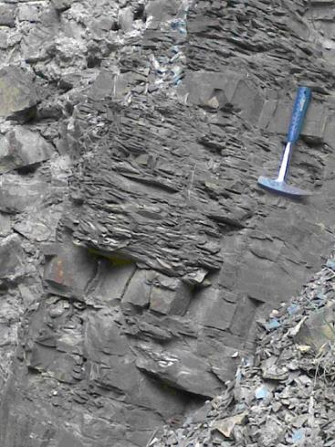
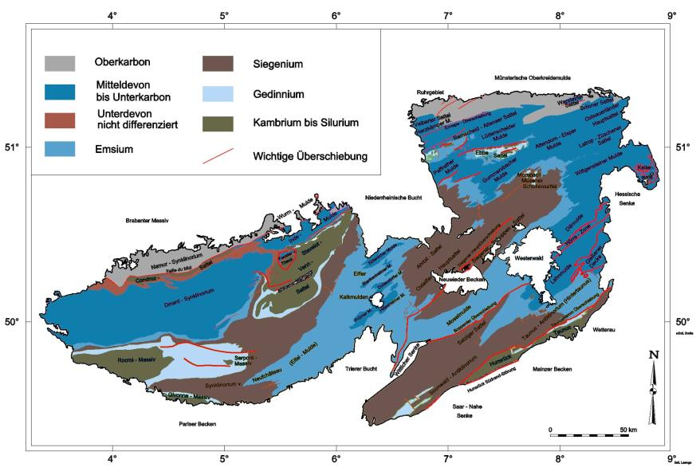
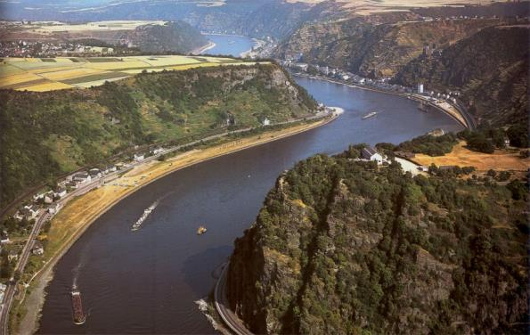
Rheinisches Schiefergebirge (Rhenish Slate Mountains)
Continuation of Ardennes in Germany
Mainly Devonian deep marine shales and slates
wikipedia
Note flat top of hills!

Slide 8
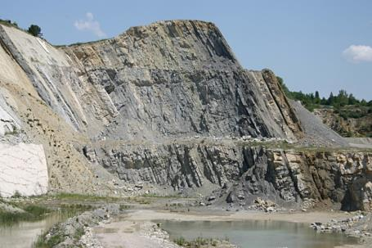
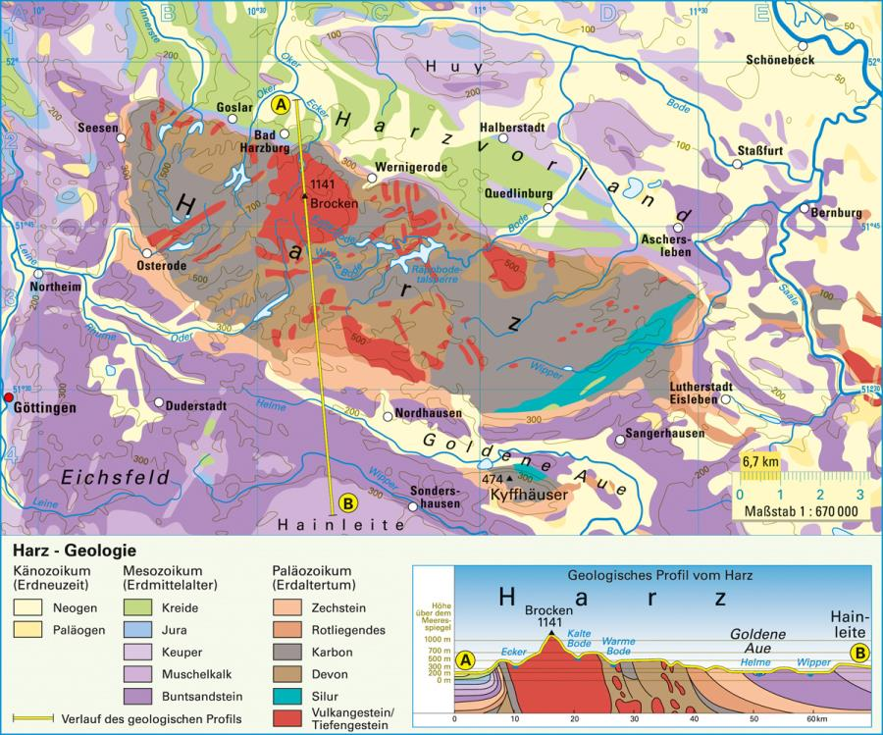
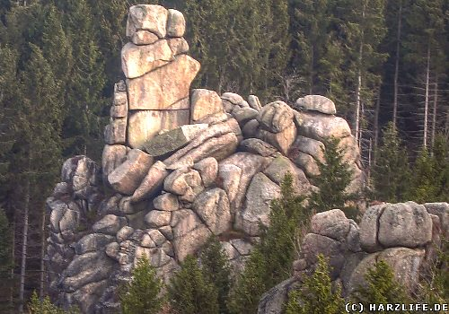
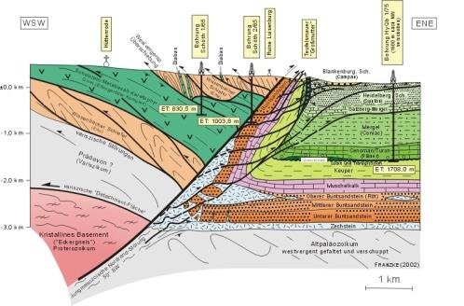
Harz
younger
Variscan massif (similar to Ardennes), but with granite core (Brocken) and overturned N edge.
Uplifted along fault several km since Cretaceous
http://www.mr-kartographie.de

Slide 9
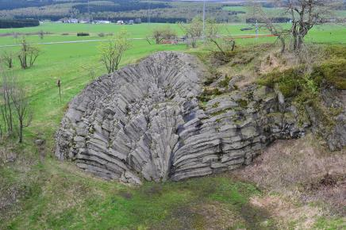
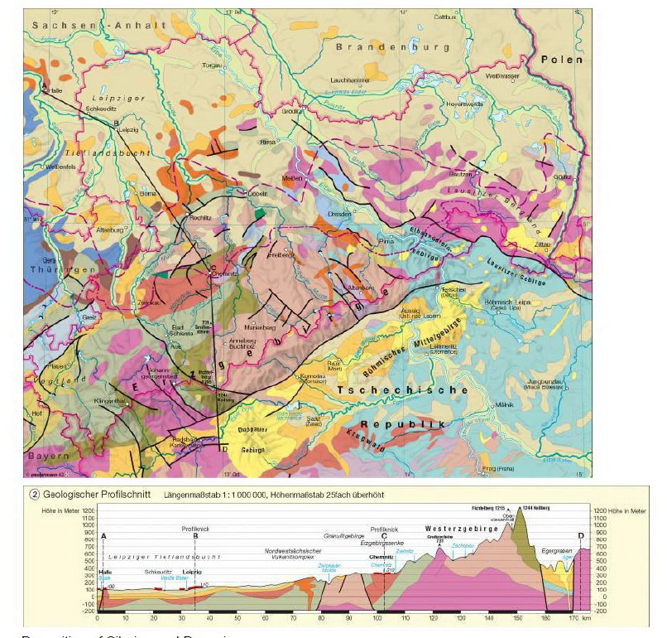
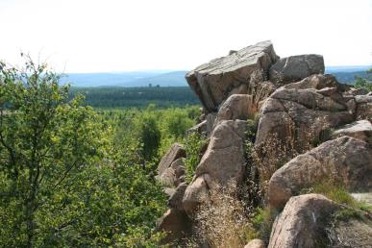
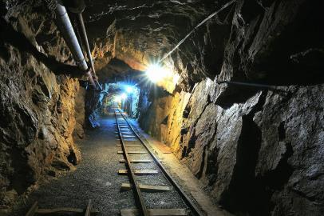
Erzgebirge (Ore Mountains)
Another Variscan Massif, with metamorphic rocks and granite intrusions
Origin of European Mining
http://www.mr-kartographie.de

Slide 10
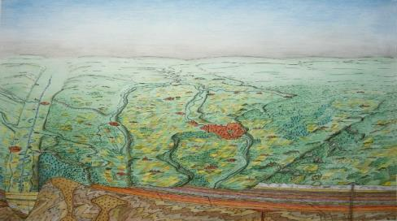
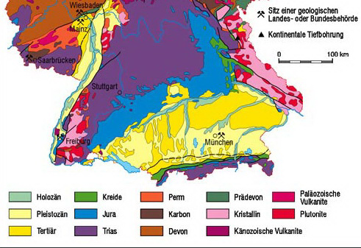
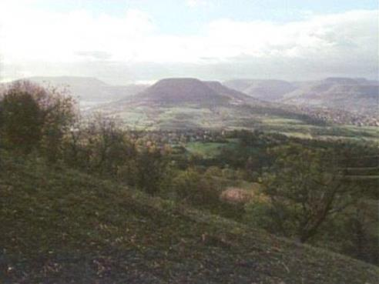
Süddeutsches Schichtstufenland (Southern German Scarp lands)
Series of more or less continuous layers from Mesozoic, slightly tilted toward southeast, giving cuesta landscape,
similar to Paris basin

Slide 11
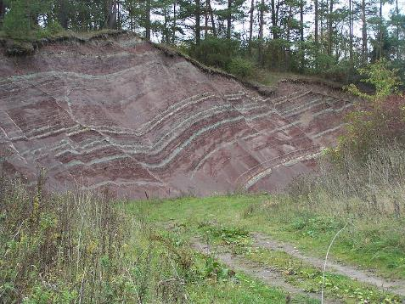
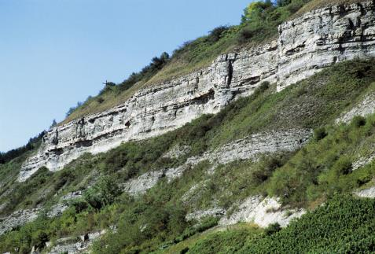
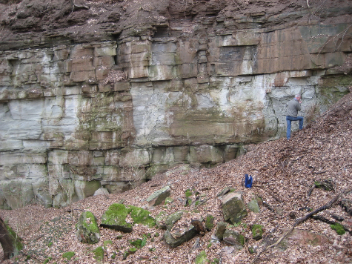
Mesozoic: Triassic
Named by von Alberti (1821) after three rock types outcropping in Germany (old -> young):
Buntsandstein, (Red sandstones , Bunter in UK)
Muschelkalk (Chalky limestones )
Keuper (Dark shales)
Jurassic & Cretaceous
Marine shales &
limestones, some sand

Slide 12
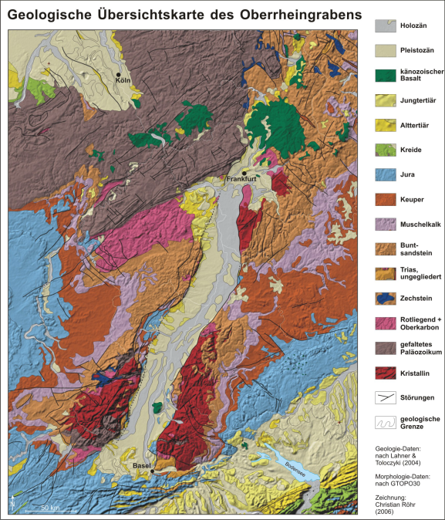
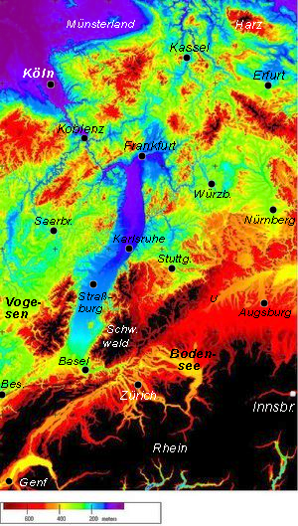
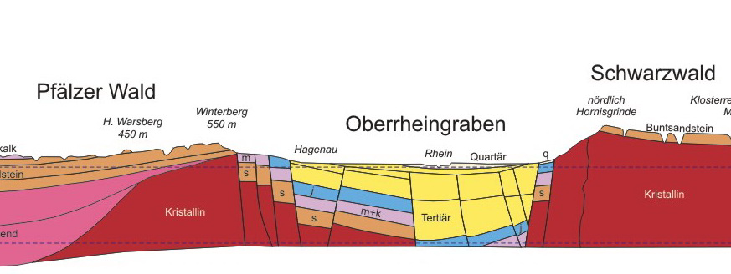
Rhine Graben
Large graben running almost N-S in front of Alps
Active in Cenozoic, some volcanism
Vosges and Black Forest on either side are uplifted about 2.5 km
What is wrong below?

Slide 13
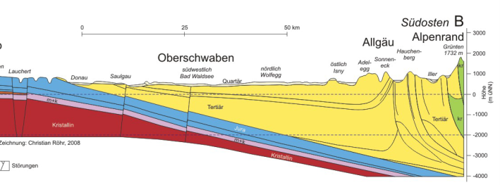
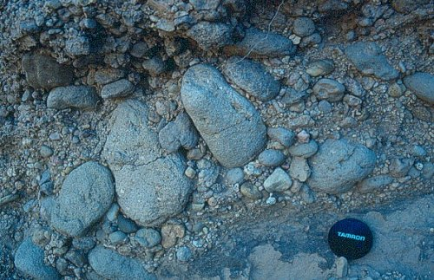
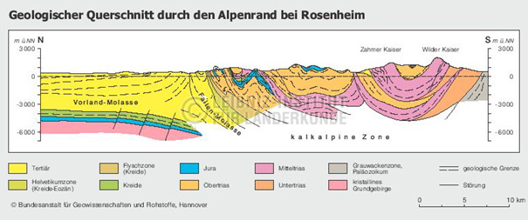
Alpenvorland (Alpine foreland, also known as Molasse Basin)
Formation of the Alps to the south pushes down basement, leading to large basin which is filled with erosional products from Alps, and in which in turn is deformed with continuation of orogeny
http://archiv.nationalatlas.de

Slide 14
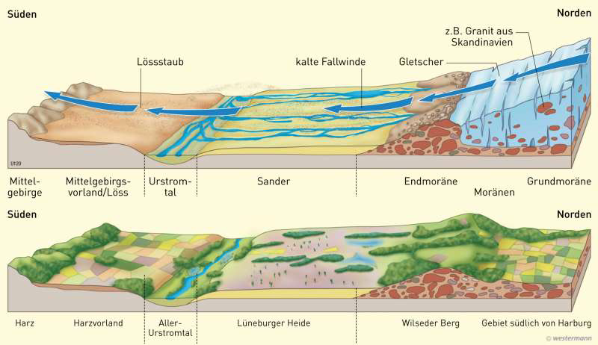
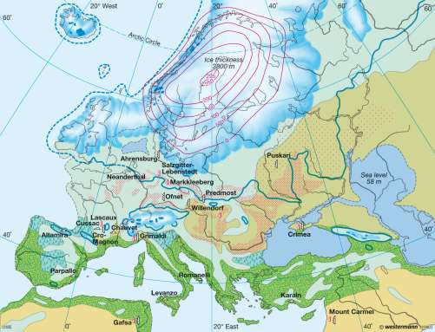
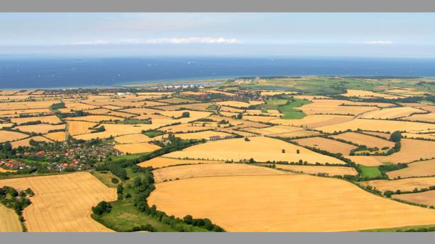
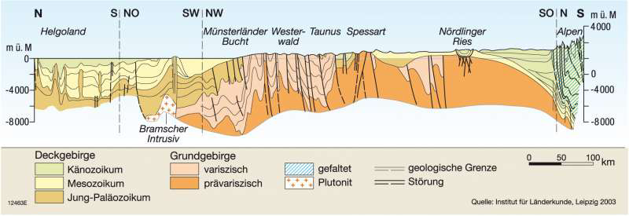
Norddeutsches Tiefland (North German plain)
Thick sequence of mainly marine sediments, deposited since the Permian.
Some salt diapirism of Permian Zechstein salt in N
Surface largely influenced by Neogene ice ages
www.diercke.de

Slide 15
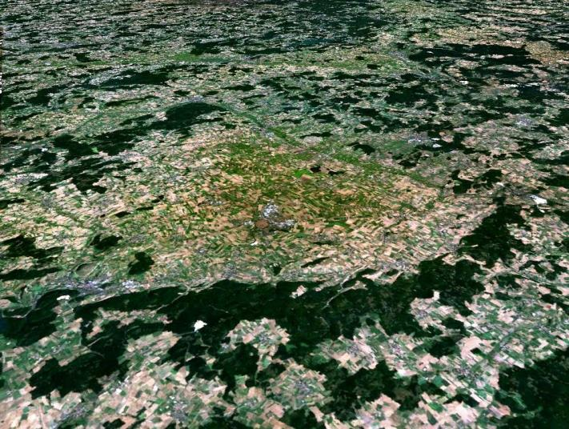
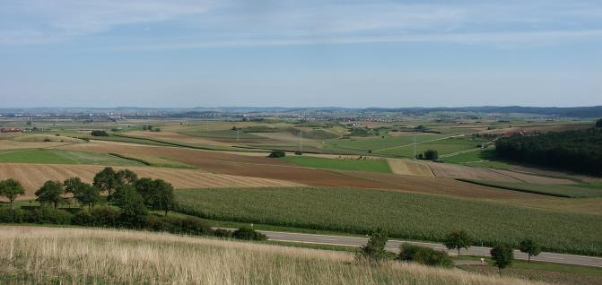
Ries crater
Large meteorite impact crater from Miocene
Diameter 24 km, now about 150 m deep

Slide 16
www.bgr.bund.de

Slide 17
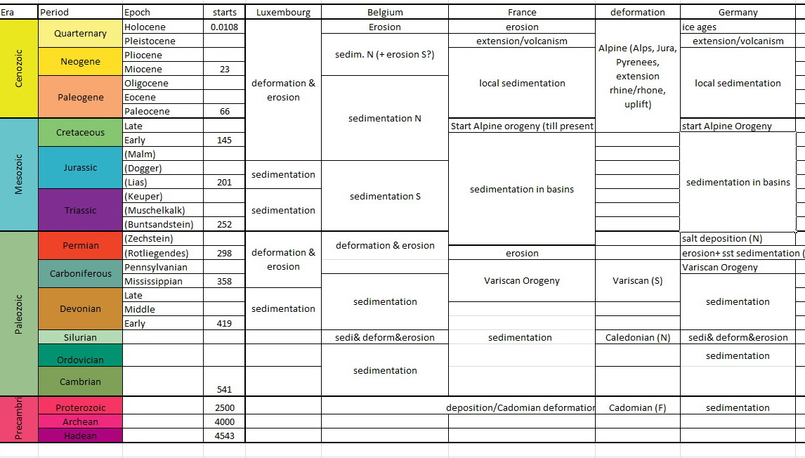

Slide 18
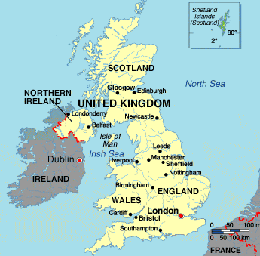
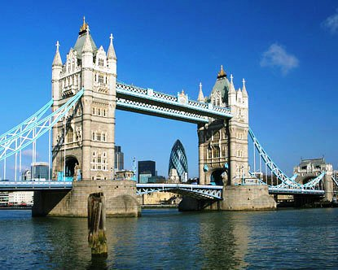
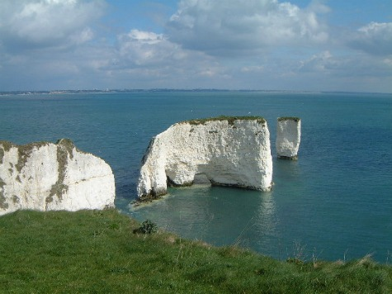
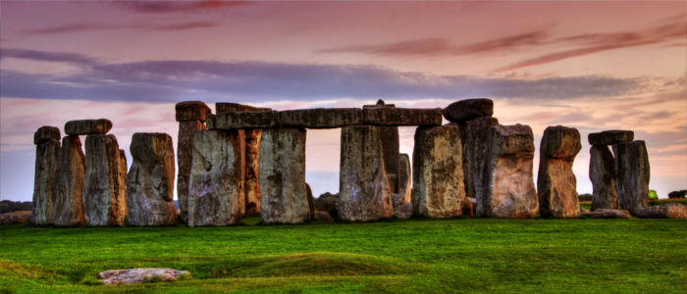
Next week: UK & Ireland

