Slide 1
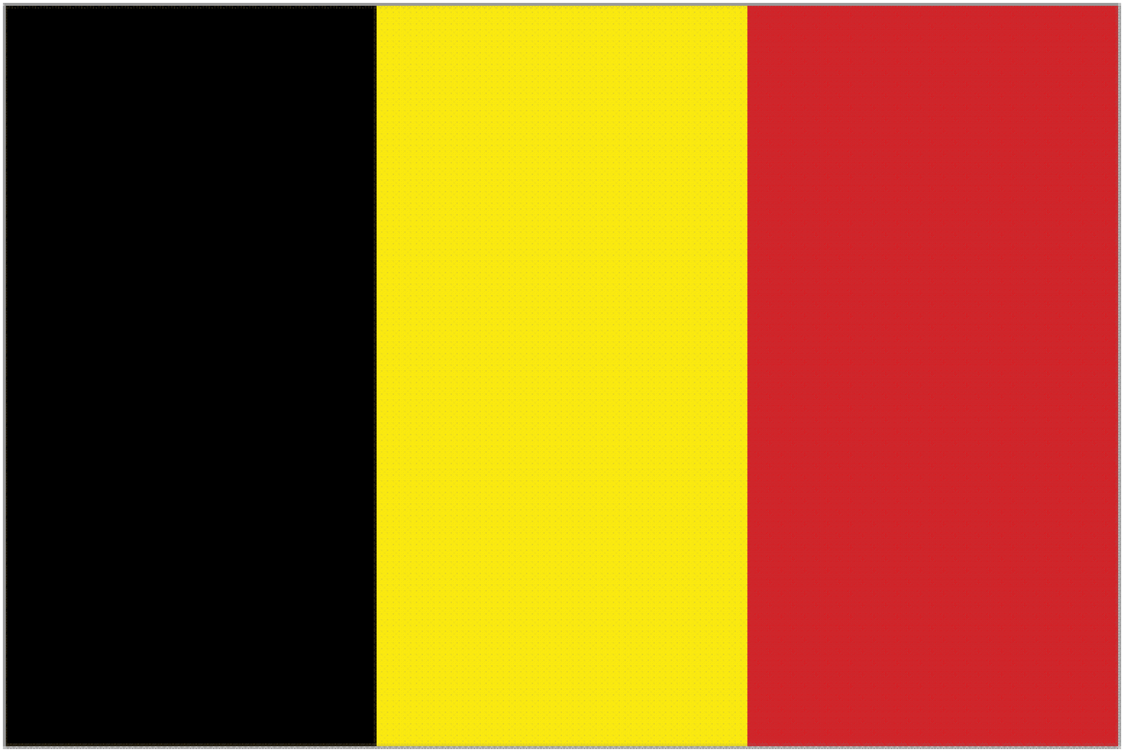
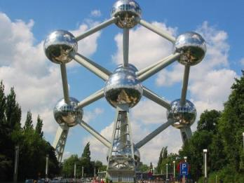
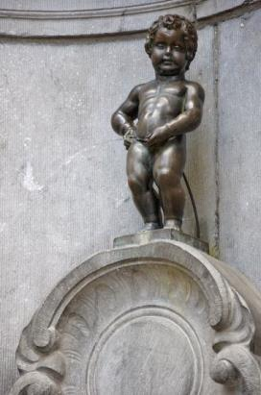

Slide 2
Geology of Belgium
With your group, find the geologic map and a N-S cross section and describe the geologic history (timing!) of
Belgium
Make use of the excel sheet on the blackboard to show when things happened in Belgium

Slide 3
Google ‘geologic map Belgium’

Slide 4
or

Slide 5
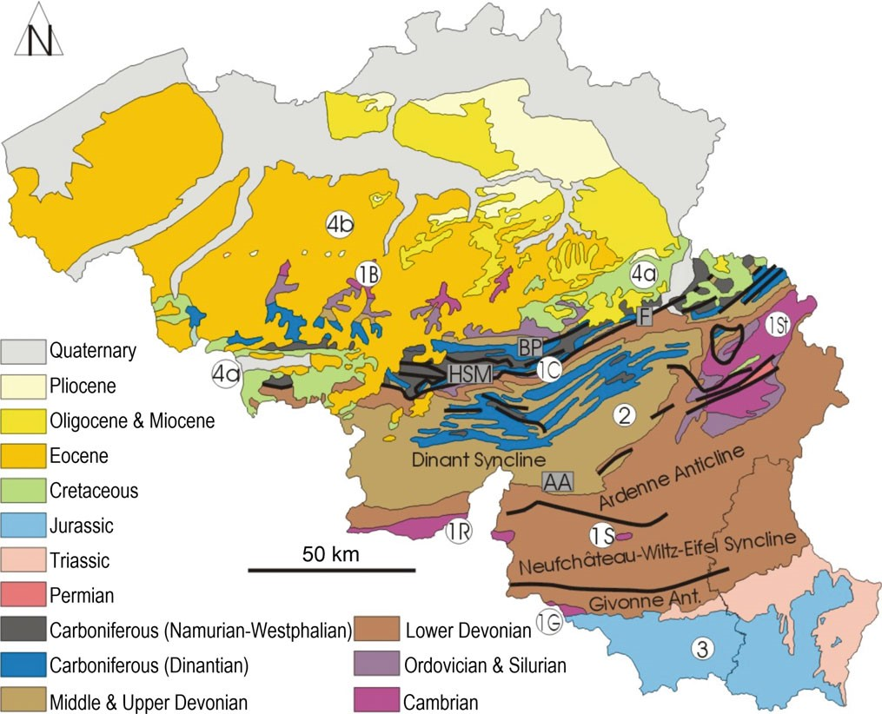
Looking back

Slide 6
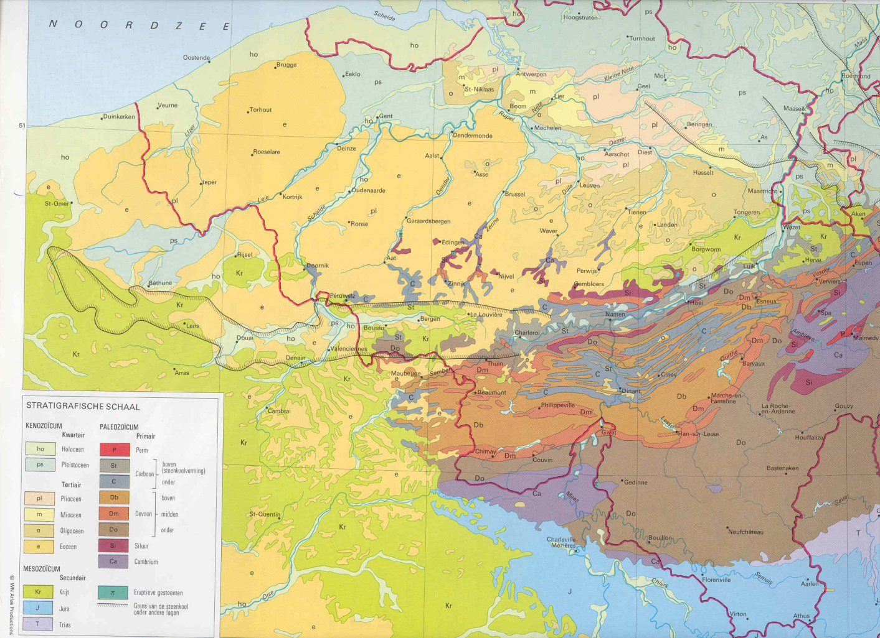
Bigger picture

Slide 7
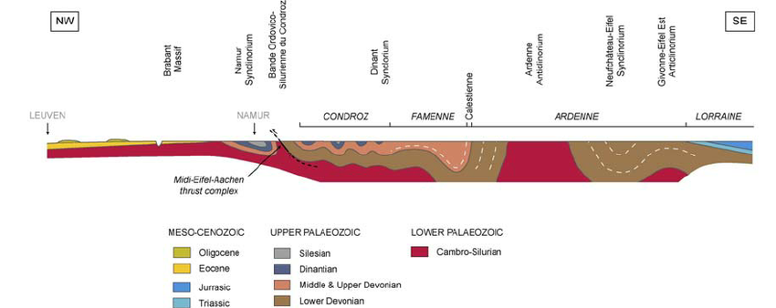
Cross sections
Same site as last map:

Slide 8
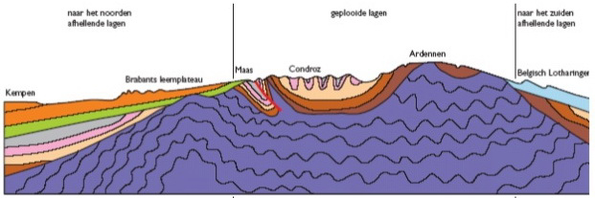
More
More sections
So, what happened?
8
7
3
4
5
2a
6
3
2
4
1
3

Slide 9
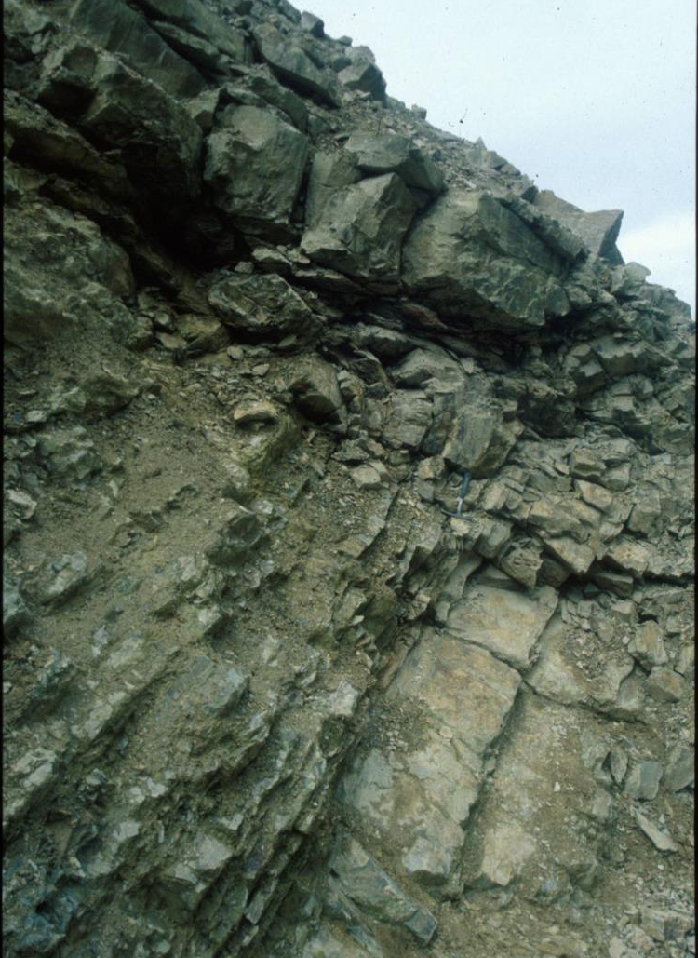
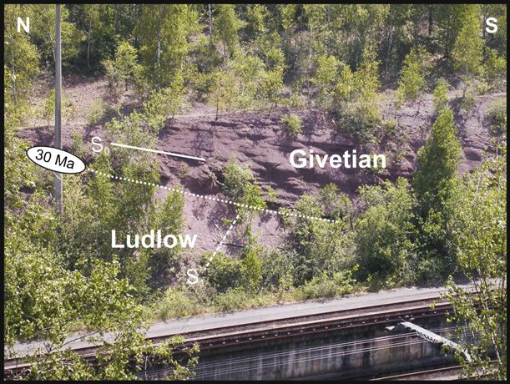
1,2:Contact Devonian & older rocks
Right: in the south
Below: in the north
(Givetian= M-Devonian,
Ludlow = Silurian)
All deep marine sediments
underneath unconformity with Devonian => deformation phase
Early Devonian
Cambrian

Slide 10
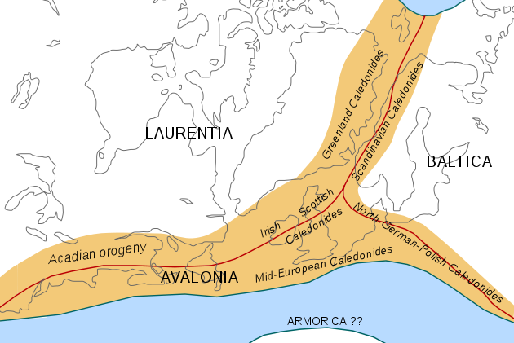
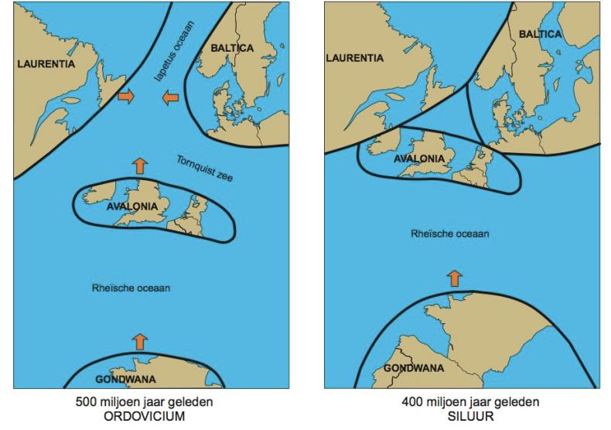
2: Caledonian Orogeny
Belgium on southern edge of mountain range
Collision between Laurentia, Baltica and Avalonia
Called Caledonian orogeny after Scotland
And watch what is coming from the south…

Slide 11
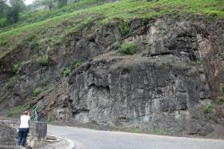
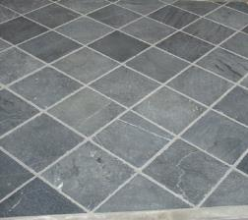
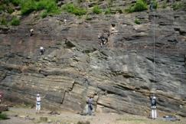
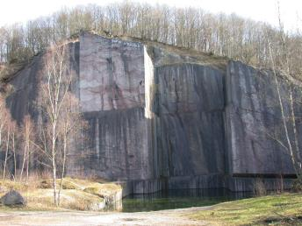
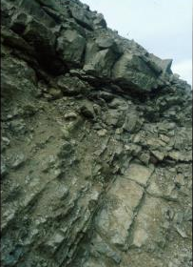
3: Devonian-Carboniferous: more marine sediments
Why these changes with sea level??

Slide 12
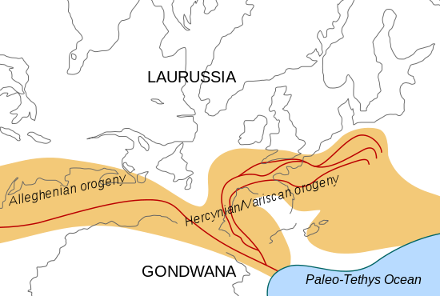
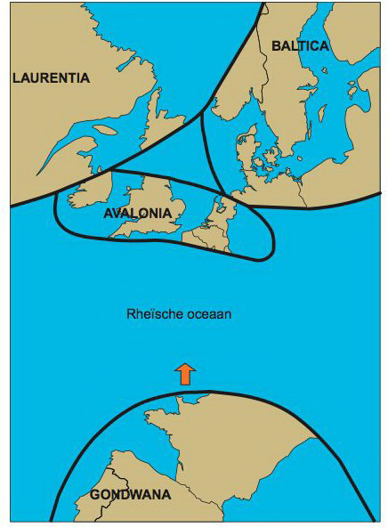
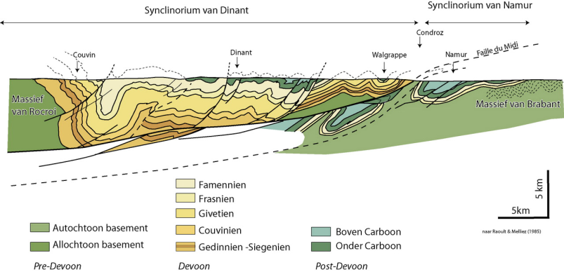
4: Variscan Orogeny
Belgium now on northern edge of mountain range

Slide 13
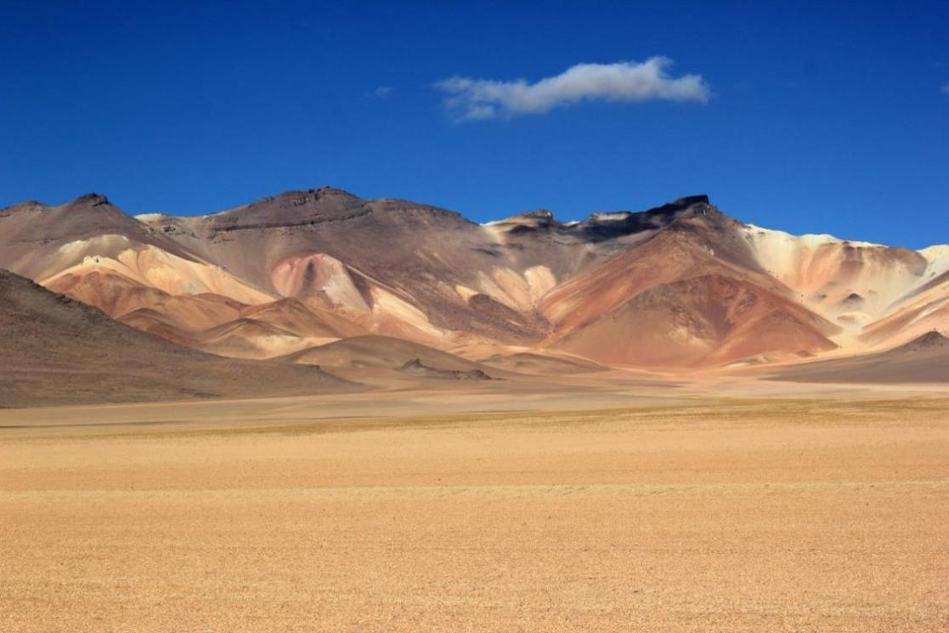
5: Permian
Belgium was a mountain range => no deposition, but erosion
In NL desert conditions: sandstones and salt lakes

Slide 14
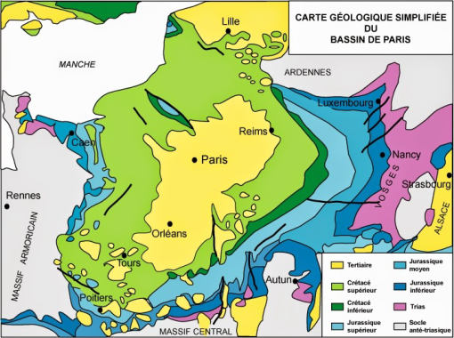
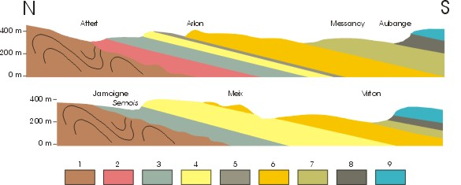
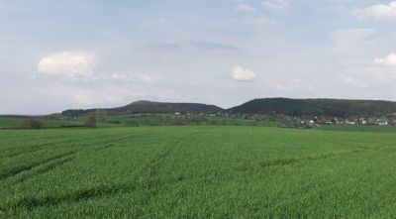
6: Mesozoic
Mountain range once again eroded
Triassic: Buntsandstein – Muschelkalk – Keuper shales
Jurassic: marine conditions
Shallow sea to the south: Paris Basin
Layers visible as cuesta’s

Slide 15
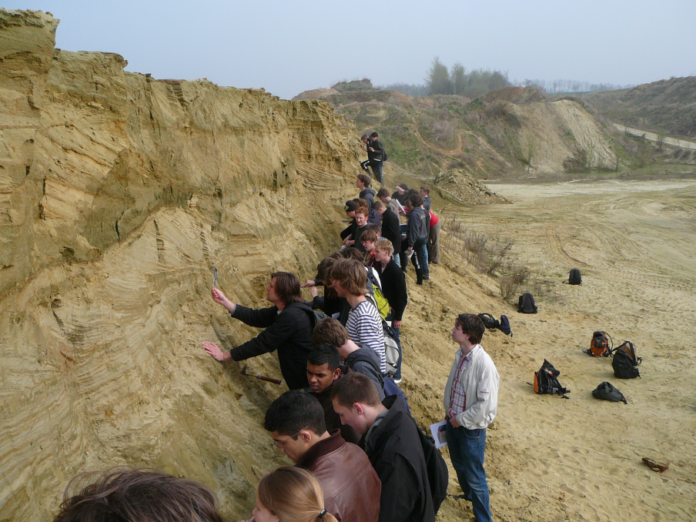
7: Cenozoic
Belgium occasionally flooded between Paris basin and North Sea
Deposition of marine sands and clay

Slide 16
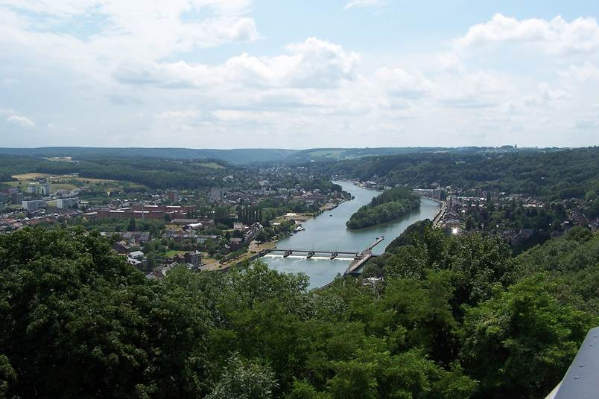
8: Peneplain
During Oligocene, after erosion, Belgium was very similar to the Netherlands, completely flat, occasional sedimentation of sand and clay, meandering rivers,
Alpine orogeny further south caused uplift of Ardennes-Eifel region
Rivers started to erode deep valleys

Slide 17
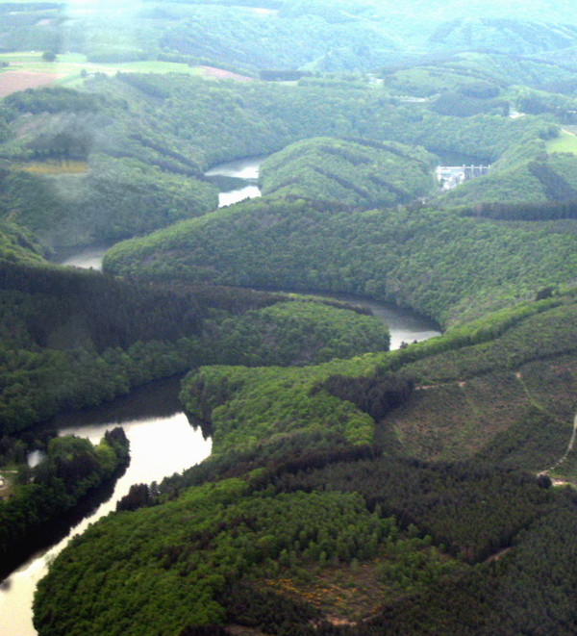
8: Meandering rivers
These normally occur in flat landscapes, like the Netherlands, where rivers can occasionally break their banks and find a new bedding.
In Belgium they form deep valleys as a result of uplift and erosion

Slide 18
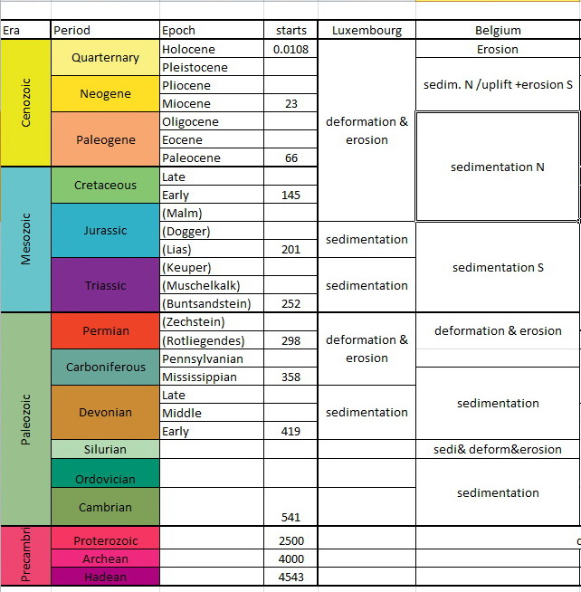

Slide 19
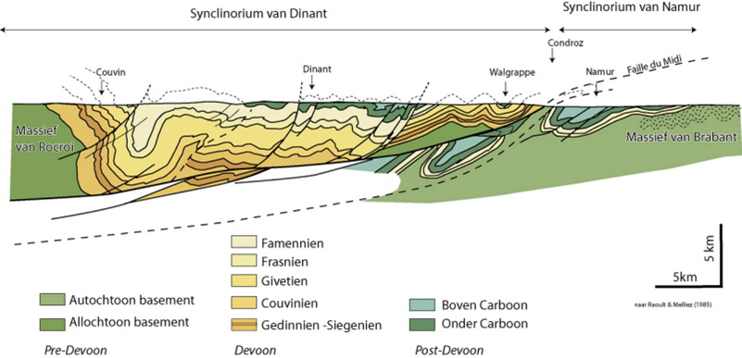
Next week
Look at the geologic history of FRANCE
study the powerpoint on fractures & faults
Look at emodules on brittle deformation & faults

